Slide 1
Take One Picture CPD 2025/6
Catherine Heath

Slide 2
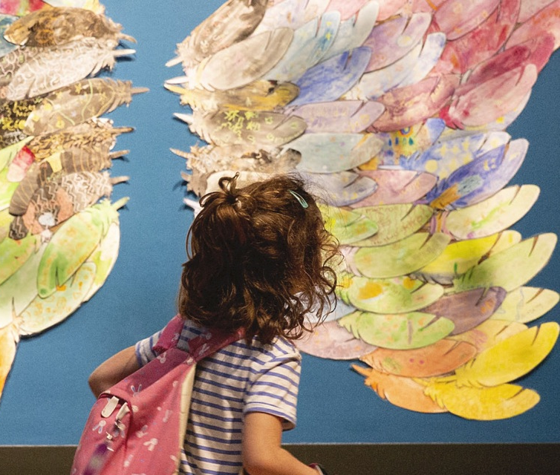
Today’s Session
1:00 – 1:15
1:15 – 2:05
2:05 – 2:10
2:10– 2:55
2:55 – 3:00
3:00 – 3:45
3:45 – 4:00
Introduction
Looking and questioning
5 minute break
Building a project
5 minute break
Making
Conclusion
The National Gallery
Child looking at the 2020 Take One Picture exhibition, © National Gallery, London

Slide 3
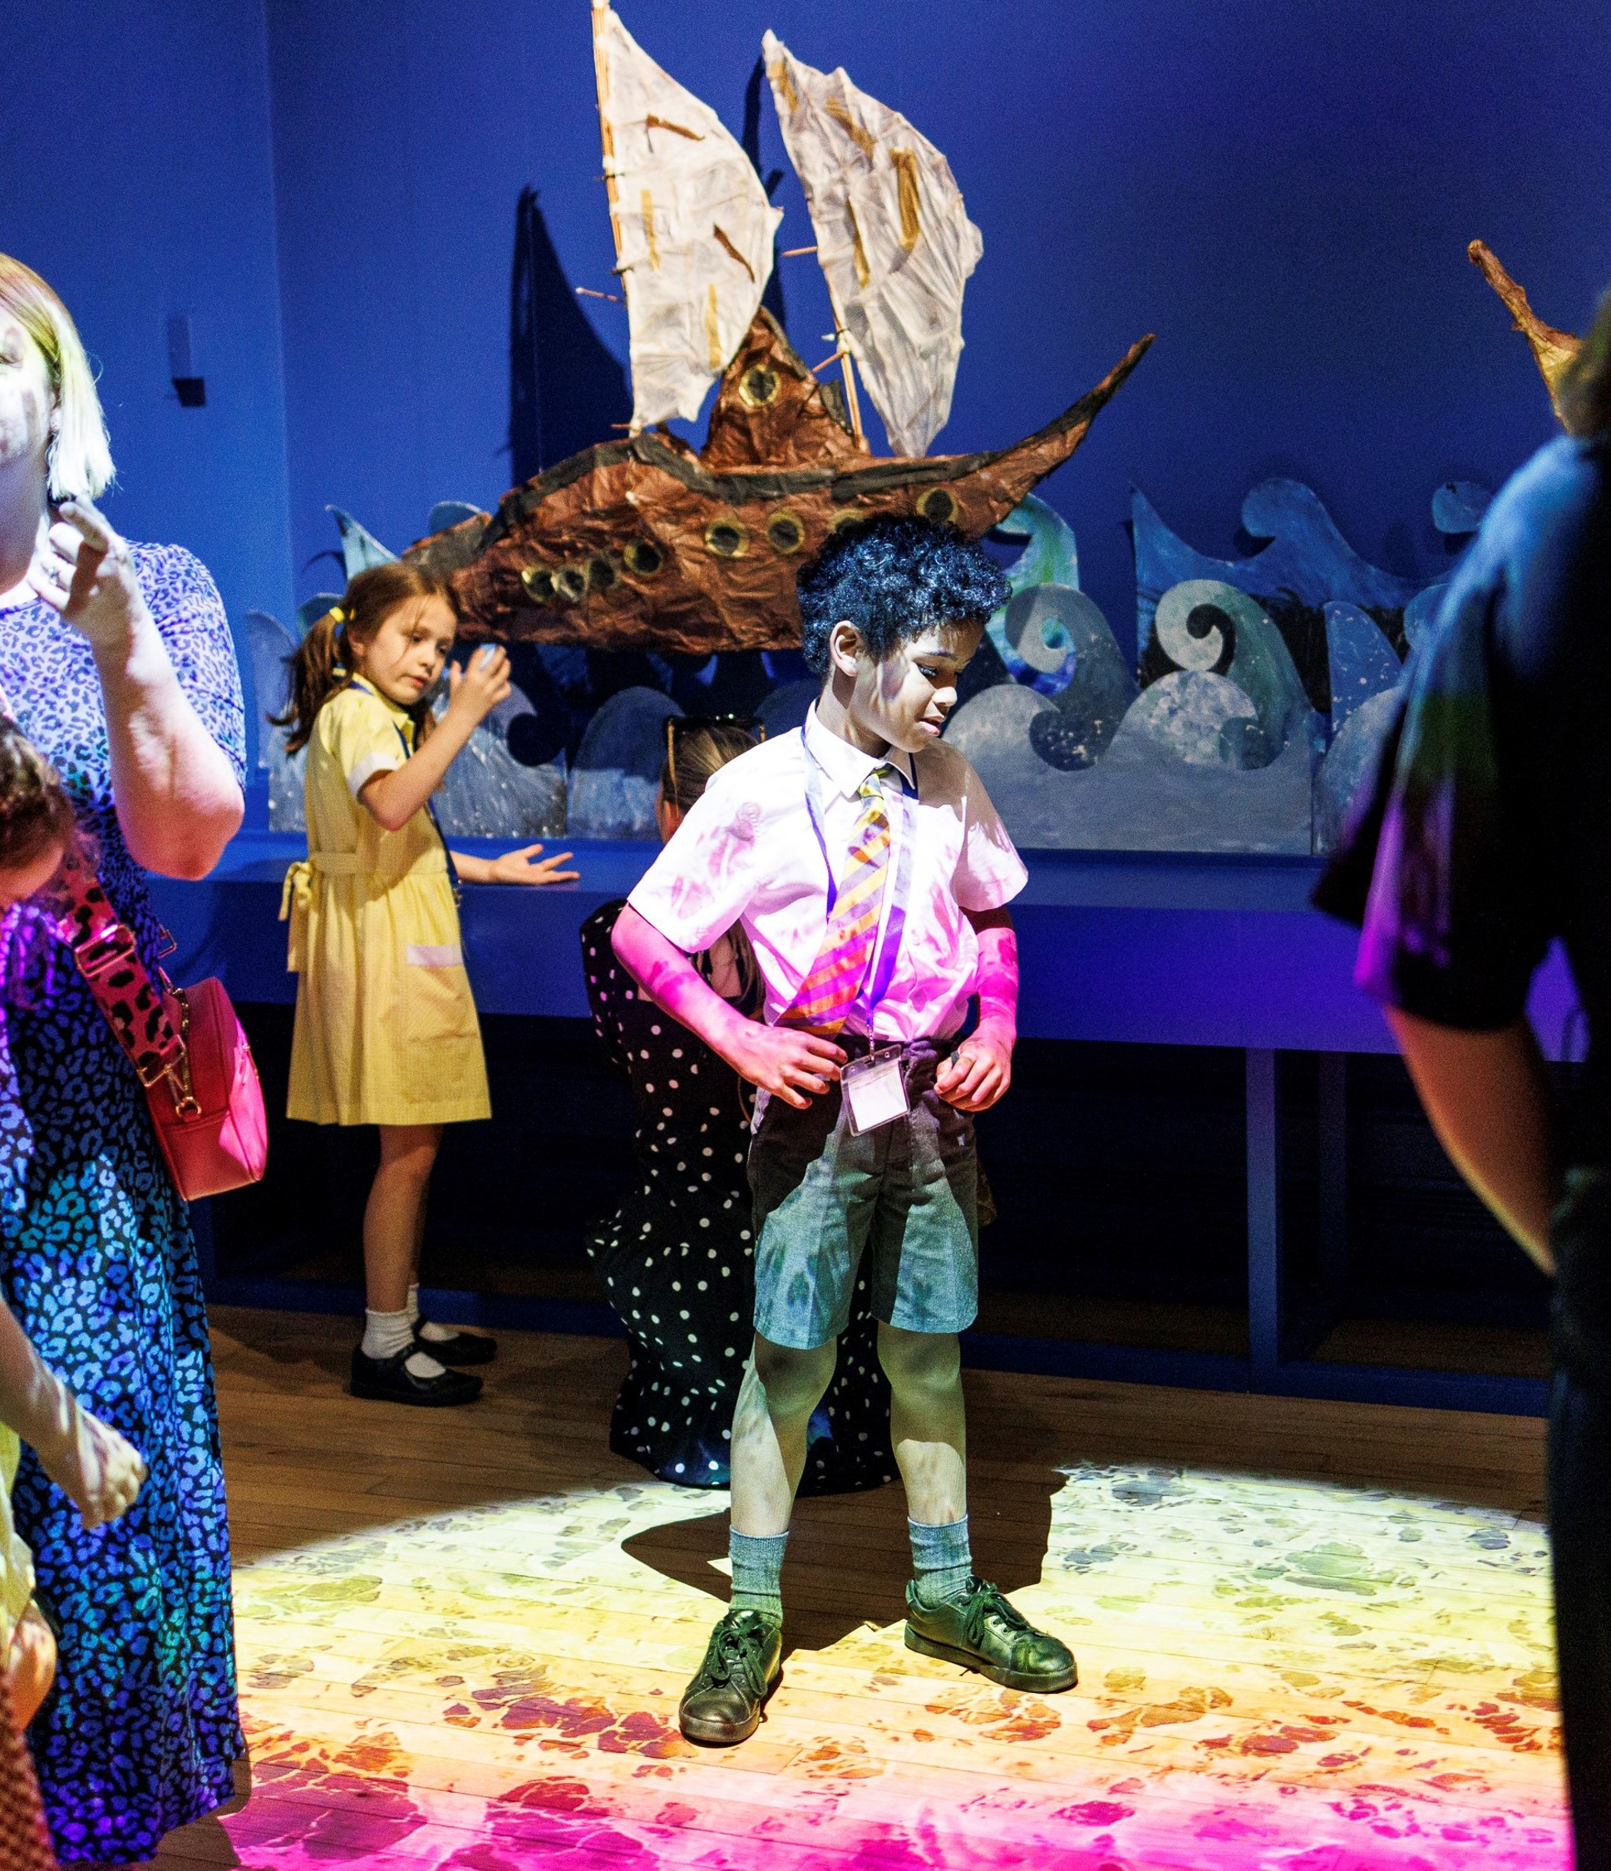
Take One Picture
The Gallery’s national programme for primary schools. It aims to put art at the centre of children’s learning across the curriculum, inspiring a lifelong connection with artists’ work, museums and galleries.
Each year, children across the UK focus on one painting from the collection and respond with creative, cross-curricular projects.
Schools can choose to submit their project for inclusion in an annual celebration.
The National Gallery
Child presenting at the 2023 Take One Picture exhibition, © National Gallery, London

Slide 4
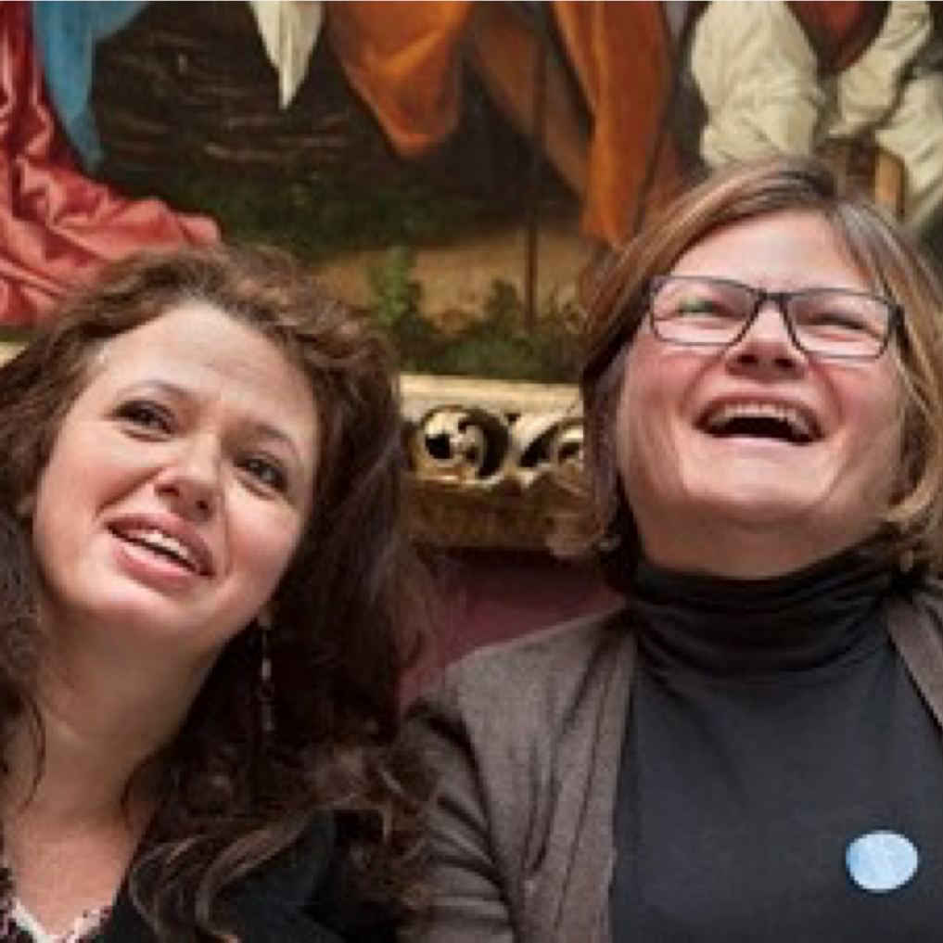
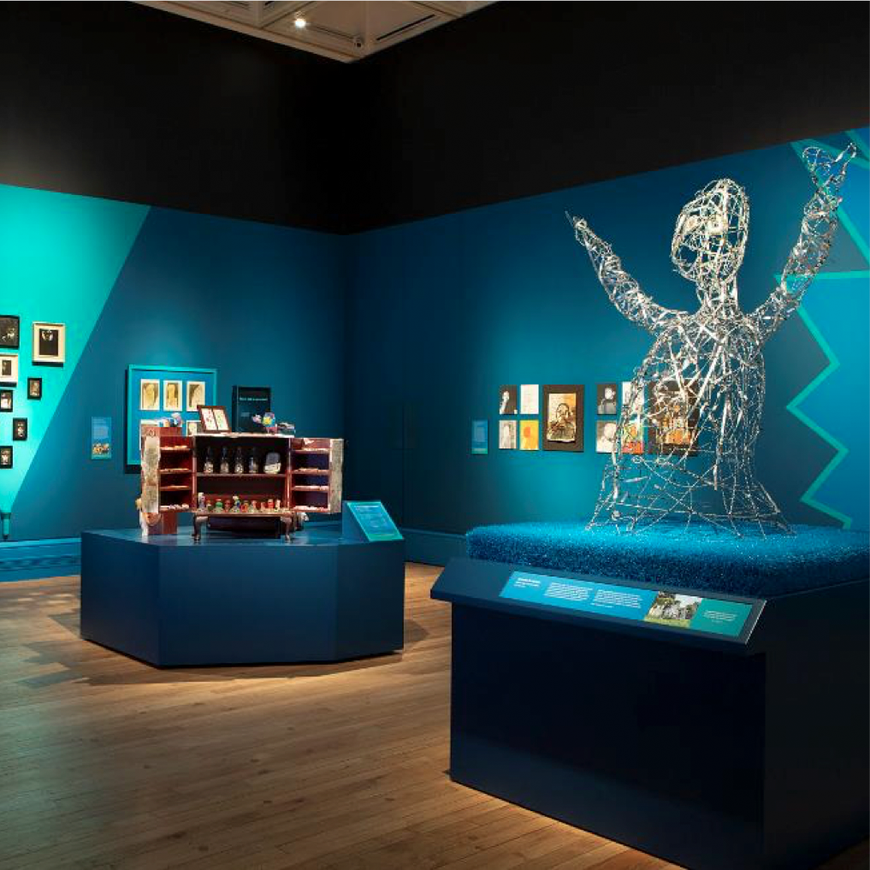
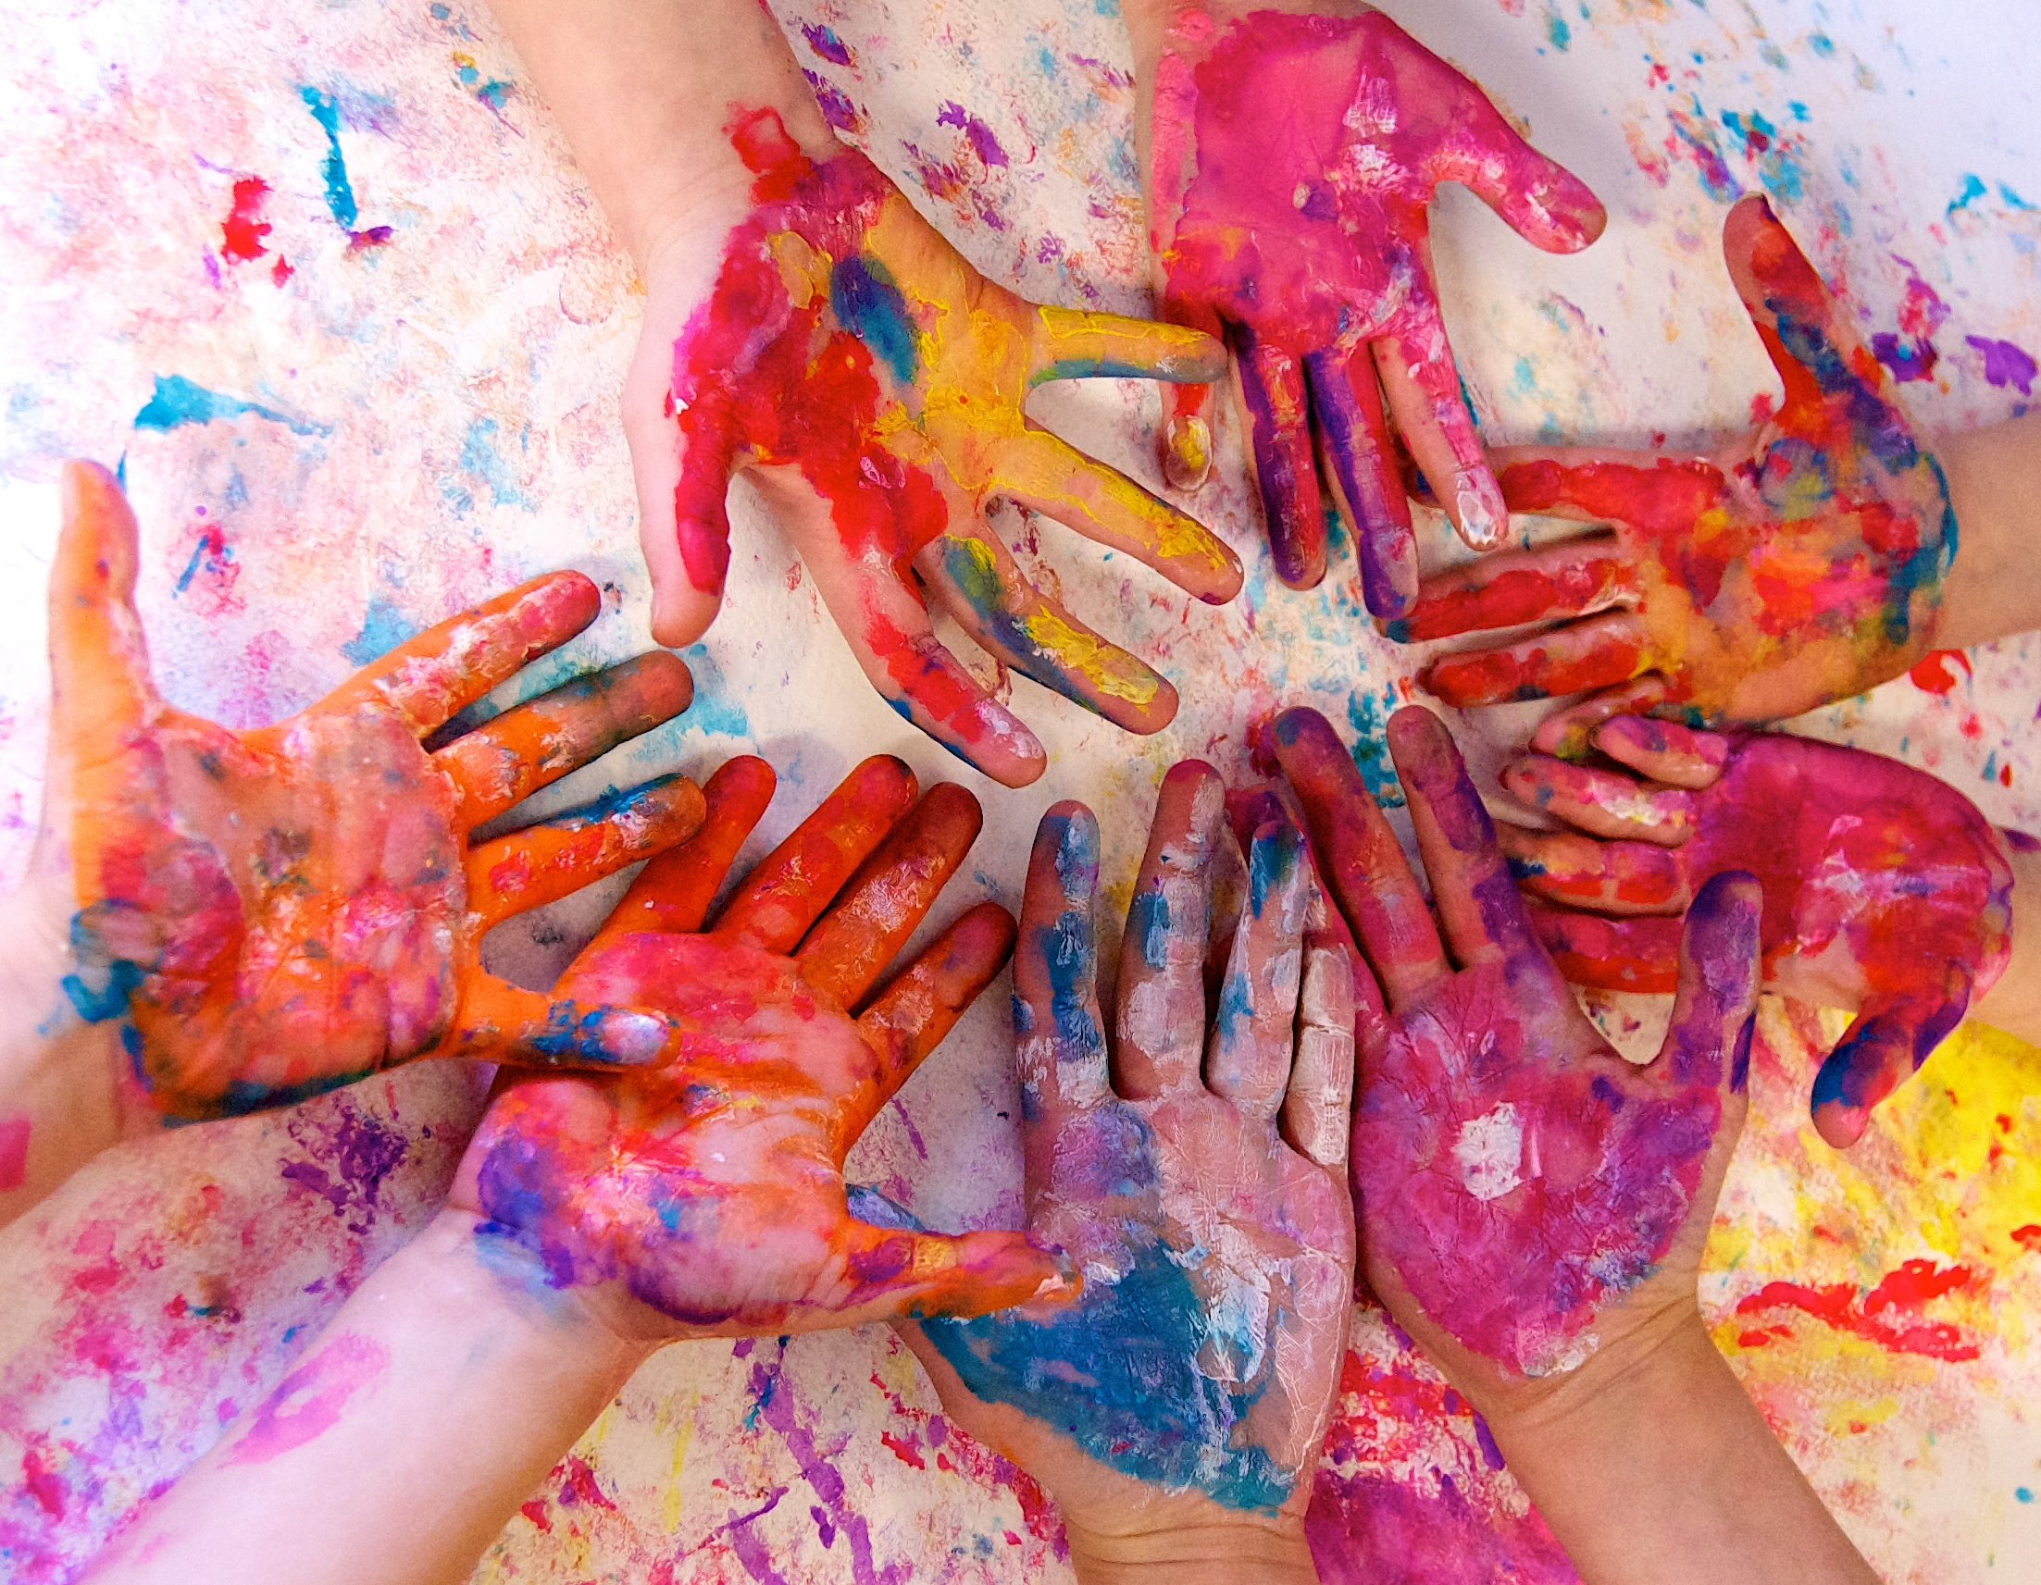
How It Works
Back at school, teachers introduce the painting to their students and work on a child-led investigation, culminating in a creative response.
Each cycle starts with a teacher training focused on the chosen painting and using visual resources to inspire cross-curricular learning.
The annual celebration displays a selection of the children’s projects, showcasing their creativity.
Notes:
Next: aims and benefits

Slide 5
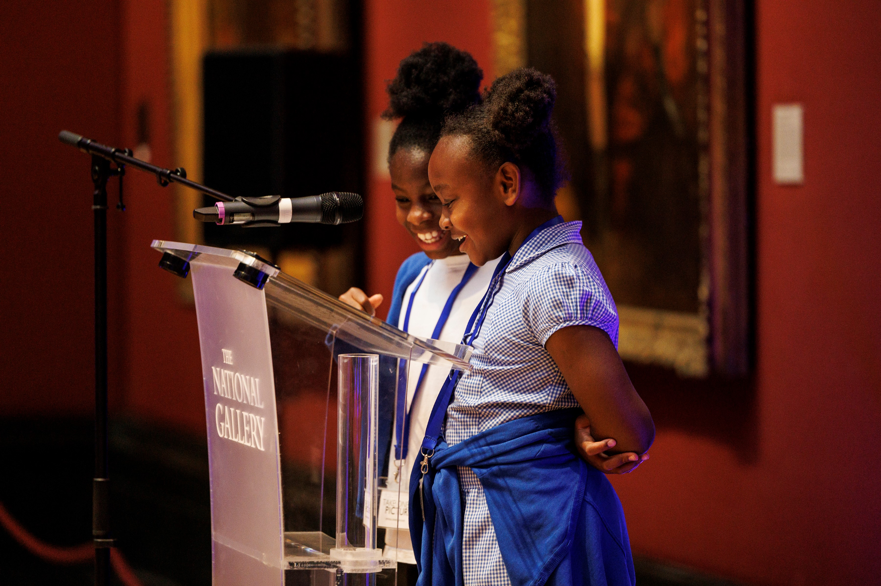
Aims and benefits
Promote the arts and visual literacy within a broad and rich curriculum
Put children’s leadership and creativity at the heart of their learning
Build cultural capital with memory-making arts and heritage experiences
Provide a stimulus for building and connecting to the wider school community
Raise students’ confidence and provide a platform for celebrating their work
The National Gallery
Children presenting at the 2023 Take One Picture private view, © National Gallery, London

Slide 6


Research Findings
Northampton Primary Academy Trust and Northampton University 2019 – 2022
All teachers agreed that they accessed high-quality CPD
90% said that taking part increased their knowledge, understanding and confidence
to teach the art and design curriculum
Pupils' ability to use technical art skills to improve their work increased from 55 to 100%
The number of pupils using 'rich tier-3 vocabulary' in response to a painting increased from 5 to 32%
Teachers said that their pupils' critical thinking increased from 28 to 70% and their creativity from 44 to 88%

Slide 7
Breakout Rooms
The National Gallery

Slide 8
We are taking a short break

Slide 9
Take One Picture – Conclusion
Catherine Heath

Slide 10

Submissions
PowerPoint presentation, explaining the project with photographs of the process and final result.
We have an optional submission template which you will receive as part of the session resources.
Register your project on our website
Send the PowerPoint via WeTransfer to takeonepicture@nationalgallery.org.uk

Slide 11


Selection criteria
Cross-Curricular
Makes relevant links across the curriculum
Child-led
Evidence of a child-led, investigative approach
Community
Involves people or places in the local community
Process
Pupils have the opportunity to learn a new process
Relevant
Enriches children’s understanding of the focus painting
The National Gallery
Notes:
Child led – very important, why we have focused on how to engage children with the painting and share their own ideas.
Cross-curricular – when a project is child-led and follows a line of enquiry, this tends to happen naturally!
Process – Learn a new art process, work with a new material – and show us that process
Community – How can you take the project outside the classroom and make it relevant to your local area? Who/ what can come into the classroom, and how can you go out? Is there a local person or group with skills or knowledge that may be relevant to the painting? Is there somewhere local you can visit?
Relevant – Is your project relevant to the painting? Keep looking back to the painting throughout. How is your project enriching children’s understanding of the themes or content of the painting?

Slide 12
Timeline
1. Online CPD sessions run from October 2025 until May 2026.
2. You have until October 2026 to submit your project.
3. The celebration will be in spring/summer 2027.
The National Gallery

Slide 13
For guidance or support, contact:
takeonepicture@nationalgallery.org.uk
Facebook Group for CPD attendees
Search ‘Take One Picture CPD’
The National Gallery

