Slide 1
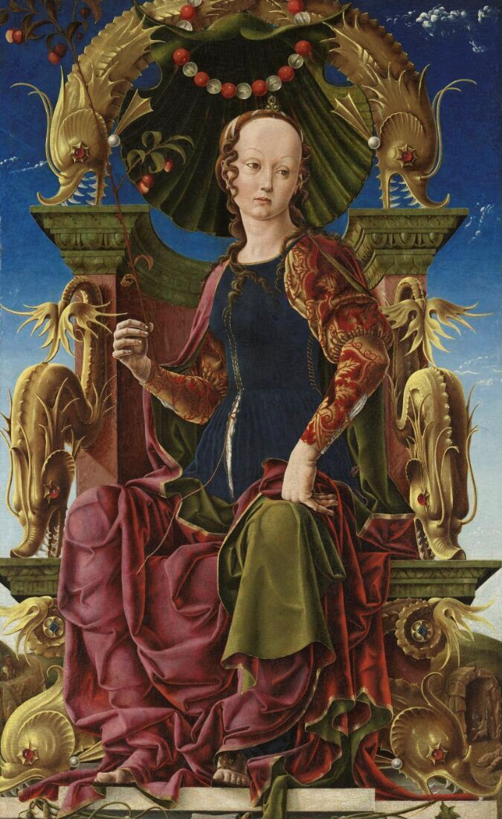
Take One Picture CPD
Cosimo Tura, A Muse
Notes:
Learning objectives:
to experience different ways of introducing children to a painting, developing their looking skills and interest
to build confidence in and learn techniques for starting a child-led investigation into Tura’s Muse and other related paintings, specifically through questioning, comparison, and generating enquiry lines
to discover key information about Tura’s Muse and reflect on individual responses to it
to explore techniques to develop students’ oracy skills by using the “third turn”
to examine the pedagogical reasons behind each activity and approach, and consider how to adapt each one to different age groups and ability levels

Slide 2
Our understanding is better and the learning journey richer when we discover something ourselves, rather than being told. Which activities encourage discovery?

Slide 3
Strategies to encourage looking, thinking and talking
Look

Slide 4
Strategies to encourage looking, thinking and talking
Look
Think

Slide 5
Strategies to encourage looking, thinking and talking
Look
Think
Imagine

Slide 6

Strategies to encourage looking, thinking and talking
Look
Think
Imagine
Talk
Notes:
The order of these approaches roughly follows Bloom’s Taxonomy, a hierarchical series of learning objectives that progressively support each other. Students should start with short observations, collecting details to allow them to make inferences and ask questions. Ultimately, they should be able to make informed creative responses that build upon and reference the learning they’ve made so far.
None of this can occur successfully without quality talk. How can you help your students to speak and listen to each other to develop their thoughts about this painting?

Slide 7
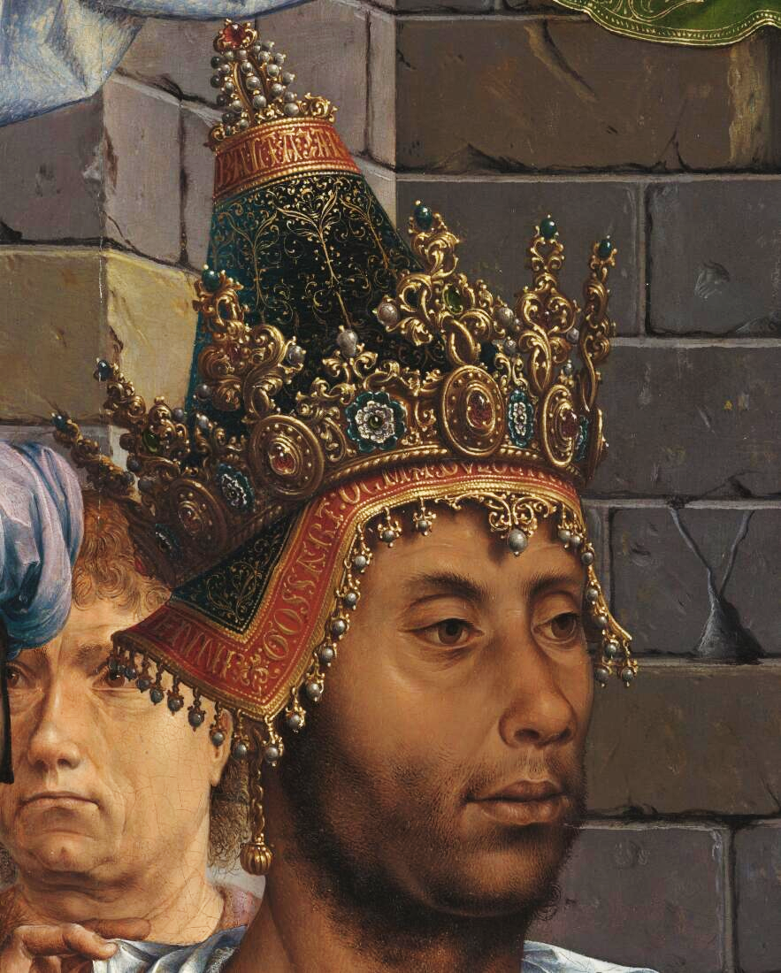
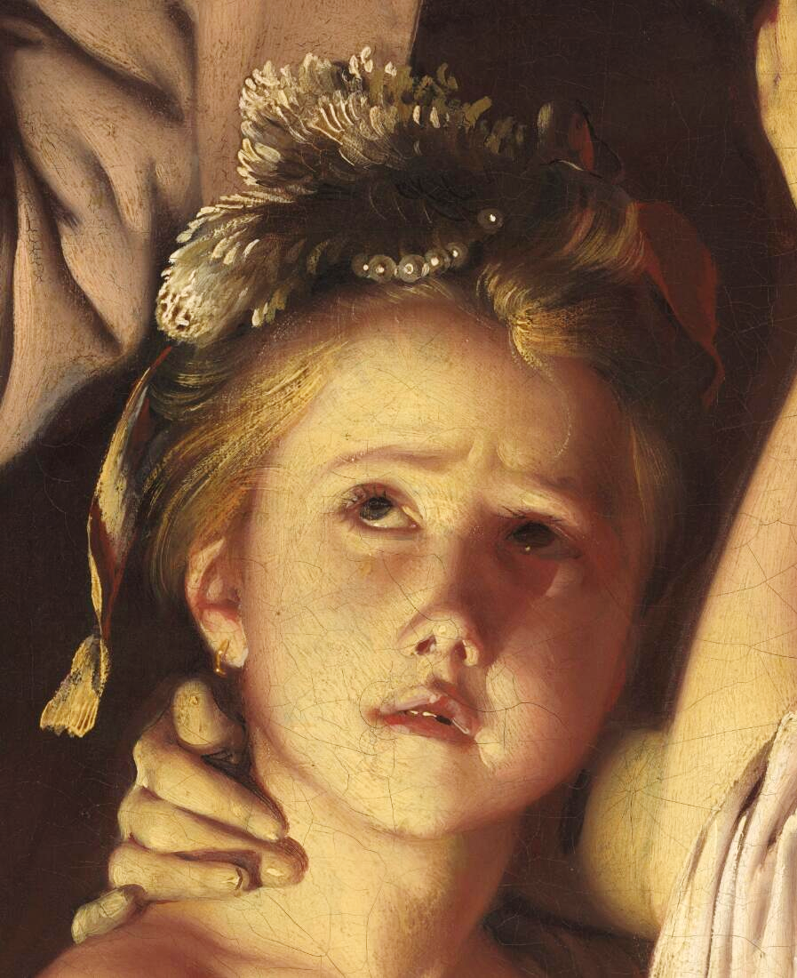
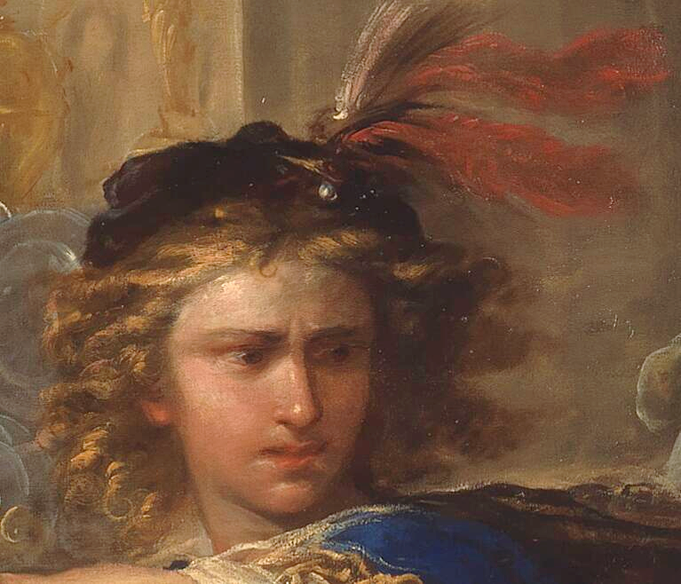
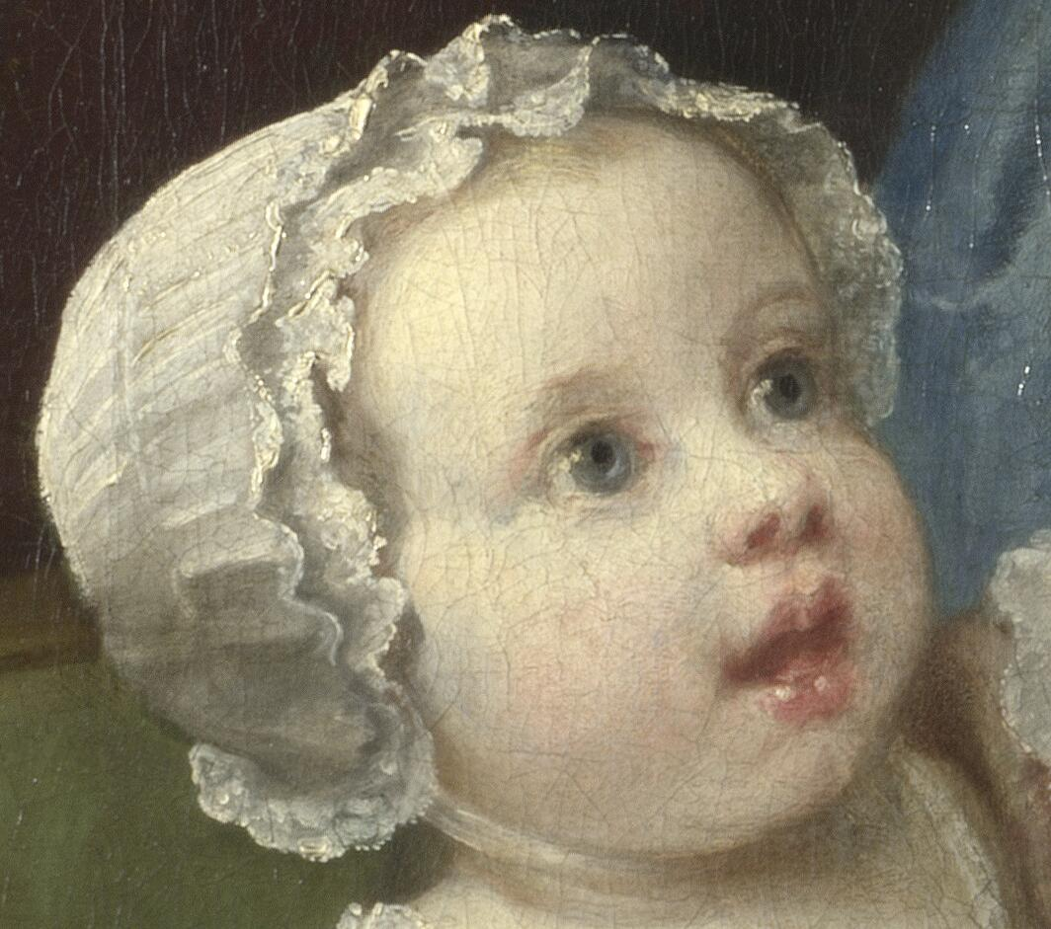
1.
2.
3.
4.
Notes:
How do we read pictures of people? What clues do artists leave for us?
Take a moment to look at these 4 cropped details then think and discuss the following: What can we tell about this person? You might want to consider where they are looking, and what they might be looking at. What might the rest of their face look like, and how might they be feeling? Who might they be, and what might they, or the artist, want us to think about them? Where does the group agree and disagree? Why might that be? Layer these questions in gradually – don't ask them all at once!

Slide 8
1.
2.
4.
3.
Notes:
Now you can see more of their faces, reflect on and discuss what has changed in your thoughts about them. What has helped inform your thoughts (hair/mouth/eyebrows/clothes)? Again, where does the group agree and disagree? Why might that be?
Gossaert’s Adoration of the Kings - https://www.nationalgallery.org.uk/paintings/jan-gossaert-jean-gossart-the-adoration-of-the-kings
Wright of Derby’s Experiment on a Bird in the Air Pump - https://www.nationalgallery.org.uk/paintings/joseph-wright-of-derby-an-experiment-on-a-bird-in-the-air-pump
Giordano’s Perseus and Phineus - https://www.nationalgallery.org.uk/paintings/luca-giordano-perseus-turning-phineus-and-his-followers-to-stone
Hogarth’s The Graham Children - https://www.nationalgallery.org.uk/paintings/william-hogarth-the-graham-children

Slide 9
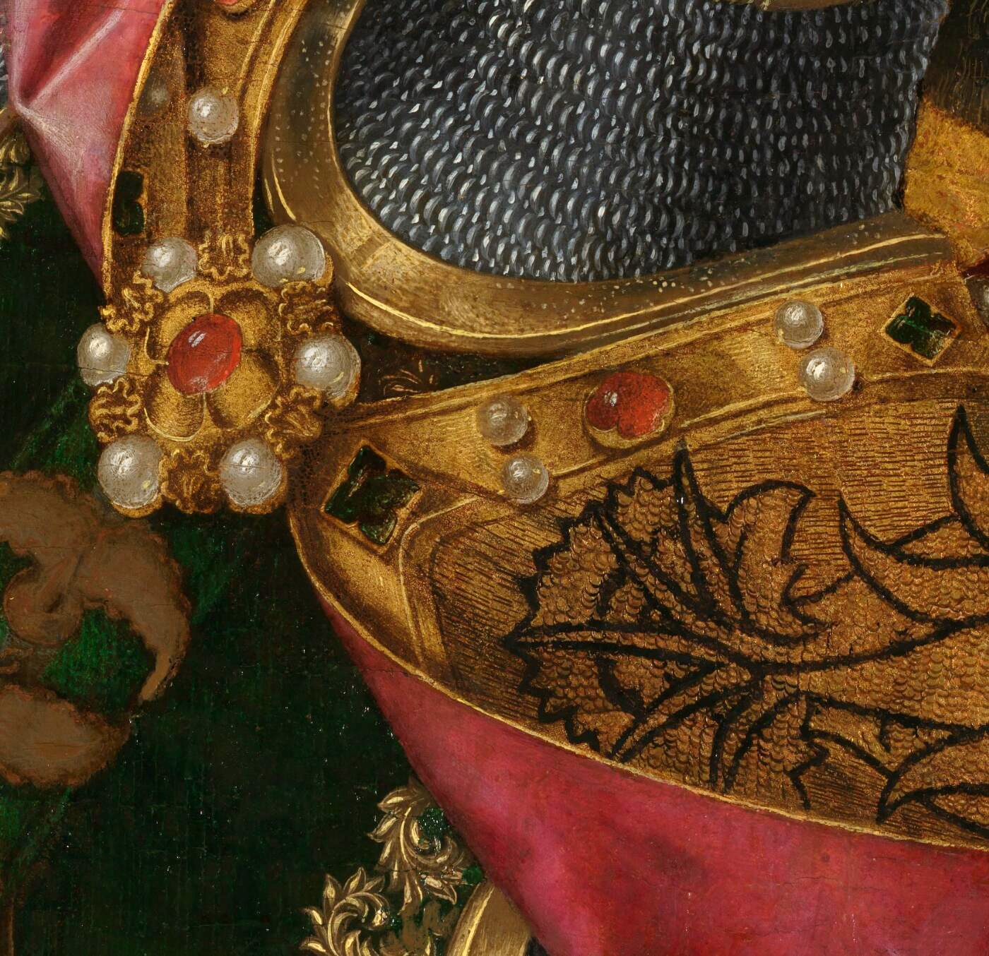
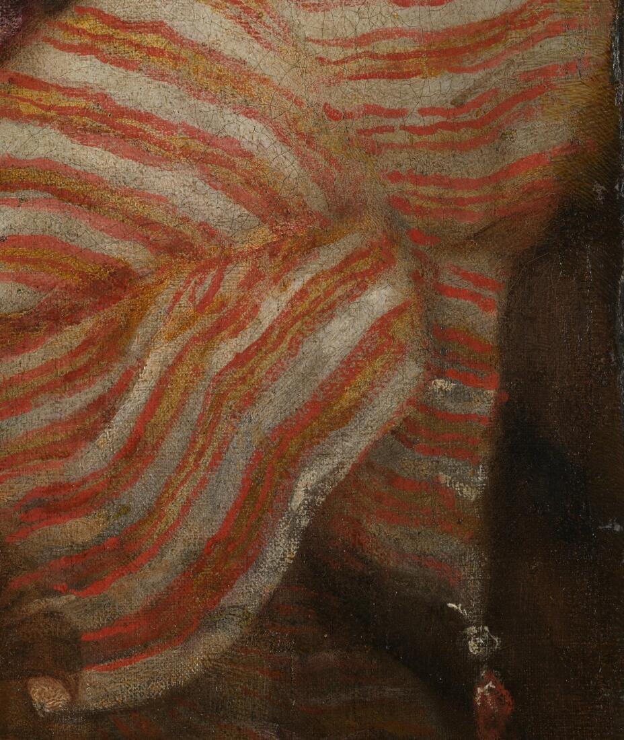
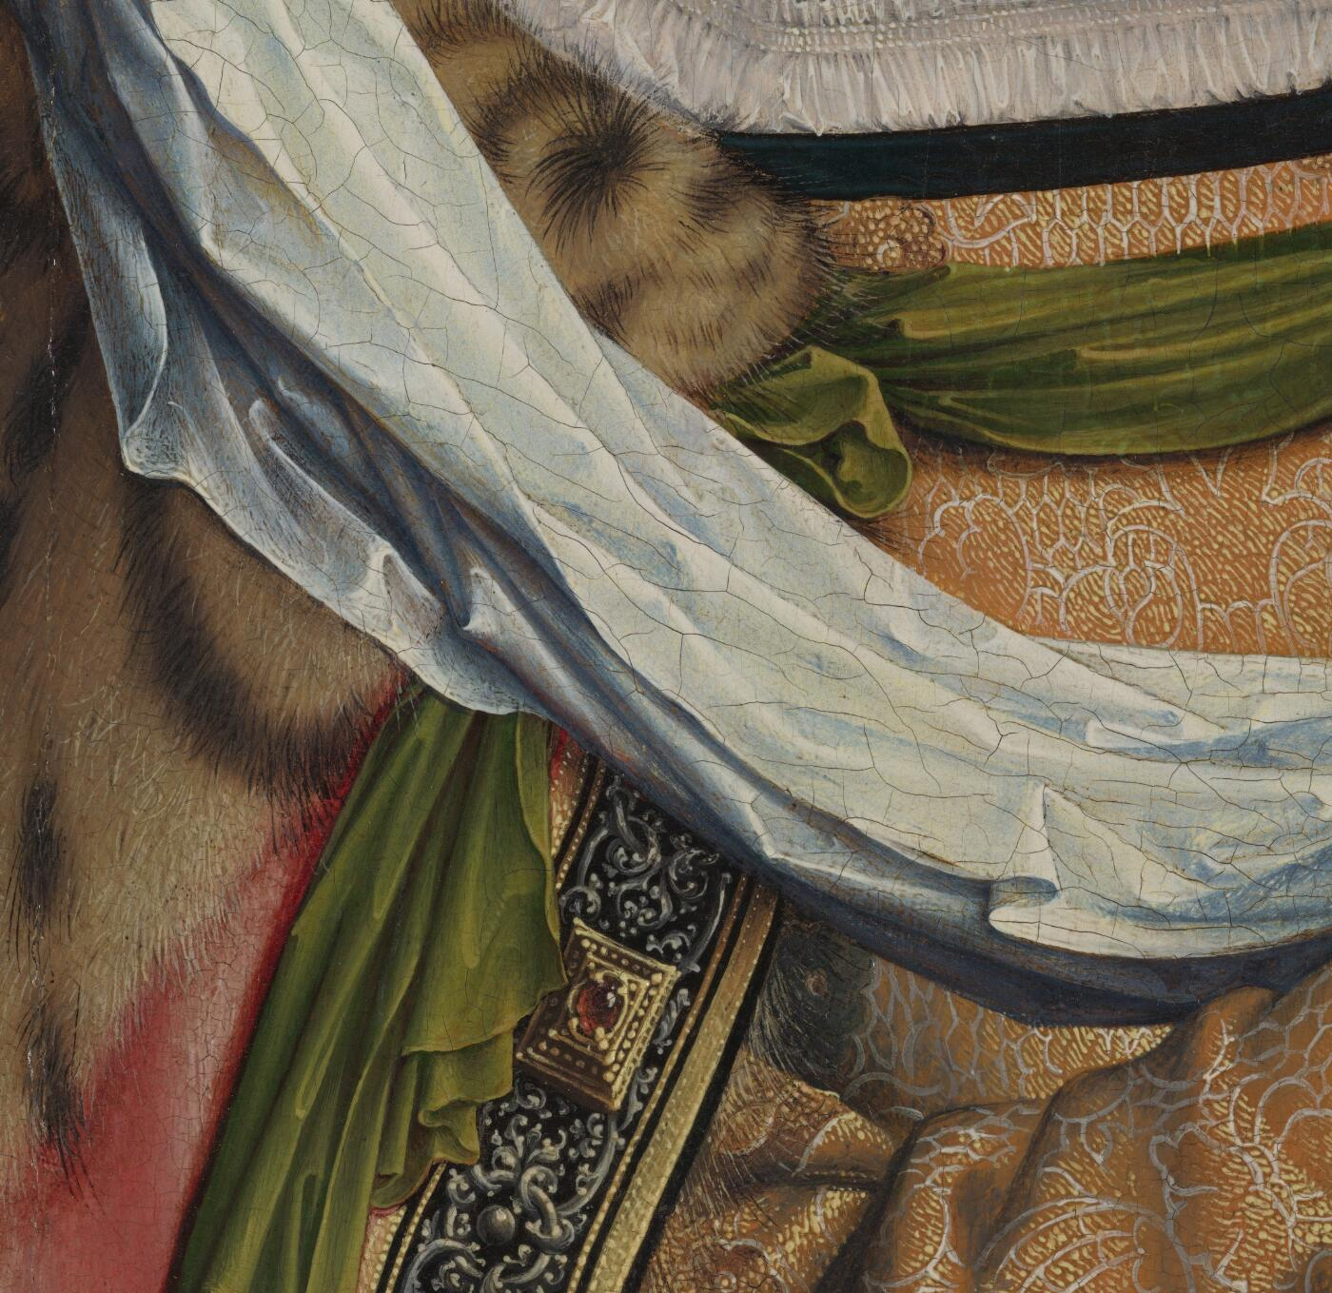
1.
2.
3.
Notes:
What can what people wear tell us about them, or tell us about what the artist might want us to feel and think?
1. Bermejo’s Saint Michael Triumphs over the Devil - https://www.nationalgallery.org.uk/paintings/bartolome-bermejo-saint-michael-triumphs-over-the-devil
2. Titian’s Diana and Actaeon - https://www.nationalgallery.org.uk/paintings/titian-diana-and-actaeon
3. Gossaert’s Adoration of the Kings - https://www.nationalgallery.org.uk/paintings/jan-gossaert-jean-gossart-the-adoration-of-the-kings

Slide 10
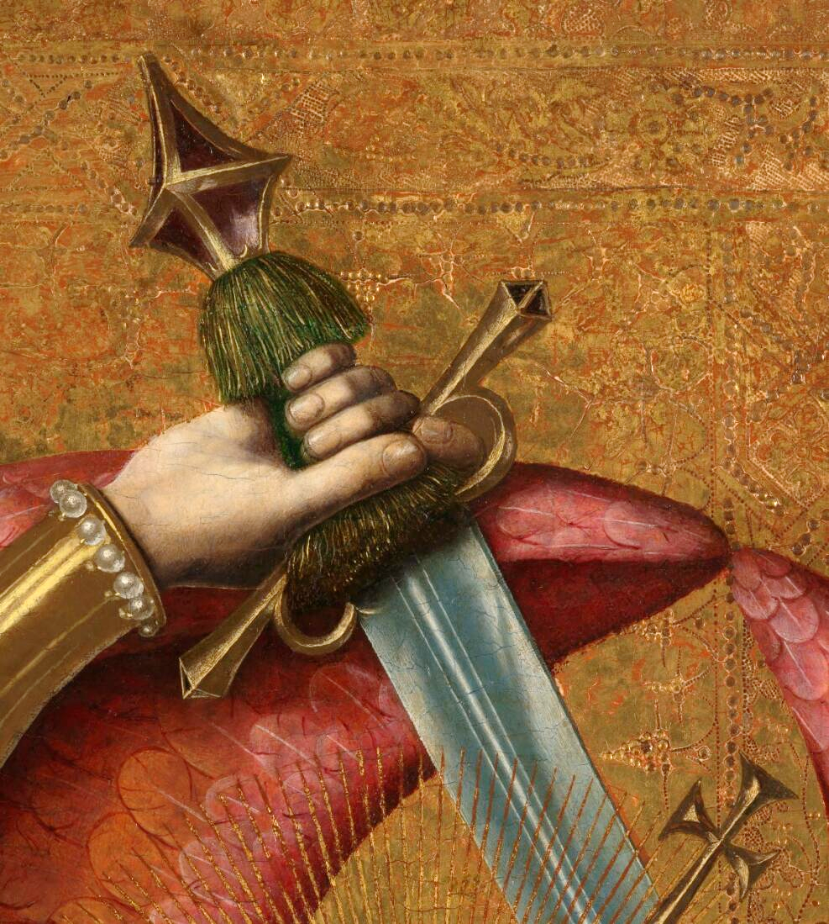
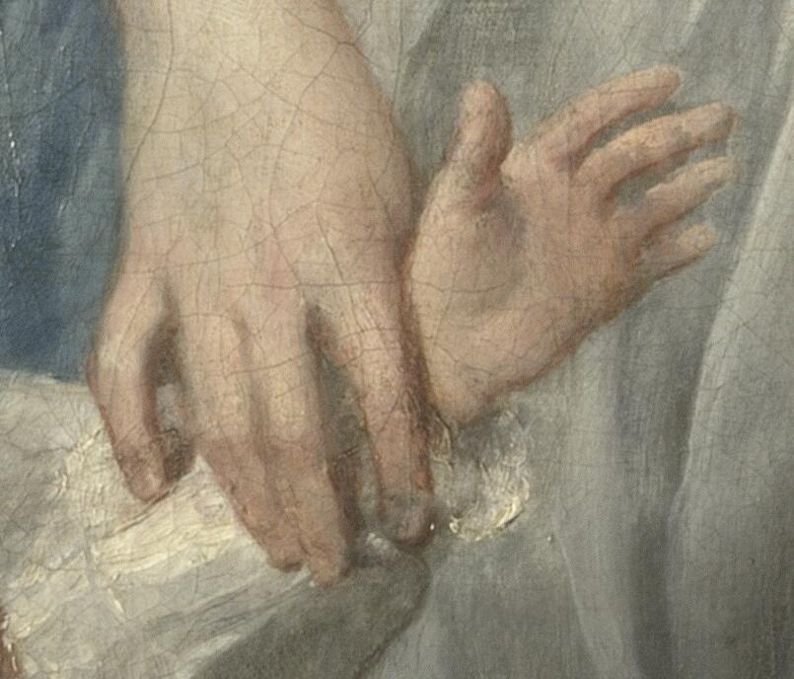
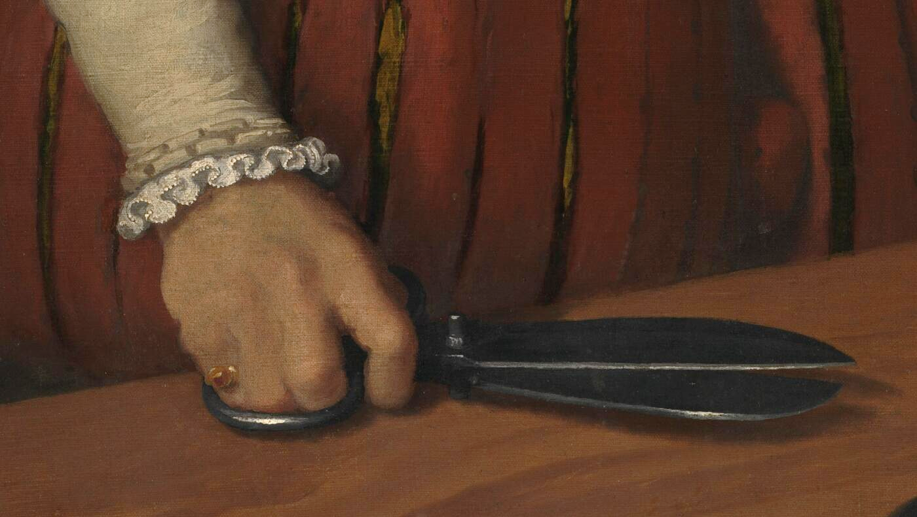
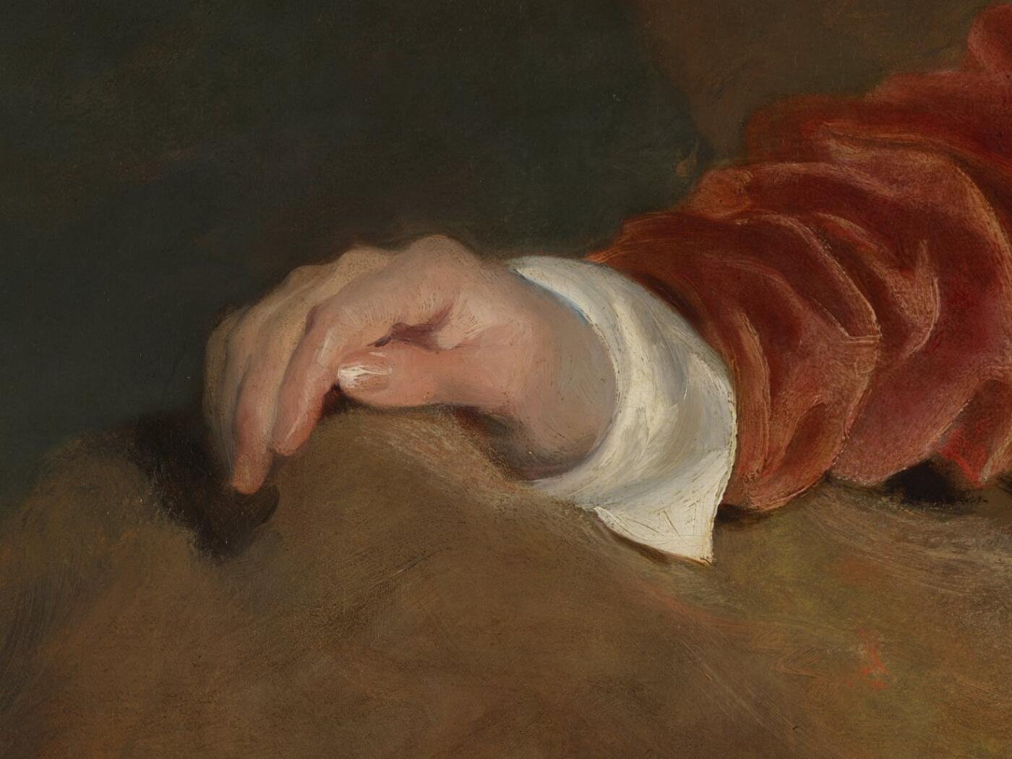
1.
2.
3.
4.
Notes:
What do hands, and what they are holding, tell us about a person? What sort of emotions can hands convey? Could you show some of these emotions now with your hands? Show us an angry hand, or a calm hand, etc. Are you all making the same gesture? Can you hold something in more than one way, and what information does that give the viewer? How might the interaction of hands in picture 2, for example, change depending on feeling and intent? Gentleness, firmness, control, love.
Bermejo’s Saint Michael Triumphs over the Devil - https://www.nationalgallery.org.uk/paintings/bartolome-bermejo-saint-michael-triumphs-over-the-devil
Hogarth’s The Graham Children - https://www.nationalgallery.org.uk/paintings/william-hogarth-the-graham-children
Moroni’s The Tailor - https://www.nationalgallery.org.uk/paintings/giovanni-battista-moroni-the-tailor-il-tagliapanni
Lawrence’s ‘Red Boy’ - https://www.nationalgallery.org.uk/paintings/sir-thomas-lawrence-charles-william-lambton

Slide 11
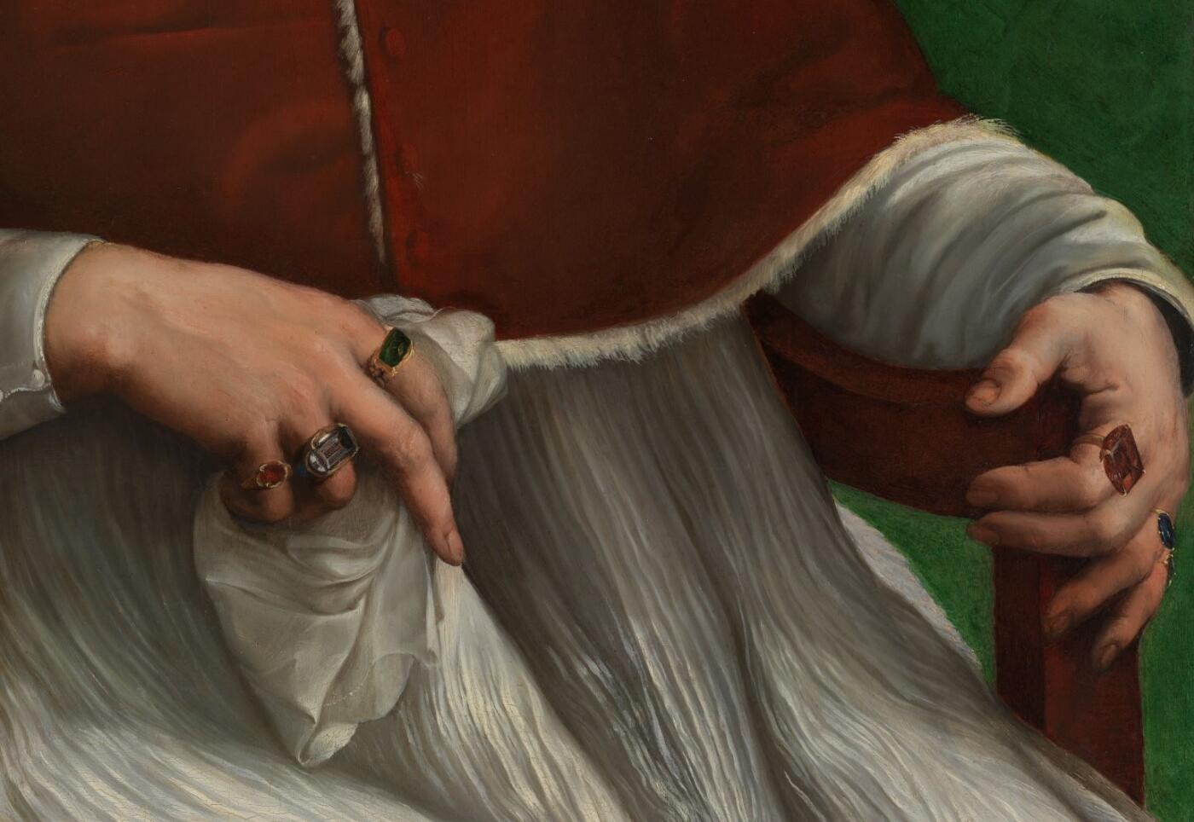
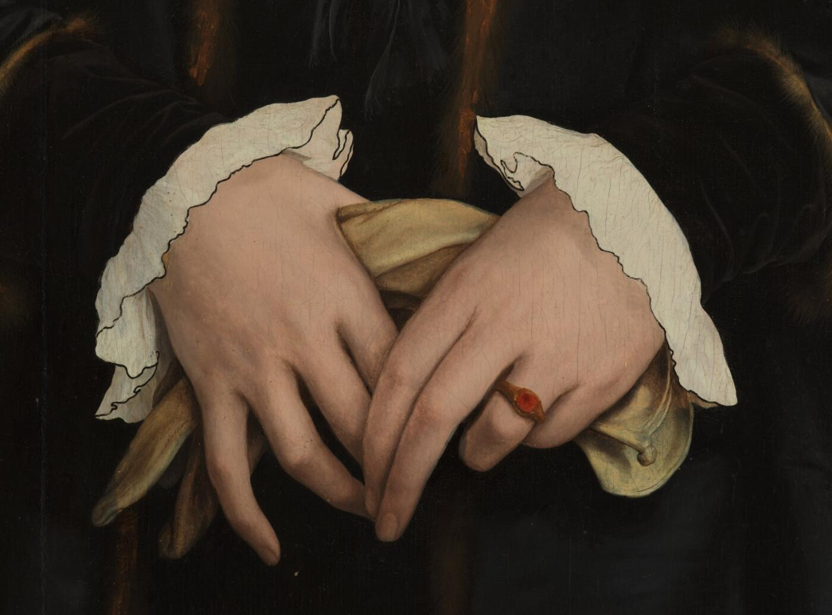
1.
2.
Notes:
Do both hands tell the same story about a person, or might they show different things?
What is the benefit to just looking at details? What is the benefit to comparing the similarities and differences between images? What might your classes need help with? Any concerns.
Raphael’s Pope Julius II - https://www.nationalgallery.org.uk/paintings/raphael-pope-julius-ii
Holbein’s Christina of Denmark - https://www.nationalgallery.org.uk/paintings/hans-holbein-the-younger-christina-of-denmark-duchess-of-milan

Slide 12
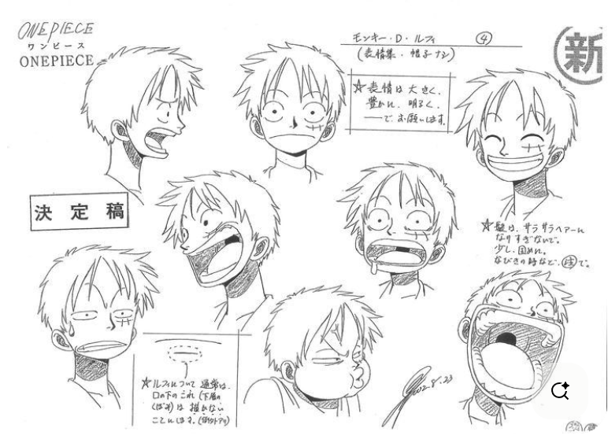
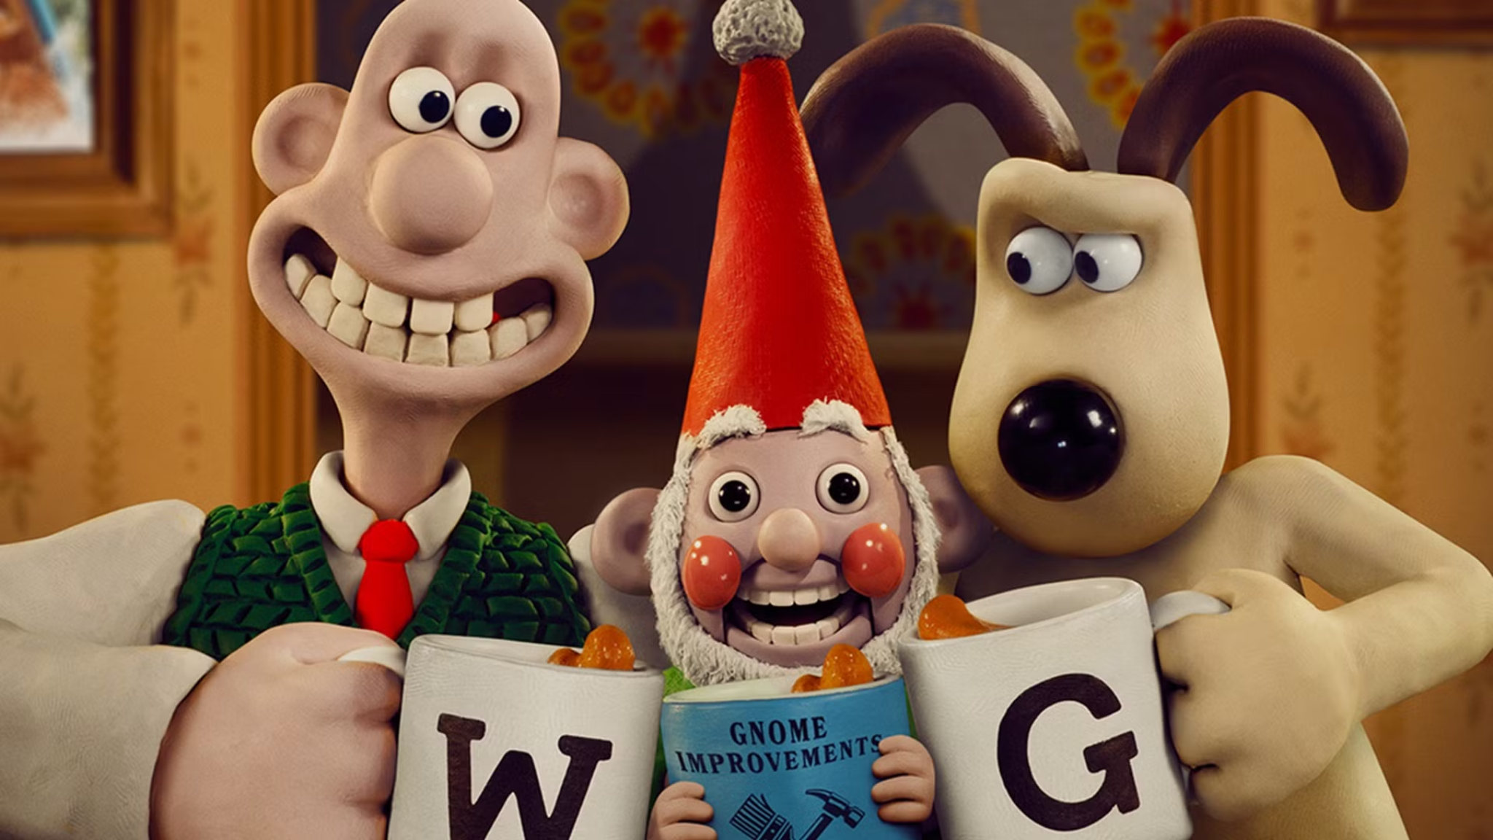
Notes:
How familiar are your children with ranges of expressions? What can they tell about the expressions in different animated characters for example? What have the artists done to make your children think that? (Gromit’s forehead, for example, is his main way of communicating feeling!)
The character sketches on the left are from the Japanese manga (comic book) and anime (animated cartoon) One Piece. Monkey D. Luffy is an extremely expressive character, his emotions conveyed through exaggerated expressions. They are often impossible to recreate in real life but still feel make sense to us. Expressions often change from culture to culture - sleepiness in Japanese comics, for example, is often depicted by half-shut eyes, but also a bubble coming out of someone’s nose! Do your children have any of their own examples they’d like to share?

Slide 13
Introducing the painting
Notes:
You can only see a painting for the first time once! How might you introduce it to your students?

Slide 14
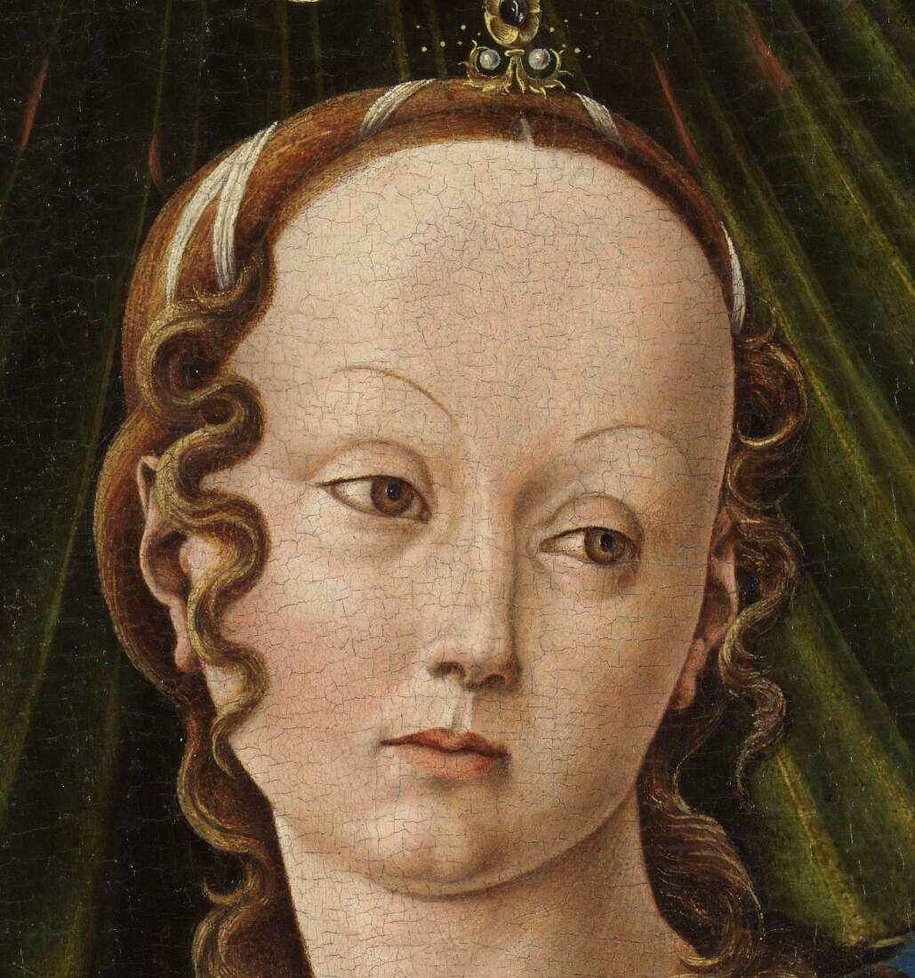
Notes:
One approach to introducing the painting might be to start zoomed in. What do you notice? What do you think about this person? What are you more certain about and what puzzles you? How do your thoughts compare to others’?

Slide 15
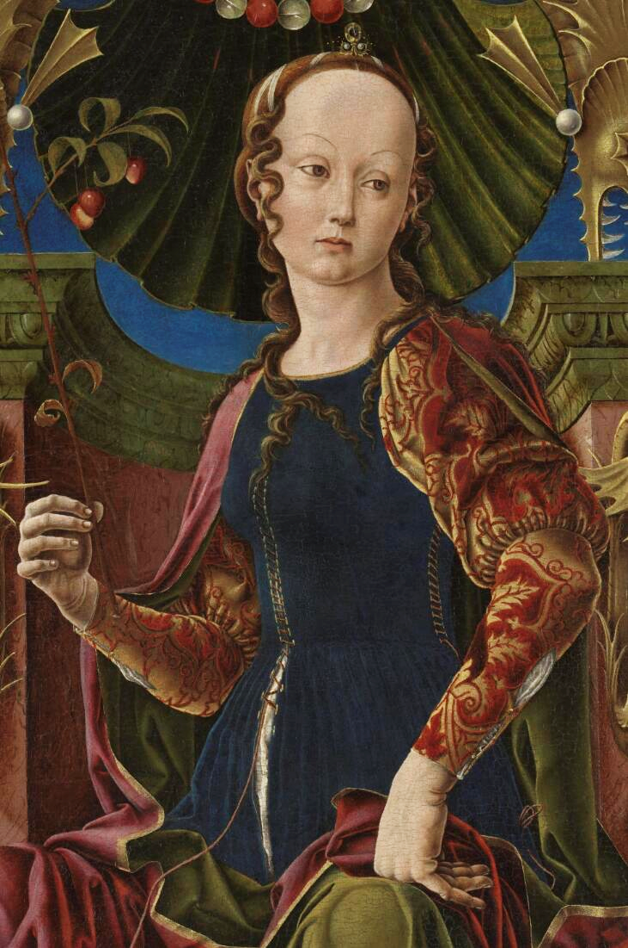
Notes:
Zoom out – what do you think now? Have any of your previous thoughts been confirmed or challenged? Compare the hands and make the poses yourself. What might they show? What ideas is the clothing giving us about this person?

Slide 16
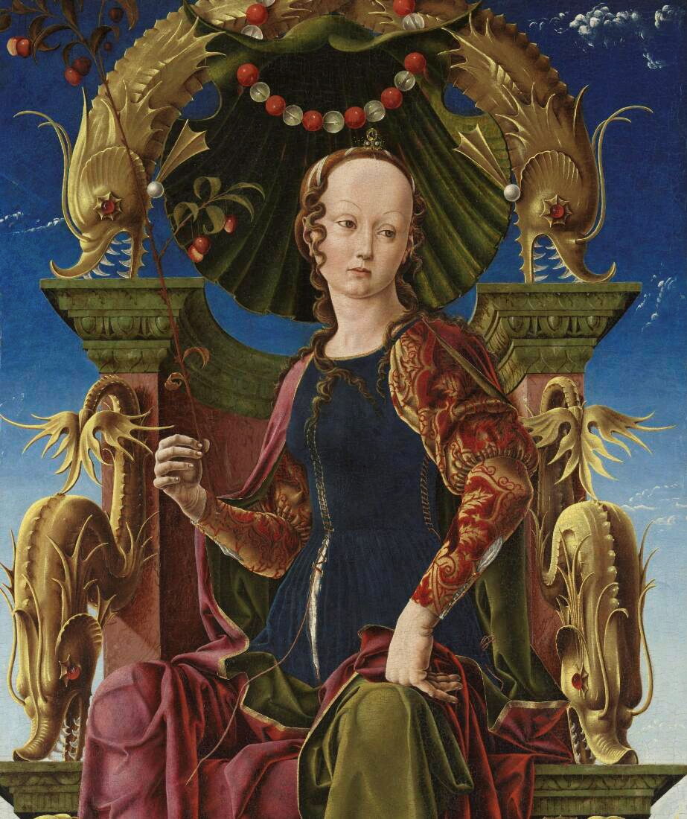
Notes:
Zoom out again. Do the surroundings tell us anything about this person? Who might sit in a chair like this? Where might this person be (on the land, in the sky)?

Slide 17
Notes:
Here’s the complete picture – any last thoughts? Spend a moment looking slowly across it, from bottom to top, and slowly back down again. Find the brightest places and the darkest places. Find something soft, and something hard. Something smooth, and something sharp.
We started with her face and slowly added more details. What might the effect be if we started elsewhere – perhaps with one of the spiky creatures, or with the background? What if we looked at everything but her face?
High resolution details of the painting will be included in your teachers’ resource pack.

Slide 18
What do you remember in the painting?
Notes:
Remove the painting. Chat to each other about what you remember – colours, shapes, objects. Don’t worry if you don’t have the words for it – what do you remember about it, and how did you feel about it?

Slide 19
Notes:
Return the image – did you miss anything? Misremember anything?
Think back to the whole process we just went through - can you remember the steps we took? Close crop, then slowly zooming out. A slow, guided look over the whole image following directions (“from bottom to top, and slowly back down again”). Then choosing opposites in the painting and focusing on them (“soft, hard – smooth, sharp”). Some of these are quite subjective qualities (does everyone agree what is smooth and what is rough?). This hopefully makes it less intimidating to contribute an opinion as there aren’t clear right or wrong answers.
Then we removed the painting. What might be the benefit to your students of doing something like that? To encourage recall, to make it a playful game, etc. The barrier to entry is quite low too. What did you remember? It may even have been misremembered! It doesn’t matter, we want to hear what you saw, or thought you saw.
And at every moment, what did we ask you to do? To talk, to share your ideas with all of us. You want to get your children talking as soon as possible. It is not only your assessment for learning, a benchmarking exercise to see their current knowledge, observations and misconceptions, but also an opportunity to see the painting through their eyes. The teachers’ notes for this painting (and its page on the website) will tell you what you’re looking at, but it can’t tell you what you see. That is unique to you, and to your students. But you can only find out what your students see if you give them the opportunity to tell you. Might you need to help them with the words to express themselves too?

Slide 20
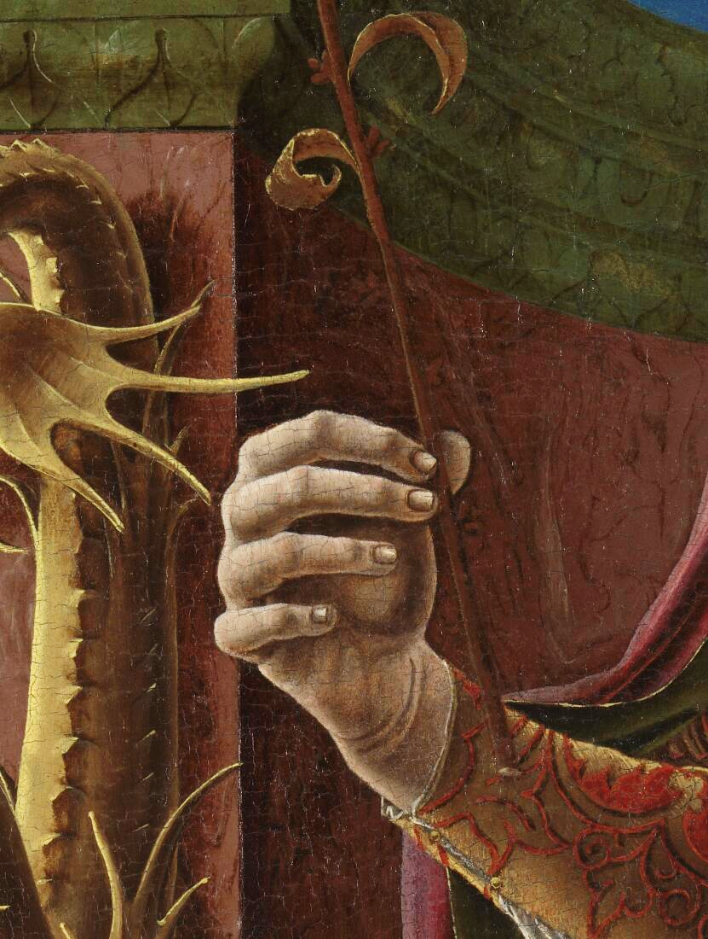
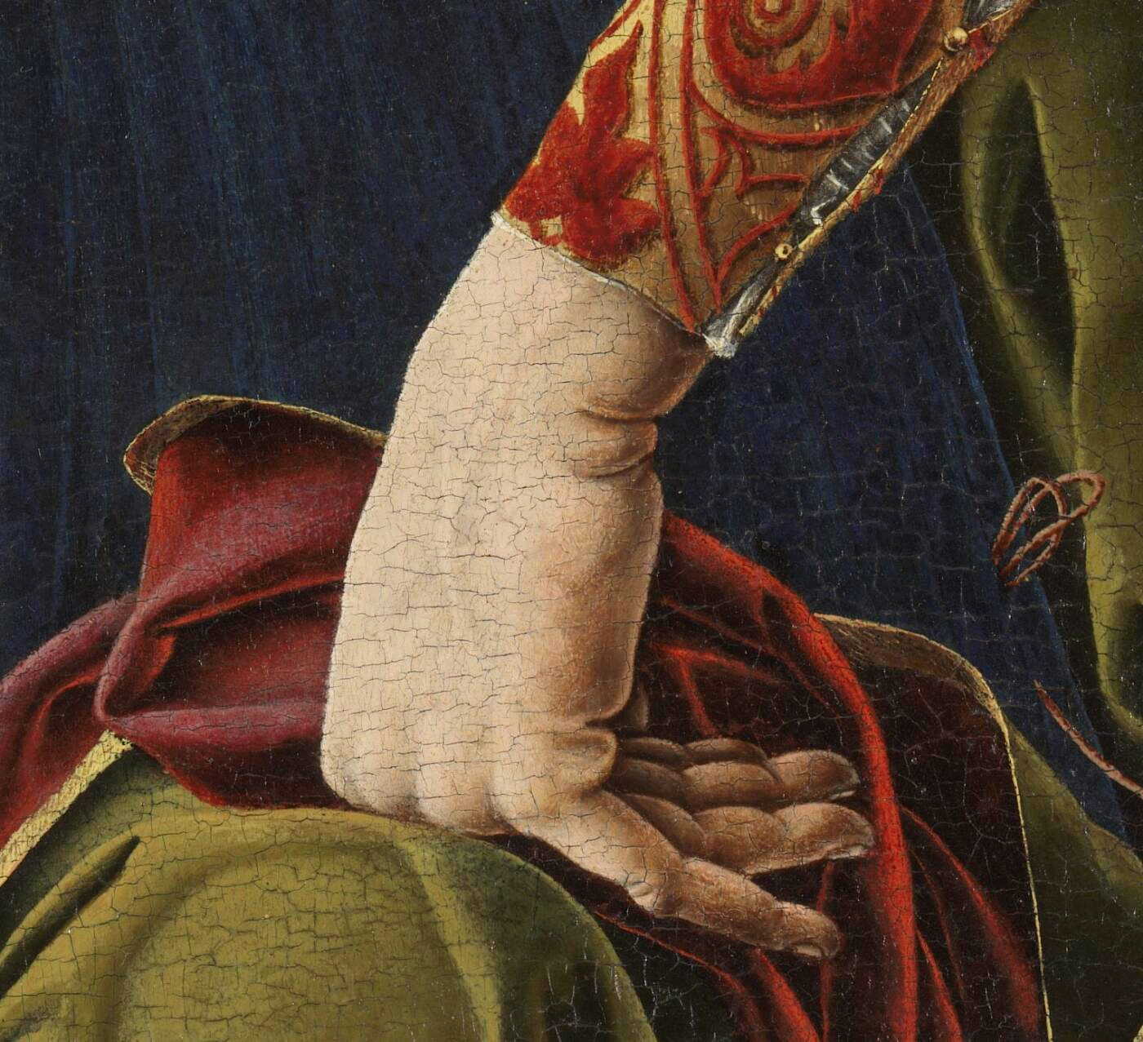
Notes:
Close ups of the hands we looked at earlier. Perhaps you could try a posing game if you haven’t already – challenge the class to show something with a gesture and have others guess it.

Slide 21
Notes:
Before we move on, what are your first impressions? What’s puzzling you? What do you want to find out? Your class’s responses can help inform your approaches in the next step.

Slide 22
Questioning structures
Notes:
Now we’ve had a good look at the painting, where do we go now? Let’s explore it further using careful questioning, all aimed to help your students discover the image, mixing their own reactions to it with others’ interpretations and some carefully deployed factual info.
What structure might your questions take though? Here are three possible examples (we will briefly try a couple before spending most of the time modelling and exploring the third example, “on – and – beyond”.

Slide 23
The 5 'W's – where, when, who, what
why?
Collect observations to make inferences.
(‘might and may’ are very important words to encourage answers!)
Notes:
One example of a questioning structure is the 5 Ws.
Where might we be? Indoors/outdoors/part of the world.
When might we be? Time of day/year/period in history.
Who can we see? Is anyone/anything the focus?
What might they be doing? What might be going on?
Why do you think that? Explore answers by answering ‘Why?’
You may wish to start by offering children binary choices for each question before expanding their scope . For example, “Where might we be?” could be too broad. Start with, “Indoors or outdoors?” followed of course by, “Why do you think that?” Then you could ask if it could be our country or not. And then if it reminds them of somewhere, or if it might be a real or made up place. Each W question contains numerous smaller questions that you can choose to carefully scaffold your students’ ability to form answers to them.
How can you encourage children’s own questions about the painting? Perhaps start by asking for their questions about the picture and, after a series of your own carefully structured questions, revisit theirs and see which have been answered and which have changed. Which new questions have arisen? Allow for their interests to direct how the class looks at the painting rather than feeling there are particular pieces of information you need to impart. New information can be told by you rather than discovered by them; use it as a prompt for more questions. “Now that you know..., does that change what you thought about x/y...? In what way?”
As a possible exercise going forward, if you could ask 10 questions about this painting, what would they be? And how would you order them?
And please remember, all of this is designed to intrigue your students and help them to discover the image individually and collectively, so don’t feel the need to slog through every W. Keep an eye on pace – if a question doesn’t elicit much, simplify it, rephrase it, or simply move on.

Slide 24
Notes:
Give some of the 5 Ws a quick try.

Slide 25
The Senses
see - hear - feel - smell - taste
Notes:
Using the senses are a simple way to explore a painting in a variety of different ways. What might you need to support your children? Feely bags made in advance containing similar fabrics and materials may help. Limit one sense to encourage children to focus on another – for example, blindfolding someone or keeping an object hidden in a bag while they touch an item may elicit different responses to if they were able to see it while they felt it.
A soundscape of this painting will be given to you.

Slide 26
Notes:
Try exploring the painting with your senses! Bear in mind that some senses may be easier to employ than others. Where else could children experience the sensations within this painting? Could they choose surfaces around the school which they feel are similar to this? Where do children agree and disagree?

Slide 27
On – and - Beyond
Notes:
Another more generic questioning structure is “On and beyond”, sometimes also called “on/in/out”. Again, this follows Bloom’s Taxonomy of ensuring surface level attention to detail in order to then work towards more creative responses.
There are 3 stages to On and beyond.
“On” – collect surface level observations: textures, colours, shapes
“And” – build on those observations with inference. What might a colour or a fabric tell us about this person? Who might sit in a chair like that? Ensure you are asking the children why they think something, backing up their observations with evidence drawn from the painting.
“Beyond” – step outside the painting into its surroundings and even our own lives. What might be beyond the frame? What sort of chair do you sit in at school? Is your teacher’s chair the same or different? Why? What other chairs have you sat in? When, and why? What do you think about this person? What would you ask them? Would you be frightened to speak to them?

Slide 28
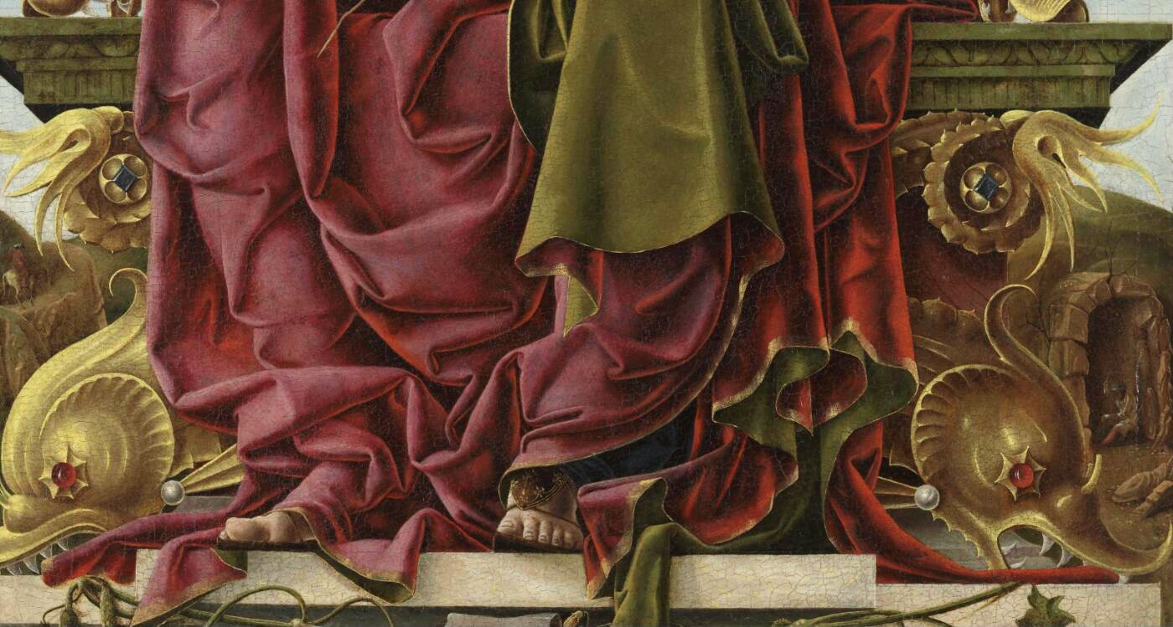
Notes:
Explore “On and Beyond” by focusing on some details. Tura’s Muse can be viewed full screen on the National Gallery website – you and the students can zoom in and out of it at will.
(All details of this image will be supplied to you separately in much higher resolution)

Slide 29
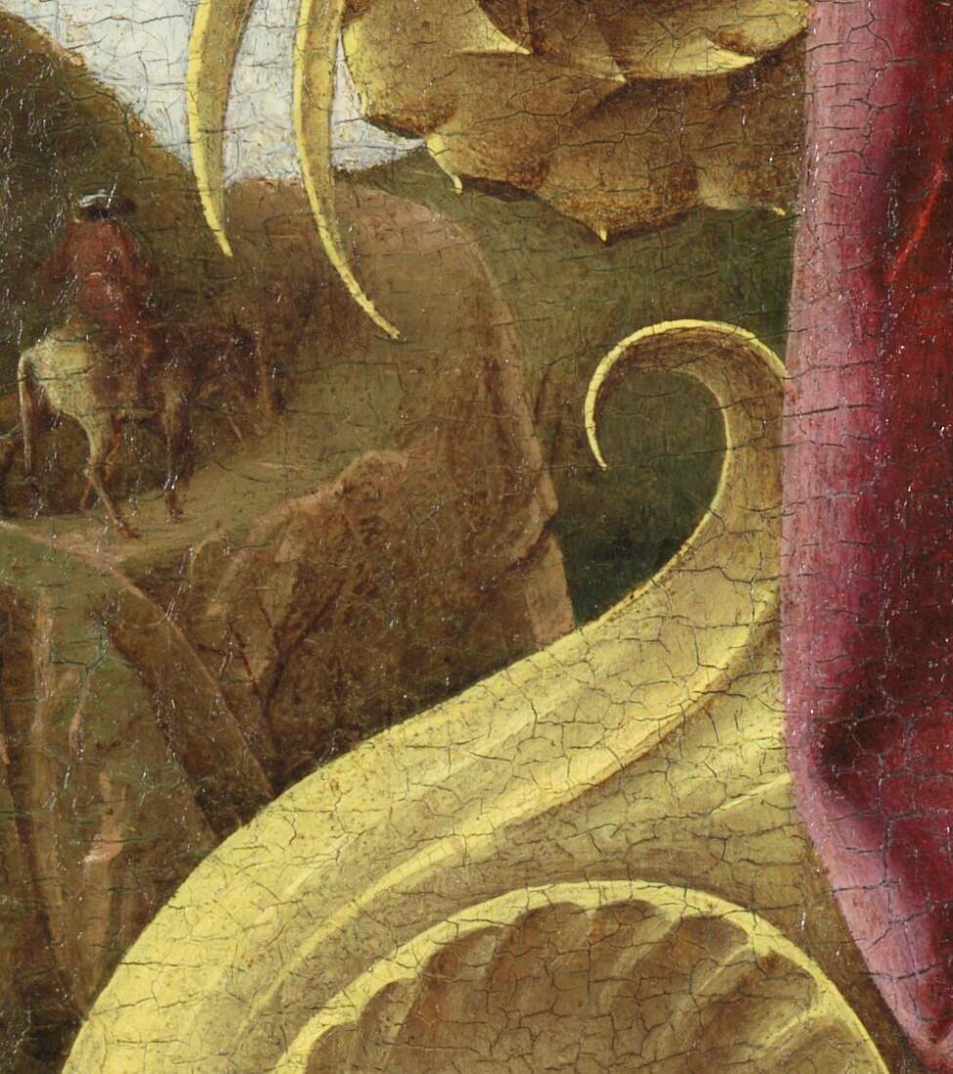
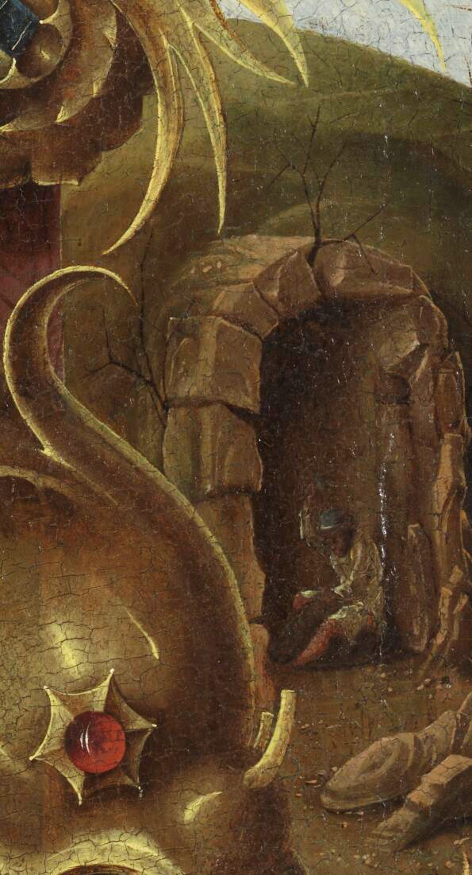
Notes:
Closer details of the background. Do they add anything to our thoughts about the figure or complicate things?

Slide 30
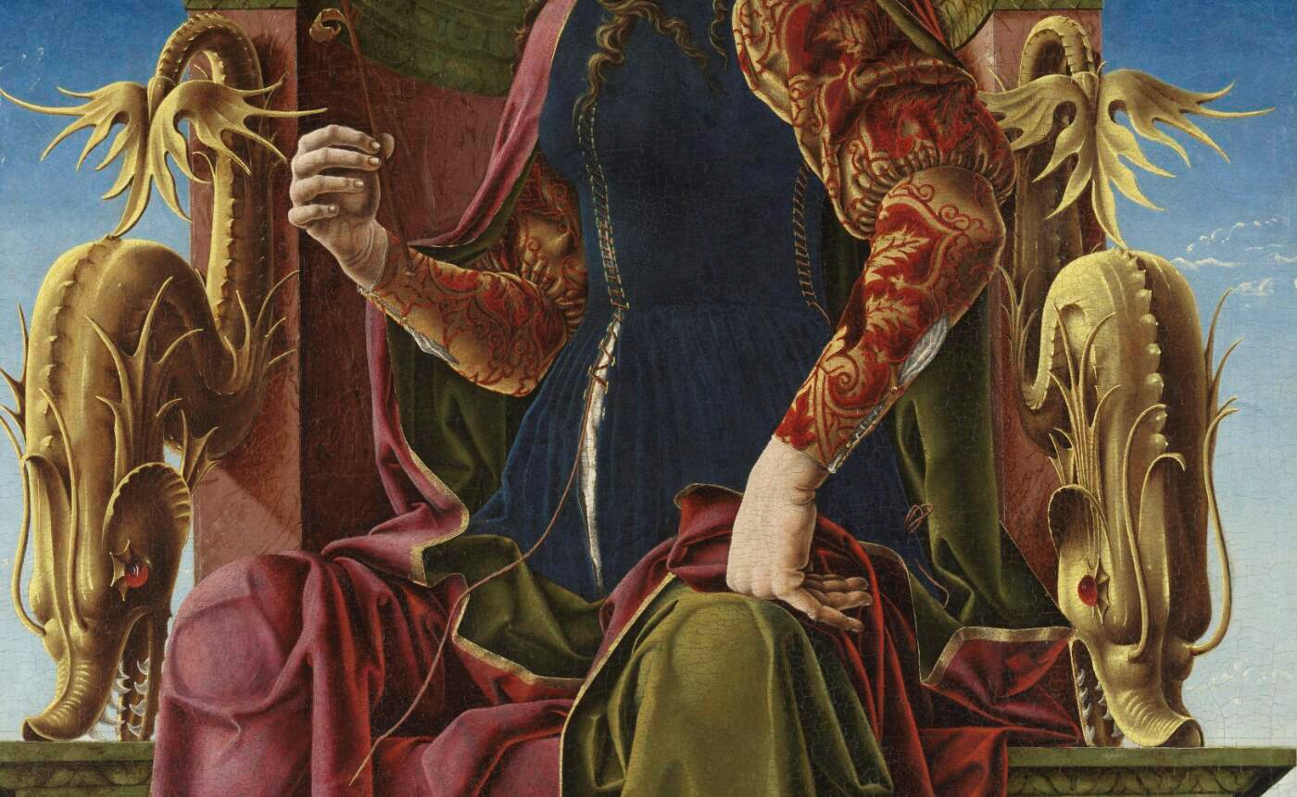
Notes:
Explore “On and Beyond” by focusing on some details. Tura’s Muse can be viewed full screen on the National Gallery website – you and the students can zoom in and out of it at will.
https://www.nationalgallery.org.uk/paintings/cosimo-tura-a-muse-calliope

Slide 31
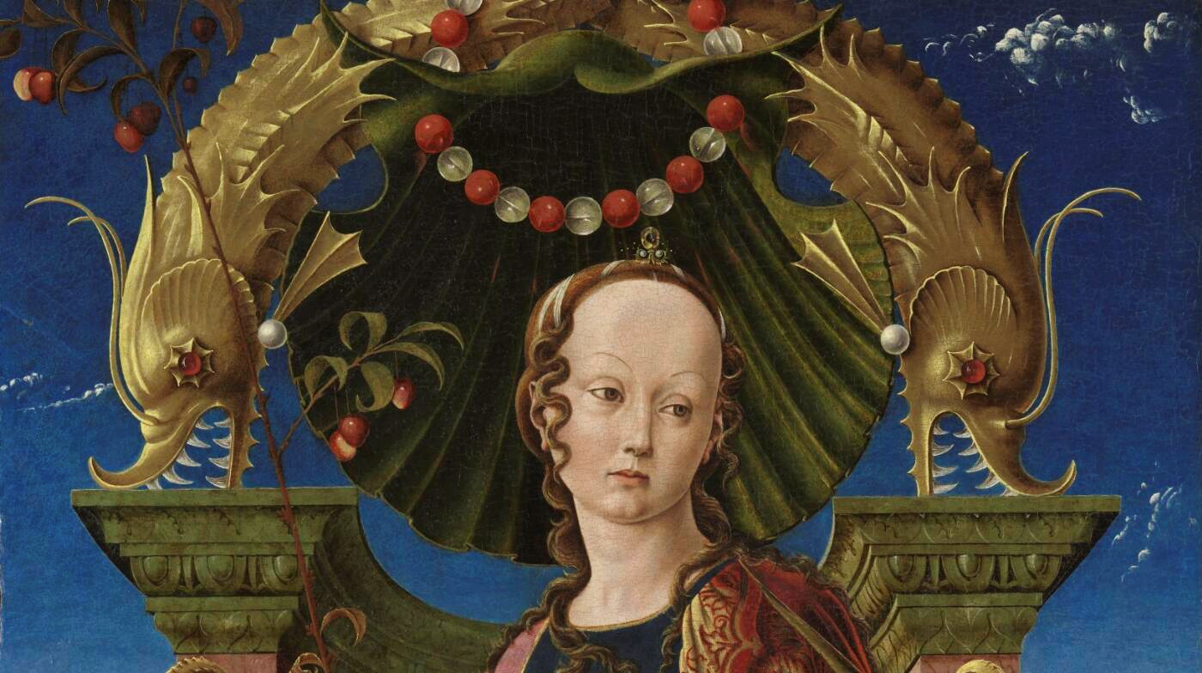
Notes:
Explore “On and Beyond” by focusing on some details. Tura’s Muse can be viewed full screen on the National Gallery website – you and the students can zoom in and out of it at will.

Slide 32
Notes:
How to add factual information? When do we ask questions and when do we tell our class things?
Some information cannot be easily “discovered” through questioning (for example, the artist’s name, or the name of the painting). Think carefully about how to introduce factual information. You don’t want the first encounter with the painting to be an art historical lecture. Too many facts may also shut down the children’s imaginative responses to the image, creating a sole “correct” interpretation and relegating the children’s ideas to feeling lesser.
That being said, there are a few things it would be helpful to learn about, but only once the class have fully explored a variety of ideas and considered which they feel more, or less, likely.
Try dropping in some information and then asking the class to reflect on it. For example, this is painting of a make-believe person. What do you think about that? How do you think we can tell that she’s not a real person? She is probably one of the “Muses” – Greek goddesses who inspired people to create things like scientific inventions, music, stories, and poetry. What does it mean to inspire someone? Have you ever inspired someone to do something, or been inspired? What examples can you think of.
Key info to impart during this slide is:
This is not a portrait of a real person but a depiction of a Muse. The Muses were Greek goddesses who inspired humans in the arts and sciences (we get the word “museum” from “Muse”). There were nine Muses altogether, and it’s thought this may be Calliope, the muse of poetry.

Slide 33

Notes:
Are the muses just ancient Greek ideas or do they still live on in some form today? What are your associations with the word “muse”? For adults it is often gendered – the stereotype of a woman who inspired a man to create something. But inspiring figures often transcend gender and culture.
This image of Supergirl, drawn by Brazilian artist Bilquis Evely, has some parallels with Tura’s Muse. Could we use some of the same approaches we’ve used already to build our thoughts about the picture? How much do Greek gods and superheroes have in common? Interestingly also, here we have a woman drawing a woman (albeit a make-believe one). Tura is a man painting a woman. How might that differ? These are discussions that may not be suitable for your class, but how could approach the issue of gender and its representation thoughtfully and carefully with your children?

Slide 34
The third turn
Notes:
Expand the idea of using oracy exercises. Have we been using them already?
Oracy is learning through talk and learning to talk. Your students need opportunities to talk but also need to be taught the strategies and techniques to learn how to speak and listen to each other

Slide 35
The third turn
Teacher asks a question

Slide 36
The third turn
Teacher asks a question
Student responds

Slide 37
The third turn
Teacher asks a question
Student responds
?

Slide 38
The third turn
Teacher asks a question
Student responds
? (usually teacher feedback / evaluation)
Notes:
The third turn in a dialogue is where a huge amount of learning can take place. Children’s thinking shuts down pretty quickly after simple feedback (“yes” or “no”) or encouragement (“well done”) when it isn’t then followed by something to challenge them to reflect on what they’ve just said. There is nothing intrinsically wrong with “yes”, “no” or “well done”, but your aim is to keep them thinking. There’s no time to sit still! Let’s keep pressing on together.
Challenge students to take their responses further, reflecting on what they or someone else has said. Keep children’s thinking and talking going, rather than simply feeling that they’ve answered a question correctly or incorrectly. The aim of good oracy practice is both learning through talk and learning to talk. Which techniques can you give to your students to help them speak and listen in order to understand?

Slide 39
The third turn
Encouraging talk
(expand) Can you tell me a bit more about that? What do you mean by that?
(rephrase) So are you saying…? Could anyone put that into their own words?
(think, pair, share) Have a quick chat with your partner and see what they think.
Dig deeper
(evidence) Why do you think that? What parts of the painting made you feel that way?
(challenge) Does it always work that way? What if…?
Interact with each other
(add on) Who would like to build on that / take it further?
(agree / disagree) Does everyone agree with that? Why / why not?
(explain another’s reasoning) Why might ___ have said that? What might they mean by that?
Notes:
Here are some possible forms the third turn in a conversation can take. Many of these you may use already, but notice how they are broadly grouped into three different sections. When might it be best to use certain questions over others? Are you using a range from all three of these groups? Which of these have you seen in use today? When were they used?

Slide 40
Notes:
Let’s have one final look at the painting. What have we discovered together, and what still puzzles you?
What have you found most useful in the training today, and what do you feel you need more help with?

Slide 41
Questions?
Notes:
We will now take a short break, but after we come back we’ll be building on the questions you all have about this painting and the avenues your class might want to explore.
Please write a question you have about this painting in the chat box now and we will choose a few of them to pursue when we come back from the break.

