Slide 1
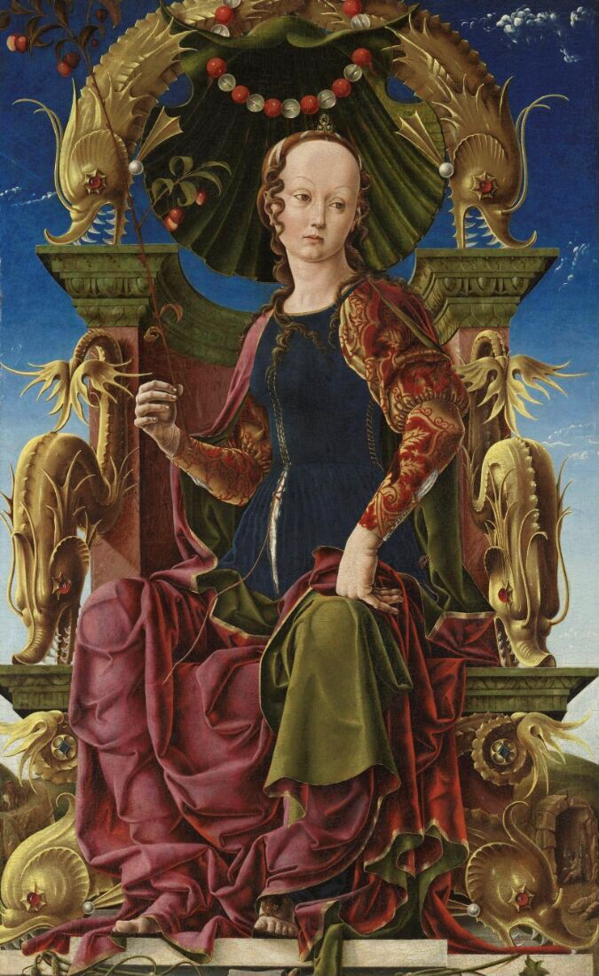
Take One Picture CPD
Building a project

Slide 2
How do we transition from looking at the painting to deciding on a project?
Notes:
How can we involve children in this decision-making process? Oracy is learning through talk and learning to talk. Your students need opportunities to talk but also need to be taught the strategies and techniques to learn how to speak and listen to each other. How can we keep children's voices at the forefront?

Slide 3
Who is that woman? What are the dolphins doing there? Why is the chair so fancy? What would that fabric feel like?
Notes:
Example questions.
How do we decide which questions might more interesting to pursue? A quick vote might show you which is most popular but what if that's a surface level reaction? What if a large number were interested in another question too, do we ignore that? How could we incorporate it? What ideas do you have, or have experience of?

Slide 4
Talk activities to help students explore the questions further: Talking in character / Hot seating - try to be a mystery rather than an authority - encourage the children's questions in character, rather than as the teacher.
Notes:
Could we use some of these oracy exercises to explore the previously generated questions before we actually focus on one we'd like to pursue?
You might find some of these activities to be more helpful than others when considering your class. Let's give it a go and reflect on how we feel about each one.
Revisit the questions to narrow down a couple that would be more interesting to pursue. Why do you find them more interesting? How do we recognise a question that has depth to it? How do we persuade others to see it in the same way we do? We can only do this by initially looking at all of the questions.

Slide 5
Who is that woman? What are the dolphins made of? Why is the chair so fancy? What would that fabric feel like?
Notes:
Hotseat
The teacher inhabits the role of the Muse in this painting so that they can answer the class’s questions in character. Draw these questions from the initial list – further questions may be generated through this activity which may be worth noting down.
The aim here is not to provide definitive answers to factual questions (although you could provide key info that you are a Muse and your purpose is to inspire others). Rather it is to continue to encourage the students’ creative exploration of the picture, using a character’s voice as an engagement tool. It is an extension of the third turn.
Example exchanges:
Student: “Who are you?”
Teacher (in role): “Look upon me, my clothes, my throne… Have you ever seen such fine fabric? Such elaborate carvings? What sort of person do you think I might be?“
Student: “Why do you have such strange fish-things on your chair?”
Teacher (in role): “You think them strange? I would think you’ve never seen a throne as fine as this. Have you ever seen anything similar? If you were as important as I am, what would decorate your throne?
Gallery educator to model these exchanges, responding to teacher’s questions either spoken or written in the chat box.
Reflect on this activity – would you use this with your class? How might it be useful? What concerns might you have? Has it made any of the questions seem more or less interesting to explore?

Slide 6
Talk activities to help students explore the questions further: Let’s say… - Help your class to place themselves within the painting, looking at it from inside in role. - People – Place – Problem
Notes:
Let’s say…
We have been exploring this painting from the outside. How can we help children explore it from within? “Let’s say” activities encourage students to use what they’ve already gathered from their questioning to imagine the world of the painting and their place within it.
It needs some structuring though. Consider the classic story structure of people – place – problem to help you plan the activity.
Look at the details of the person in the cave and the one on the horse. Imagine you are a person in this painting (other than the Muse). You live a long time ago, hundreds of years in the past. What things do you not have that you do have today?
What is your job? Do the actions of your job. What do you like about your job? What don’t you like?
What sort of place do you live in? How do you feel about living there?
One day you look out to see this enormous golden throne with elaborate decorations. On it sits a woman who doesn’t look like anyone you’ve ever seen before. You feel a little frightened when you look at her – why might that be? You also feel a little awestruck and excited – why might that be?
The woman turns to look at you. Her piercing stare gazes deep within you. Then, in a voice unlike any you’ve ever heard, she says, “I am a great and mighty Muse. I inspire people to create great things. I offer you my gift of inspiration.” A strange and wonderful feeling flows through you – you suddenly feel compelled to make or do something that will make the place you live better. What might it be?
Reflect on this activity – would you use this with your class? How might it be useful? What concerns might you have? Has it made any of the questions seem more or less interesting to explore?

Slide 7
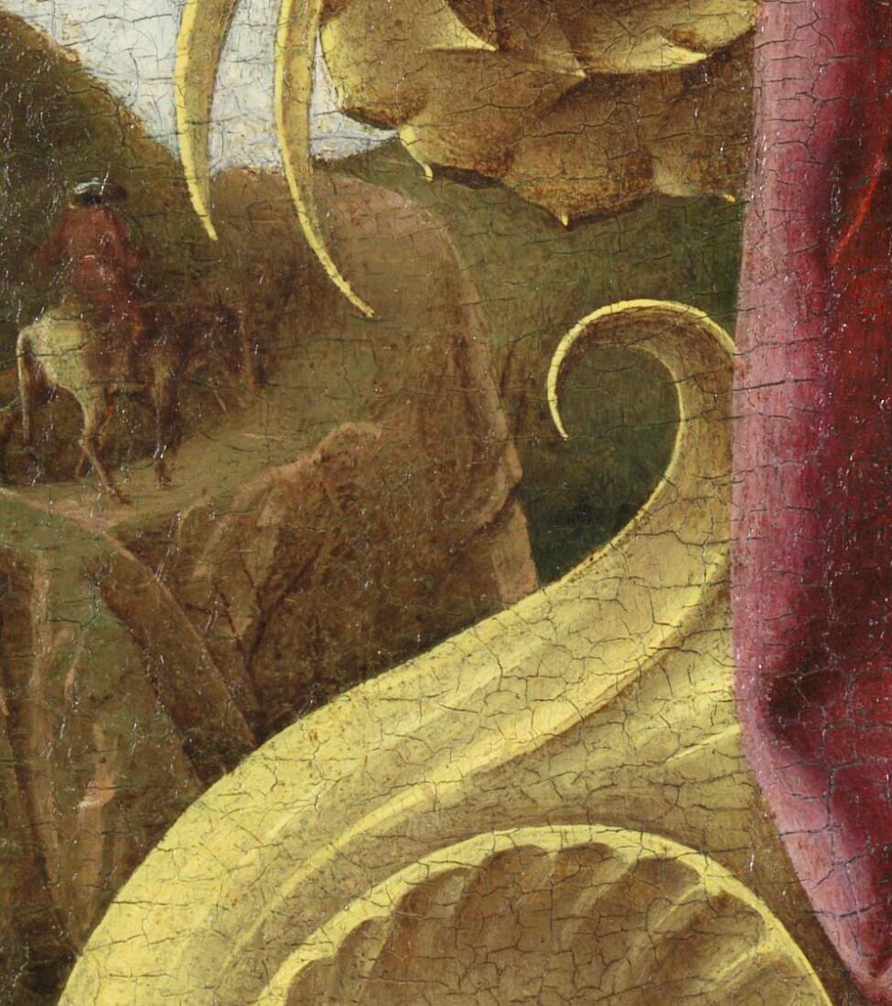
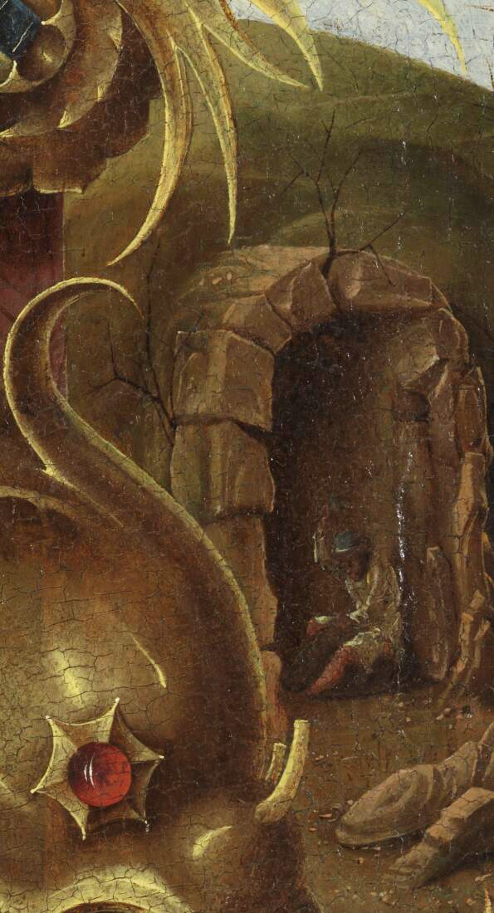
Notes:
What is your job? Do the actions of your job. What do you like about your job? What don’t you like?
What sort of place do you live in? How do you feel about living there?

Slide 8
Who is that woman? What are the dolphins made of? Why is the chair so fancy? What would that fabric feel like?
Notes:
Revisit questions to discuss-Which techniques can we use to model this?

Slide 9
Decide on one question to focus on – suggestions for deciding could be: - voting, explaining choices, voting with feet, etc. - each group having a painting detail to explore - each group having some objects / textures to explore How can we combine ideas?
Notes:
Just one question? How do we value students who wanted to explore other questions? Can their opinions inform the direction your project takes? How to involve non-verbal and less vocal students, and nursery/reception? Could different stations be set up to explore different sections of the painting (the chair, the clothes, the dolphins, the woman) and you observe how the children interact with them and where they are drawn to.

Slide 10
How could this question become a project?

Slide 11




Selection criteria
Cross-Curricular
Makes relevant links across the curriculum
Child-led
Evidence of a child-led, investigative approach
Community
Involves people or places in the local community
Process
Pupils have the opportunity to learn a new process
Relevant
Enriches children’s understanding of the focus painting
The National Gallery
Notes:
Child led – very important, why we have focused on how to engage children with the painting and share their own ideas.
Cross-curricular – when a project is child-led and follows a line of enquiry, this tends to happen naturally!
Process – Learn a new art process, work with a new material – and show us that process
Community – How can you take the project outside the classroom and make it relevant to your local area? Who/ what can come into the classroom, and how can you go out? Is there a local person or group with skills or knowledge that may be relevant to the painting? Is there somewhere local you can visit?
Relevant – Is your project relevant to the painting? Keep looking back to the painting throughout. How is your project enriching children’s understanding of the themes or content of the painting?

Slide 12
Examples of past projects
Notes:
Once you've decided on a question (or questions) to pursue, how can you generate ideas about how to investigate them? How to decide organically the form your project takes? Child-led still means adult-guided! They pick the path and we clear the nettles.
Sometimes, projects may start well, but take a turn or get stuck – how can you guide them back on track?
A few things to avoid – copying the CPD practical session, letting the project get too generic (e.g. Greeks and Romans without specific reference to this painting), a range of activities across each curriculum area rather than a tied together project.

Slide 13
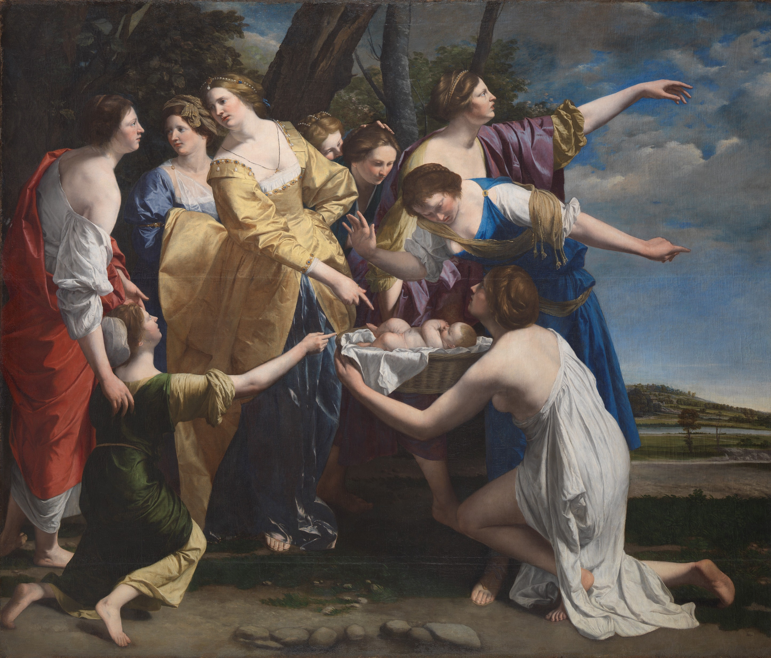
Orazio Gentileschi, The Finding of Moses, early 1630s, © National Gallery, London
Notes:
This was the focus painting for our 2022 exhibition. As an adult/ teacher, we might look at this painting and think about doing a project on biblical stories, or costume. However, when children are allowed to come up with their own questions and lines of enquiry, unexpected projects can happen!

Slide 14
‘Why aren’t the women wearing any shoes?’
Notes:
Children at St Robert’s First School in Northumberland wanted to know why the women in the painting weren’t wearing any shoes!
They wondered if this was important to the story of the painting, what it would feel like to walk along the ground with bare feet, and how the artist got so good at painting the feet so realistically.

Slide 15
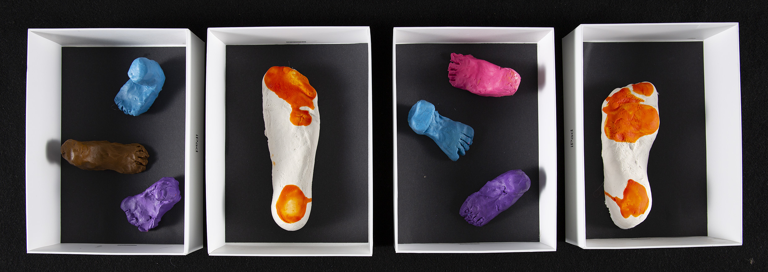
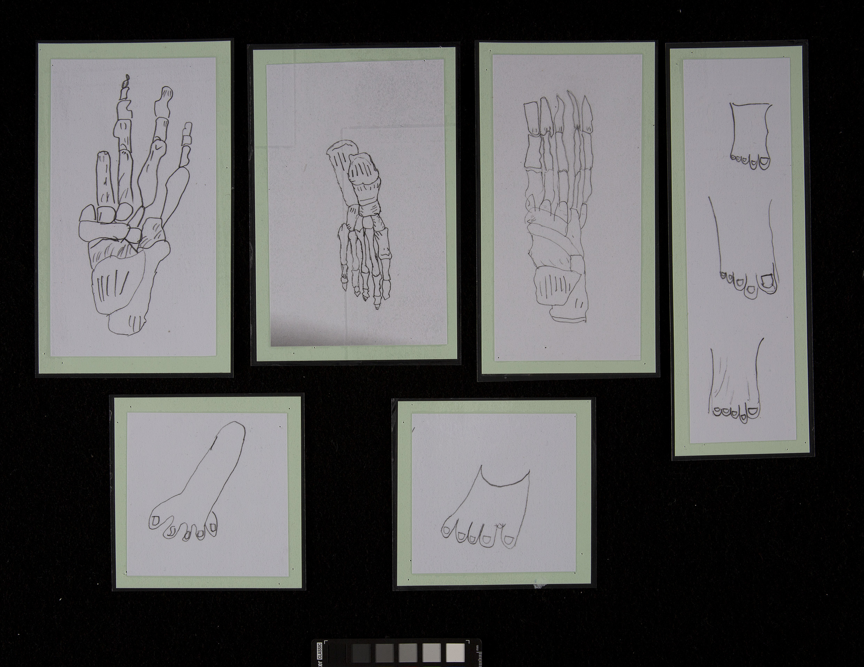
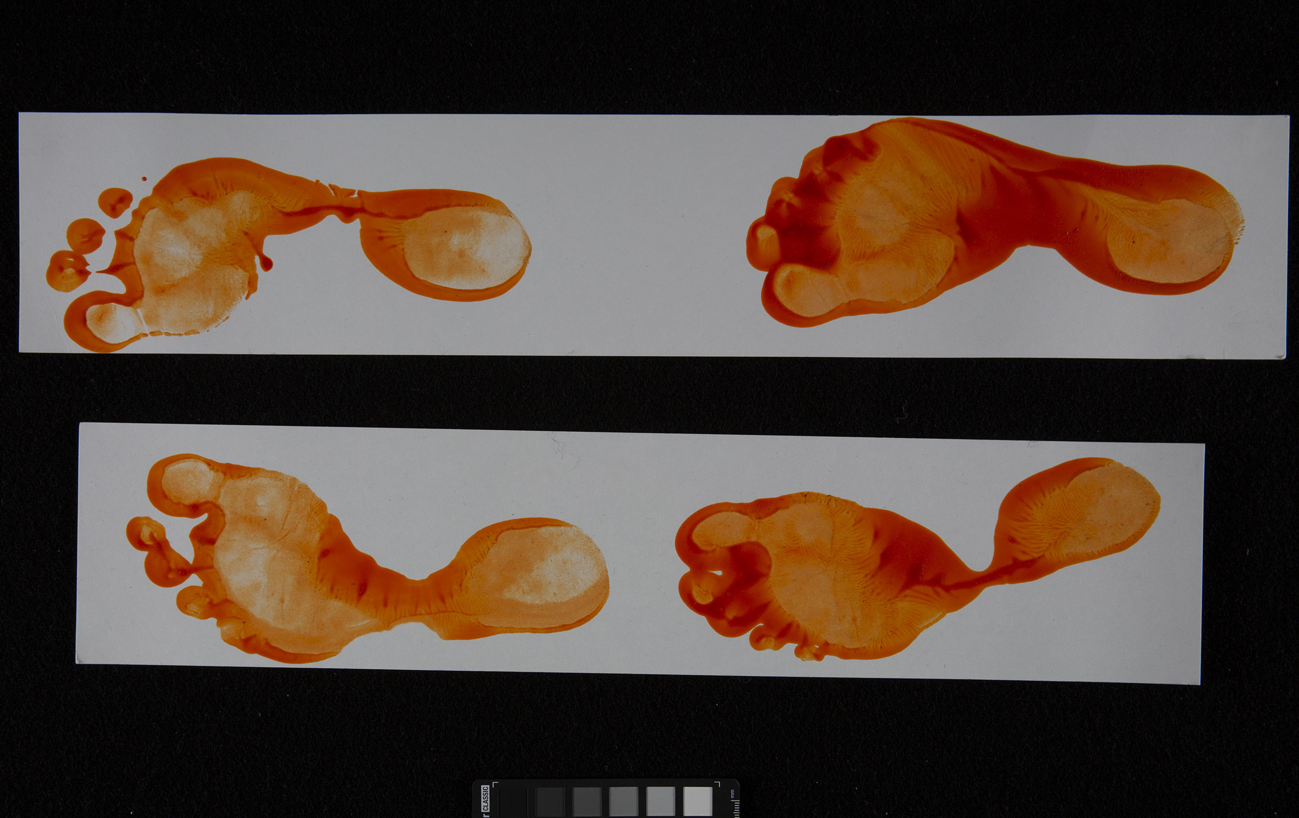
Fantastic Feet, St Robert’s First School, Northumberland
Notes:
Through their investigation, they fulfilled all of the TOP criteria:
Child-led – the project came from an unexpected child’s question, and the children continued to make decisions and shape the outcome throughout the process.
Cross-curricular – when the project is truly child-led and investigative, this tends to happen naturally! Interest in the feet led them to science – studying the anatomy of feet
New Process – they wrapped their own feet in plaster of paris to make casts, dipped their feet in orange paint to make footprints (and notice different arch shapes) and made detailed anatomical drawings.
Community – they invited a local podiatrist into school to talk to the children about anatomy and foot health.
Relevant – throughout the process, they linked their work back to the painting, relating dipping their feet in the paint to how it must have felt for the women to be walking along the squishy muddy riverbank. They also realised that the feet in the painting must have been so realistic because the artist studied anatomy.

Slide 16
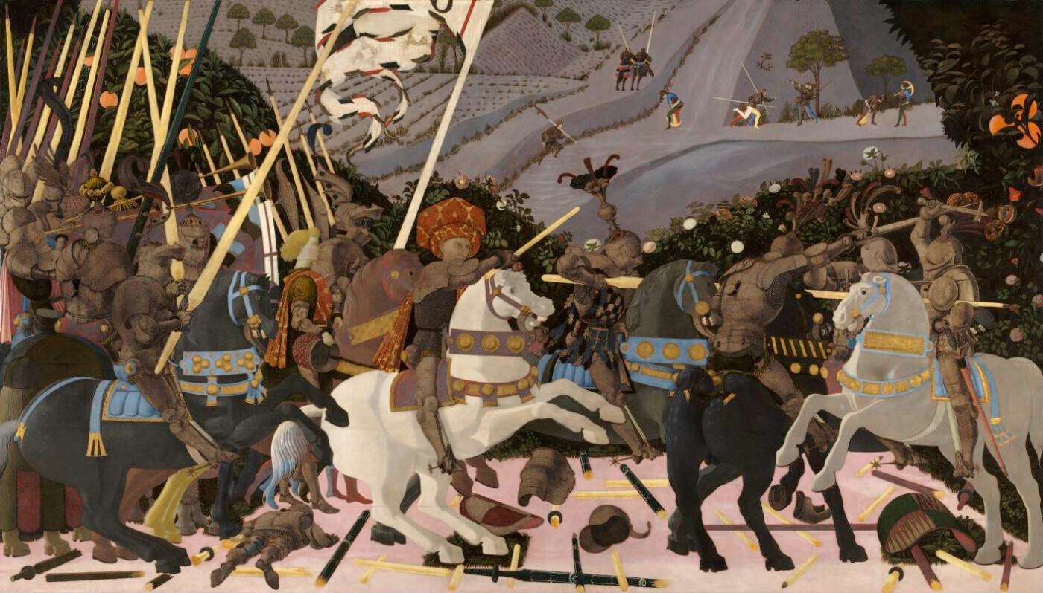
Paolo Uccello, The Battle of San Romano, probably about 1438-40
Notes:
This was the focus painting for the 2021 exhibition

Slide 17
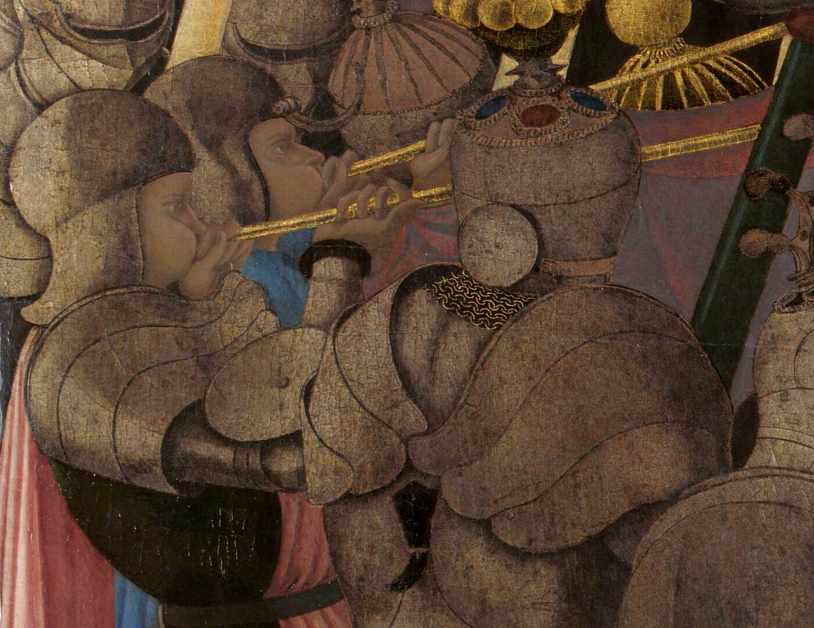
‘That armour looks like a woodlouse!’

Slide 18
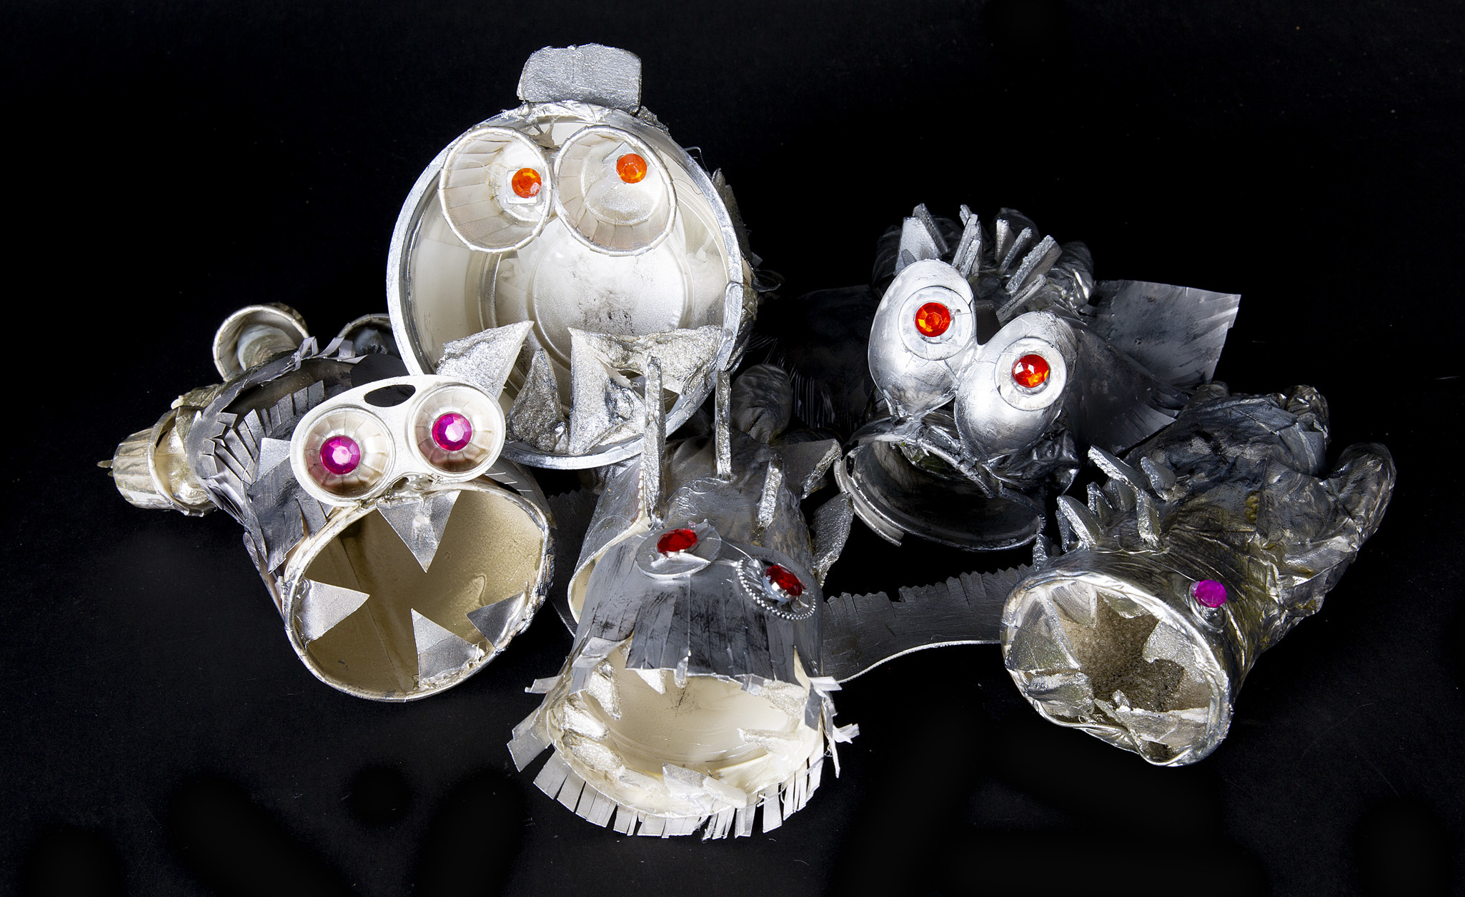
Armoured Beasts, Beavers Community Primary School
Notes:
Child-led – Initial ideal came from a child’s observation, children’s input continued to shape project throughout.
Cross- Curricular – Line of enquiry naturally led to history and biology. Why do we wear armour? Did armour look different in different time periods? Why do some animals look like they are wearing armour? Investigation of exoskeletons.
New Process – Building up different techniques and materials to make their ‘armoured beasts’ look like they are made from burnished silver – e.g. using brusho.
Community – Collected recycled materials. Went into playground and local community to find and study bugs with shells
Relevant – Linked back to the painting, carefully studying the shape, colour and decoration of the armour, thinking about what it was made from, why it was worn etc.

Slide 19
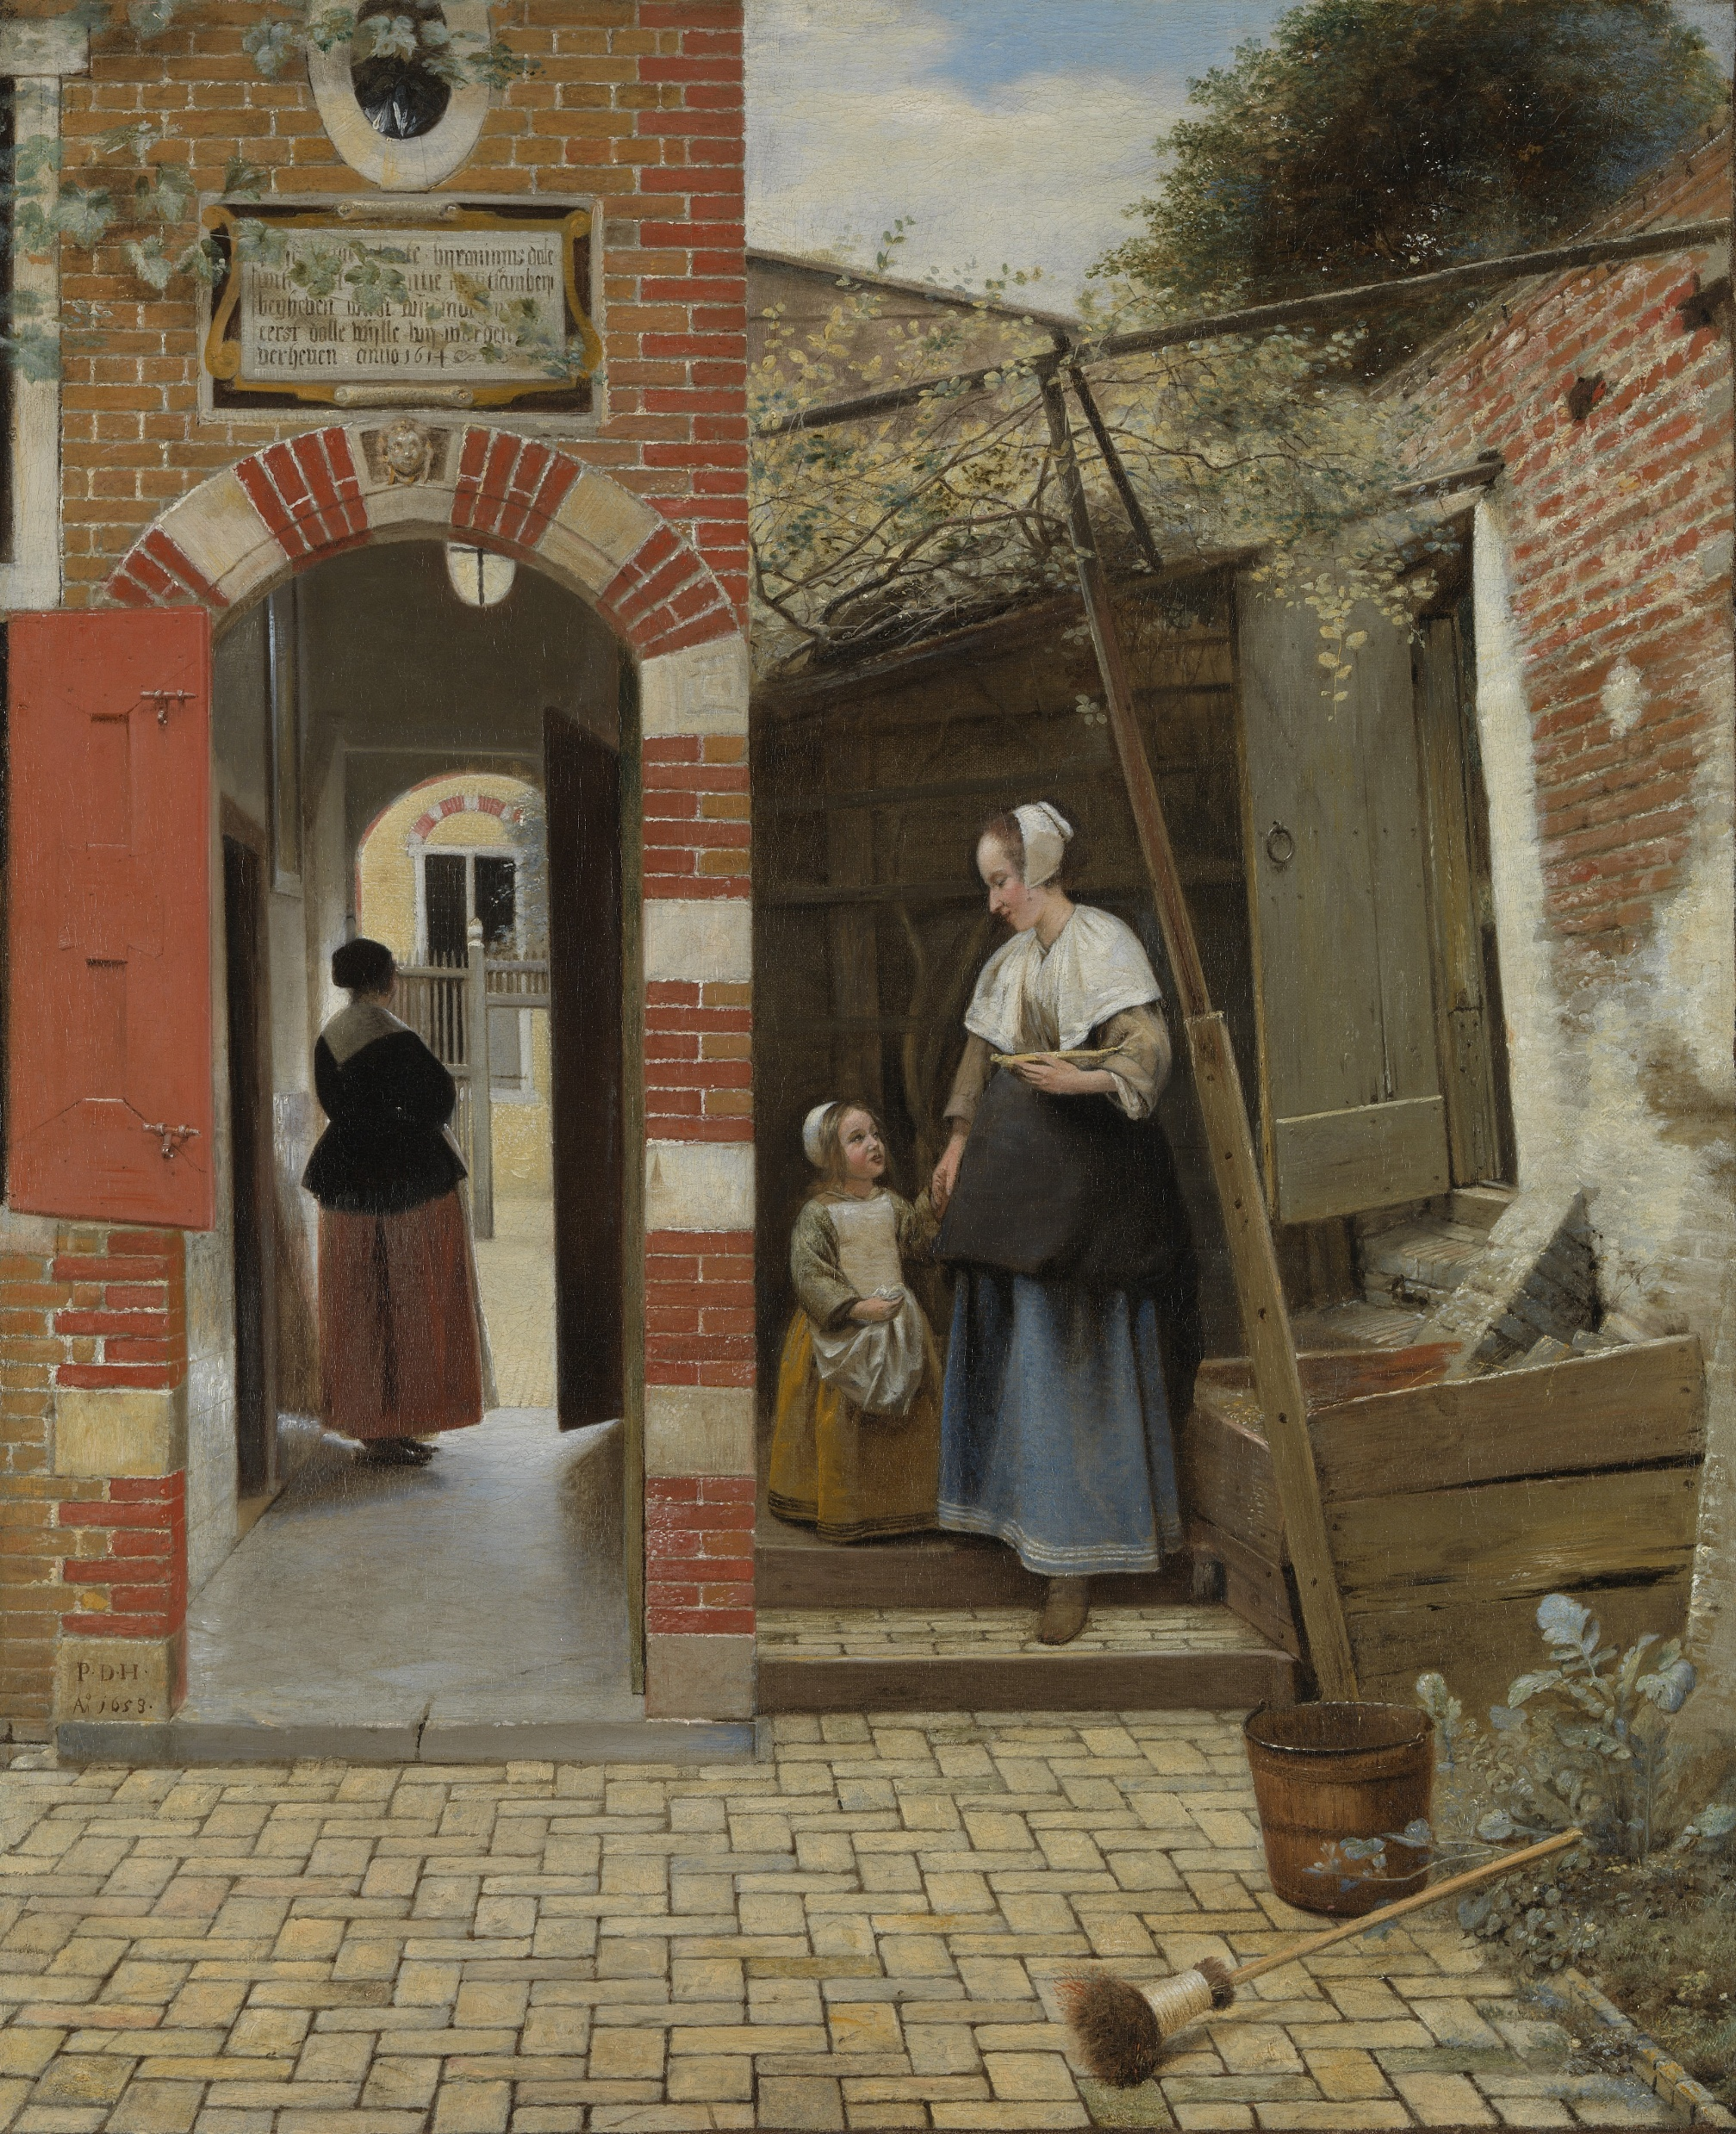
Pieter de Hooch, The Courtyard of a House In Delft, 1658
Notes:
Focus painting for the 2025 exhibition

Slide 20
‘Those buildings look like Sheppey!’

Slide 21
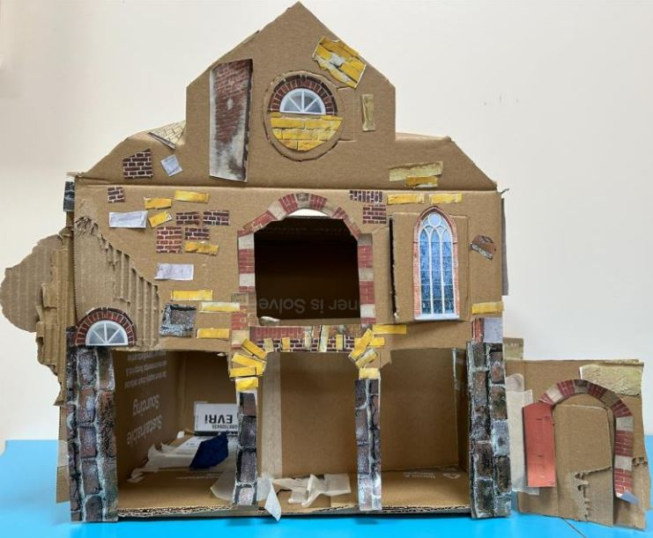
Over the Bridge, Queenborough School, Isle of Sheppey
Notes:
Child-led – Children noticed that the building in the painting reminded them of local buildings to them (on the Isle of Sheppey)
Cross-Curricular + Community – They went into the local town, studied and took photographs of local buildings, learnt about the history of the town and how it was invaded by the Dutch in the 1660s.
Process – They made cardboard structures of buildings inspired by both the painting and local buildings. They collaged on images from the painting and photographs they had taken.
Relevant – They learned about the architecture of the building in the painting and Dutch history

Slide 22
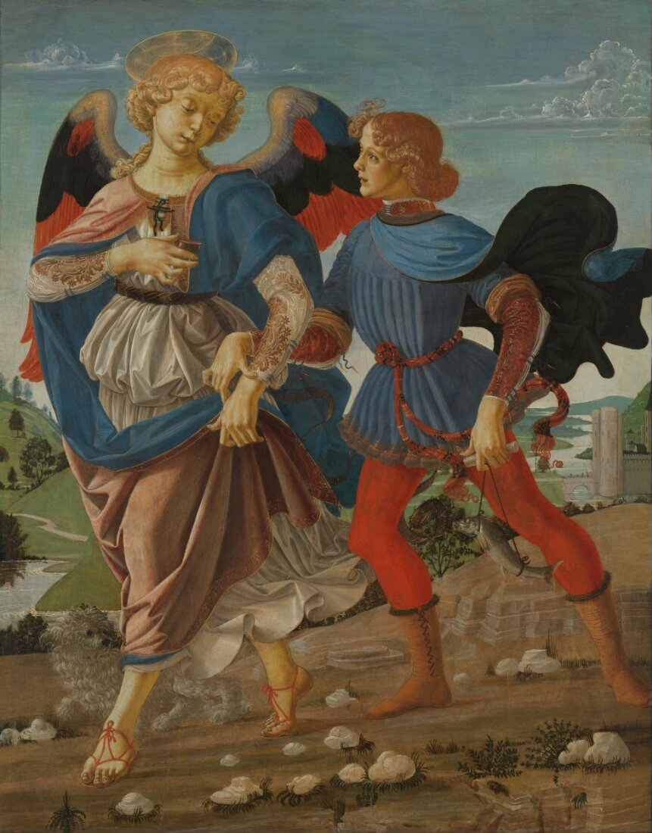
Workshop of Verrocchio, Tobias and the Angel, 1470-80

Slide 23
‘What would it be like to be blind?’
Notes:
Story of Tobias and the Angel – Tobias is searching for a cure for his father’s blindness. Children wondered what it would be like to be blind or have a visual impairment.,

Slide 24
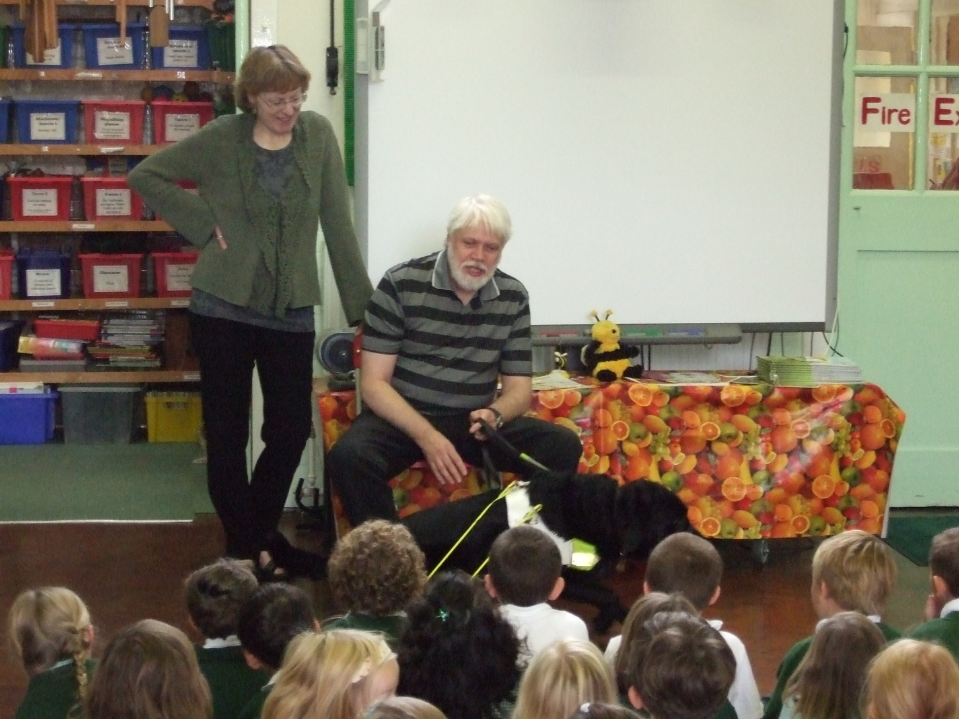
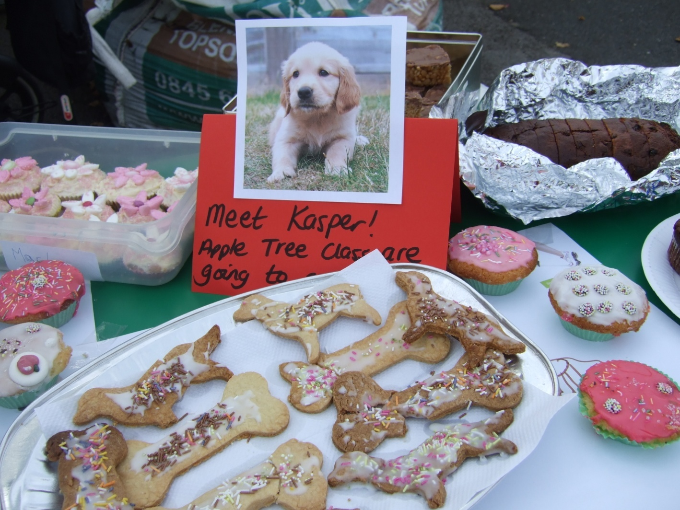
Barnet Wood Infant School, Surrey
Notes:
A TOP project doesn’t need to have a physical artwork as the final outcome.
Child-led – Children wanted to learn more about what it would be like to be blind or have a visual impairment.
Community – Teachers invited a member of the local community who is blind to talk to the children about their experience and answer their questions. The children were interested to learn about his guide dog and how important the guide dog is to his life. They learnt more about how guide dogs are trained, and decided to raise money to train a guide dog puppy for a local person.
Cross-curricular + Process – Children ran all aspects of the bake sale, from making the biscuits (learning about ingredients, weighing and measuring), to setting prices and handling money/ giving change, designing marketing materials etc.
Relevant – They deeply explored one of the key themes in the painting, and could better relate to the characters

Slide 25
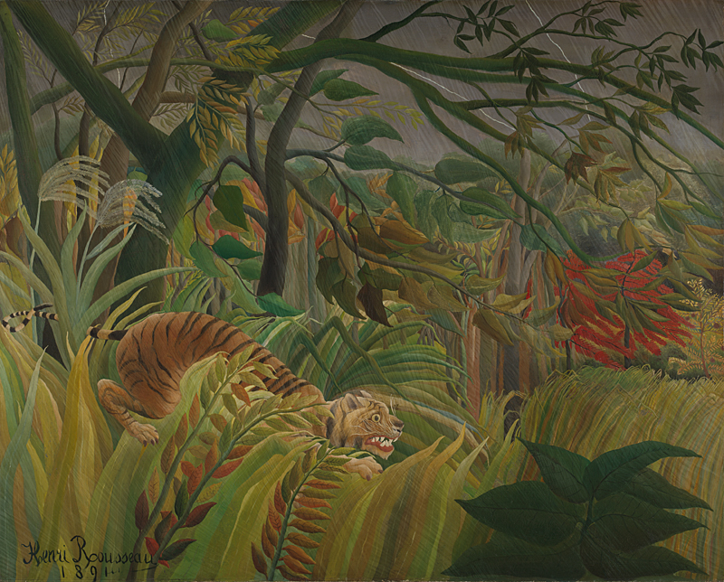
Henri Rousseau, Surprised!, 1891

Slide 26
‘Is the tiger scared of the rain?’

Slide 27
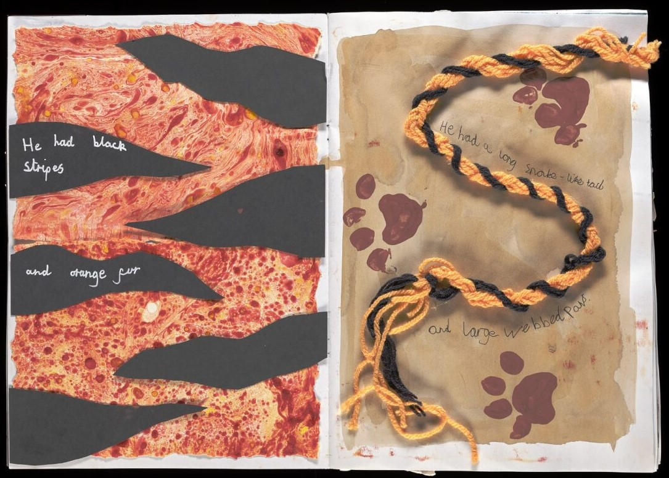
The Tiger Who Didn’t Like the Rain, Mab’s Cross Primary School
Notes:
A TOP project could also be a written response.
Child-led – Children thought that the tiger looked scared, and wondered if this was because it didn’t like the rain!
Cross-Curricular – Children collaboratively wrote a story about the tiger who didn’t like the rain. On each page, the tiger visited a different set of animals to see how they hide from the rain – e.g. the monkeys said to climb a tree, the boar said to hide in a cave. Ultimately the tiger saw a group of tourists with umbrellas and decided to make its own umbrella using large leaves from the jungle. Children thought carefully about how to structure the story (literacy) and learnt about different habitats of animals (science).
Process – Used a variety of new processes on each page – from sketching, to collage, marbling, weaving etc.
Relevant – Looked carefully at the painting, thought about how the tiger might be feeling and noticed the rain. Story all closely based around what they could see in the painting. Helped them to understand what the key character (the tiger!) might be feeling and experiencing.

Slide 28
What projects will we have for the Muse?

