Slide 1
Introducing the painting using crops.
(You could use this PowerPoint, or print them out).
What can you see? What do you imagine the rest of the painting might look like? Why?
Introduce a new crop and repeat questions. Does the new crop change your thinking? Why?
Look at all crops together. Where might these pieces go?
Reveal full painting. Is it what you expected? Are there any surprises? Can you see where the crops were from?

Slide 2
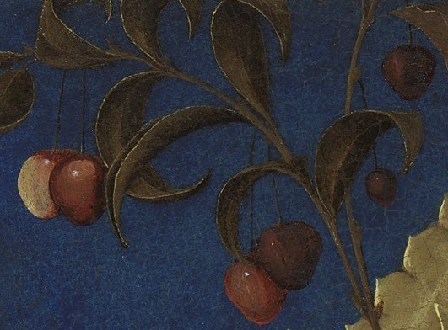

Slide 3
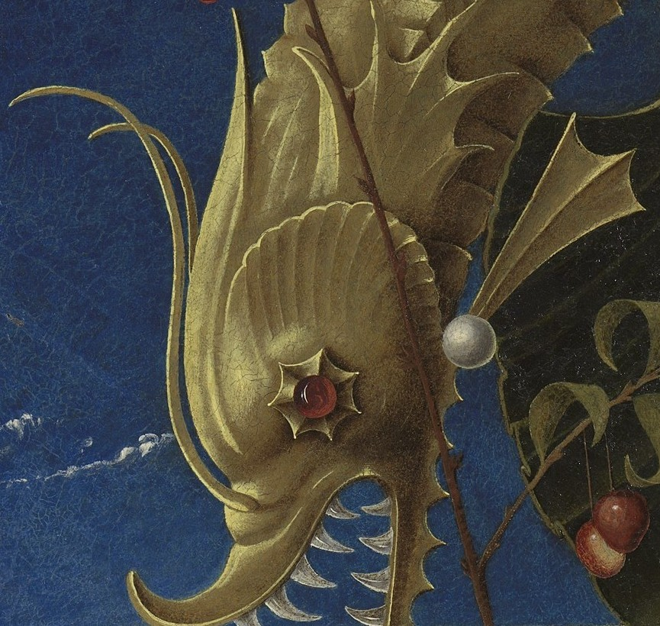

Slide 4
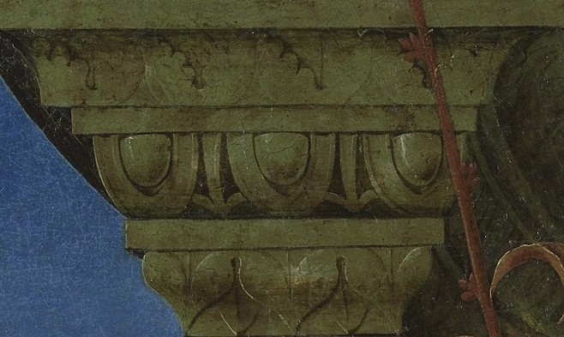

Slide 5
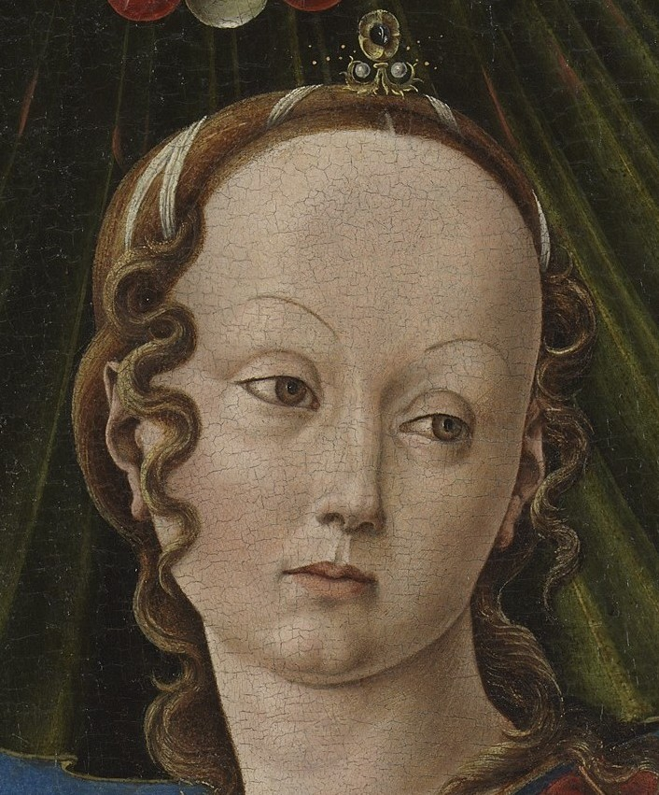

Slide 6
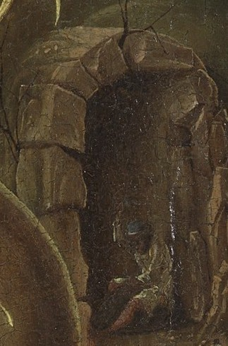

Slide 7
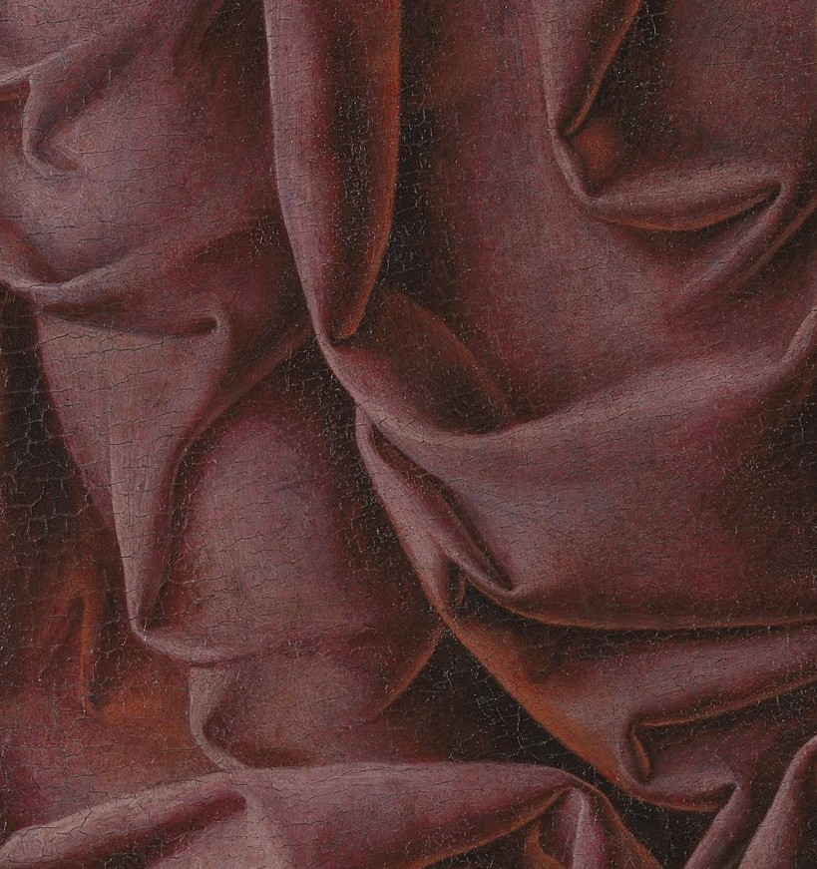

Slide 9
