Slide 1

Sponsored by
Resource for Art Teachers

Slide 2
Rules and Regulations
The source is provided for non-commercial educational purposes only.
Any reuse of National Gallery or non-National Gallery images is not permitted unless requested in writing.
For further information on the National Gallery’s terms and conditions of image use, please see http://www.nationalgalleryimages.co.uk/upload/terms_and_conditions.pdf

Slide 3
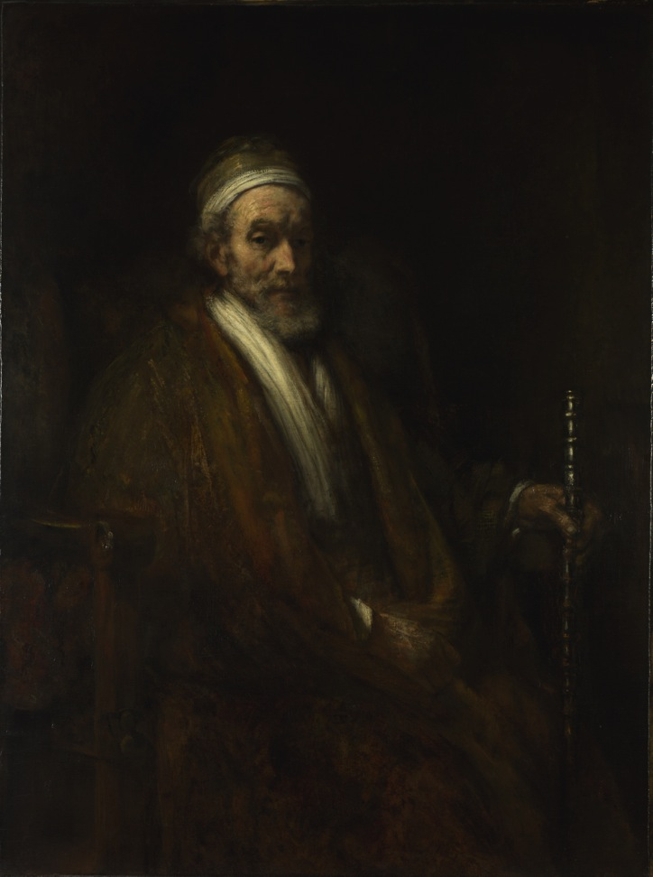
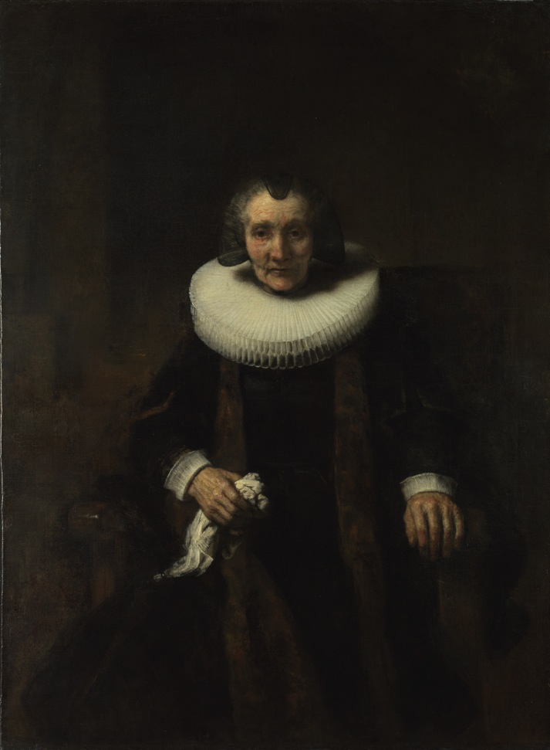
Rembrandt, Portraits of Jacob Trip and his Wife Margaretha de Geer, about 1661 © The National Gallery, London
Notes:
Suggested activities and discussion points
Look at the people in these paintings. Do you think they might be connected? Why/why not?
What type of people do you think they were? Wealthy? Poor? Royalty? How old are they? What was their place in society? What do these paintings tell you about their personalities?
Explain a pendant portrait. ‘If I tell you about pendant portraits, how does that change your thinking about these paintings?’
If these two characters were alive today, what kind of jobs do you think they might have? Can you explain why?
Collect contemporary images of family portraits. Do you think the way we portray families has changed since Rembrandt’s time?
Restage a family portrait live in groups of 3 to 5.

Slide 4
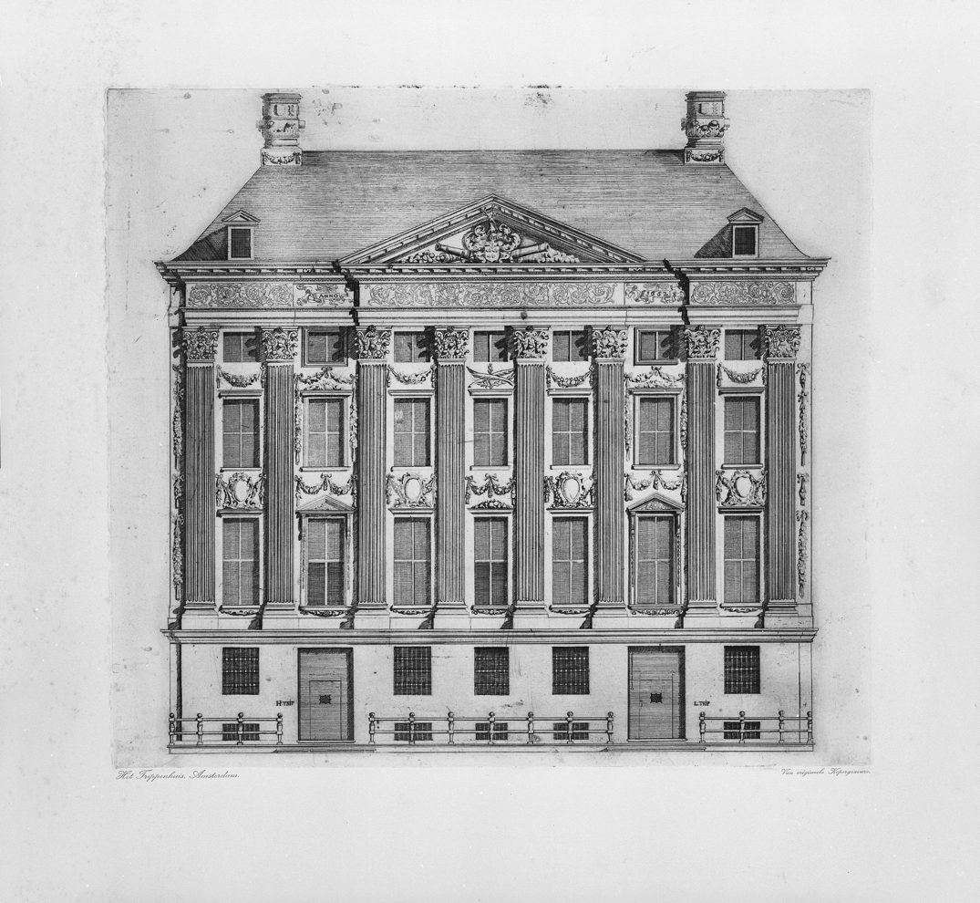
Engraving of Trippenhaus, Amsterdam
© Cultural Heritage Agency of the Netherlands, Amsterdam
Notes:
Suggested activities and discussion points
What words or phrases would you use to describe this house? And the people who live in it?
Some people have said that the pendant portraits of Jacob Trip and Margaretha de Geer were first displayed in this house. What do you think?
Imagine some alternative contexts to display these portraits. Where would you show them? Be as creative as possible – make collages, 3D models, computer animations!

Slide 5

Rembrandt, Portrait of Margaretha de Geer, from Portraits of Jacob Trip and his Wife Margaretha de Geer, about 1661
© The National Gallery, London
Notes:
Suggested activities and discussion points
Objects in portraits, which we sometimes call attributes, are significant and can tell us about the people in a painting. What do you think Margaretha is holding in her hand? What might this object tell us about her?
Gather objects and props. What would you include in a portrait of yourself today?
Why might people have wanted their portraits painted in the 17th century?
Why do people want photographs of themselves today?

Slide 6
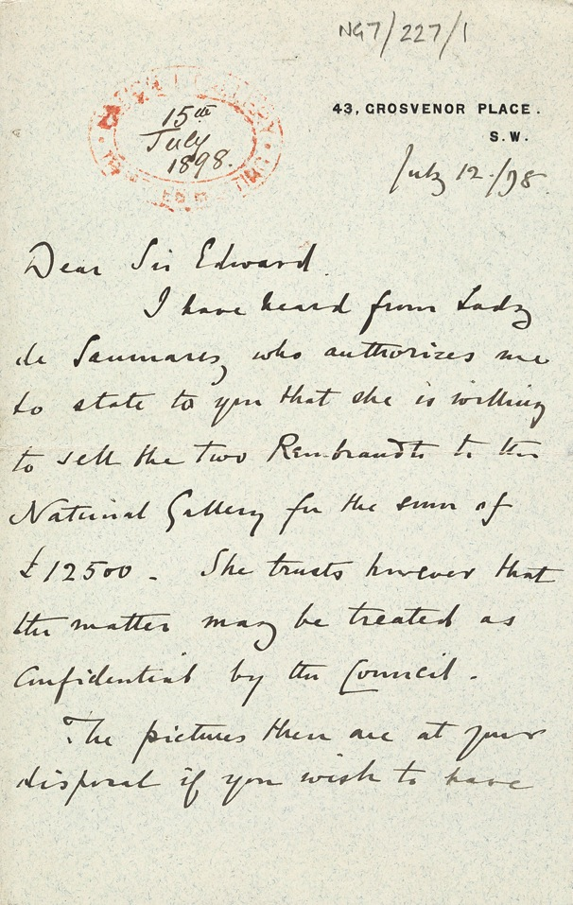
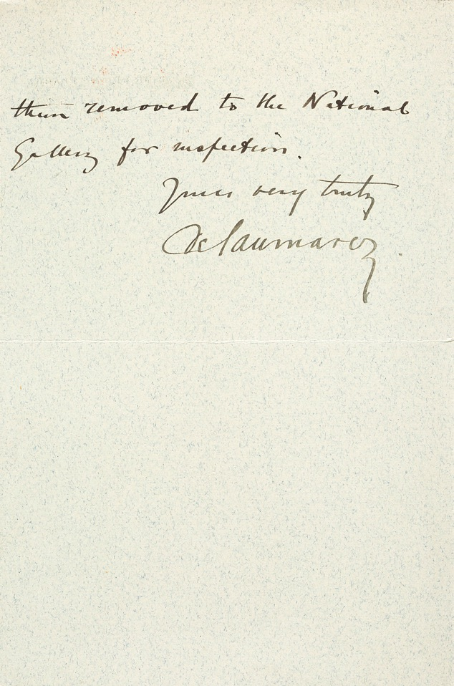
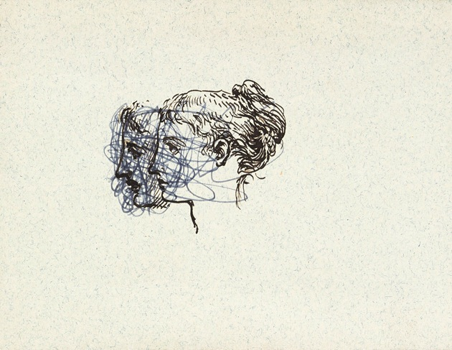
Letter from Lord de Saumarez offering the two portraits by Rembrandt for sale. Photo © The National Gallery, London
Notes:
Suggested activities and discussion points
These paintings were first sold to the National Gallery by Lady de Saumarez in 1898 for the sum of £12,500. What does this tell you about the significance of these paintings?
If I point out that these paintings are now owned by the British nation, and so every one of you, does your opinion of them change? If yes, how? If no, why not?

Slide 7
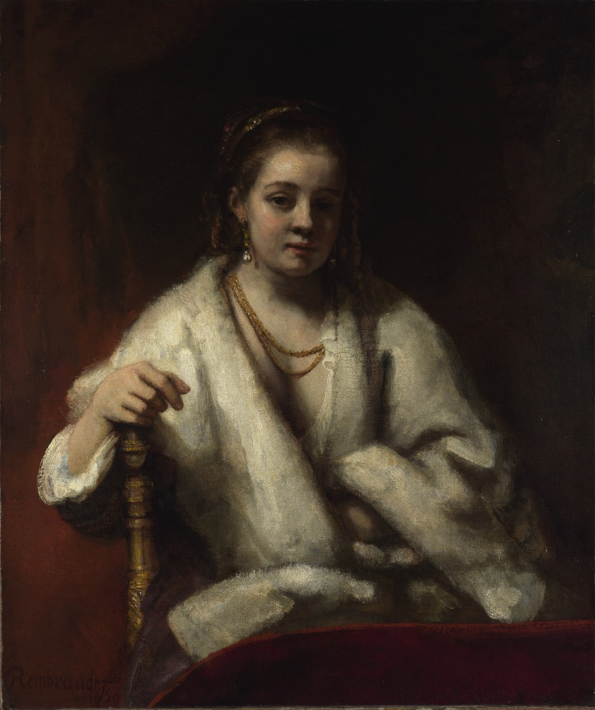
Rembrandt, Portrait of Hendrickje Stoffels, 1654–6
© The National Gallery, London
Notes:
Suggested activities and discussion points
Look at the painting for 20 seconds. Now close your eyes for 10 seconds and see if you can picture the painting. Look again. What didn’t you notice the first time?
What do you want to know about the woman in this painting?

Slide 8
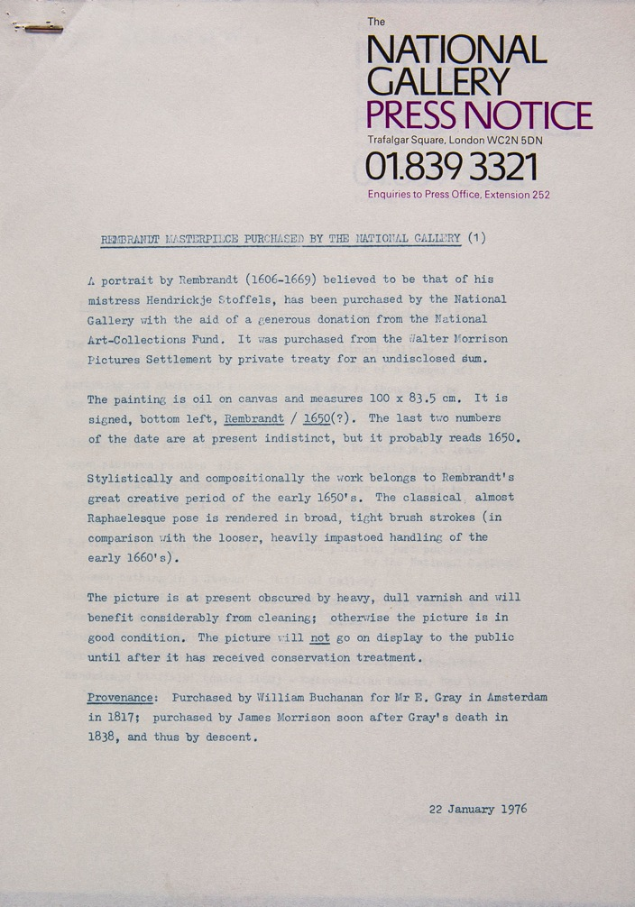
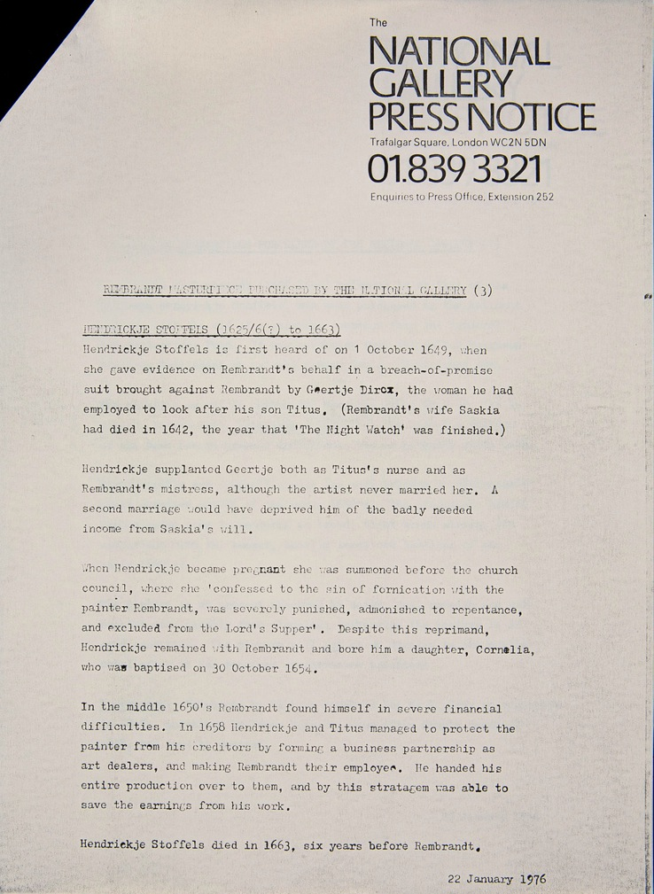
Press releases from 1976 from National Gallery Photo © The National Gallery, London
Notes:
Suggested activities and discussion points
Imagine that Rembrandt’s ‘Portrait of Hendrickje Stoffels’ , 1654-6 is being revealed to the public for the first time. Write a press release to celebrate. What would you include? What is most exciting about this painting?

Slide 9
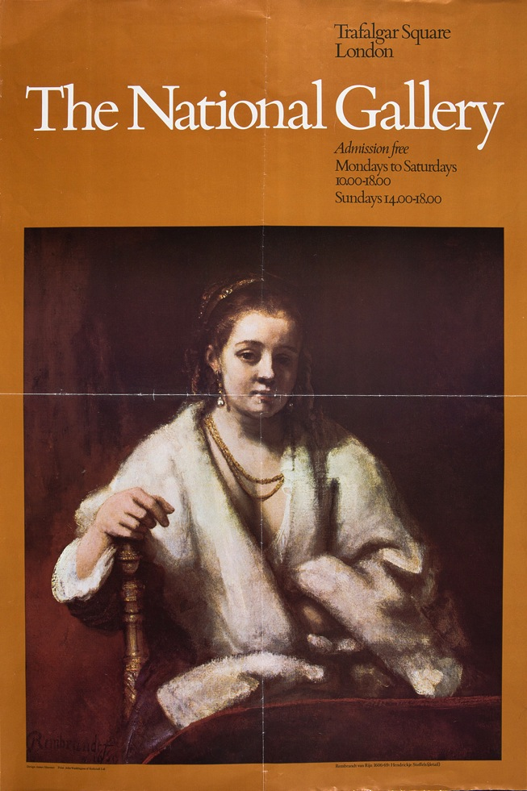
Poster from 1978 featuring Rembrandt’s Portrait of Hendrickje Stoffels. Photo © The National Gallery, London
Notes:
Suggested activities and discussion points
How would you make a poster to interest people in Rembrandt today? What other methods might you use to market Rembrandt?

Slide 10
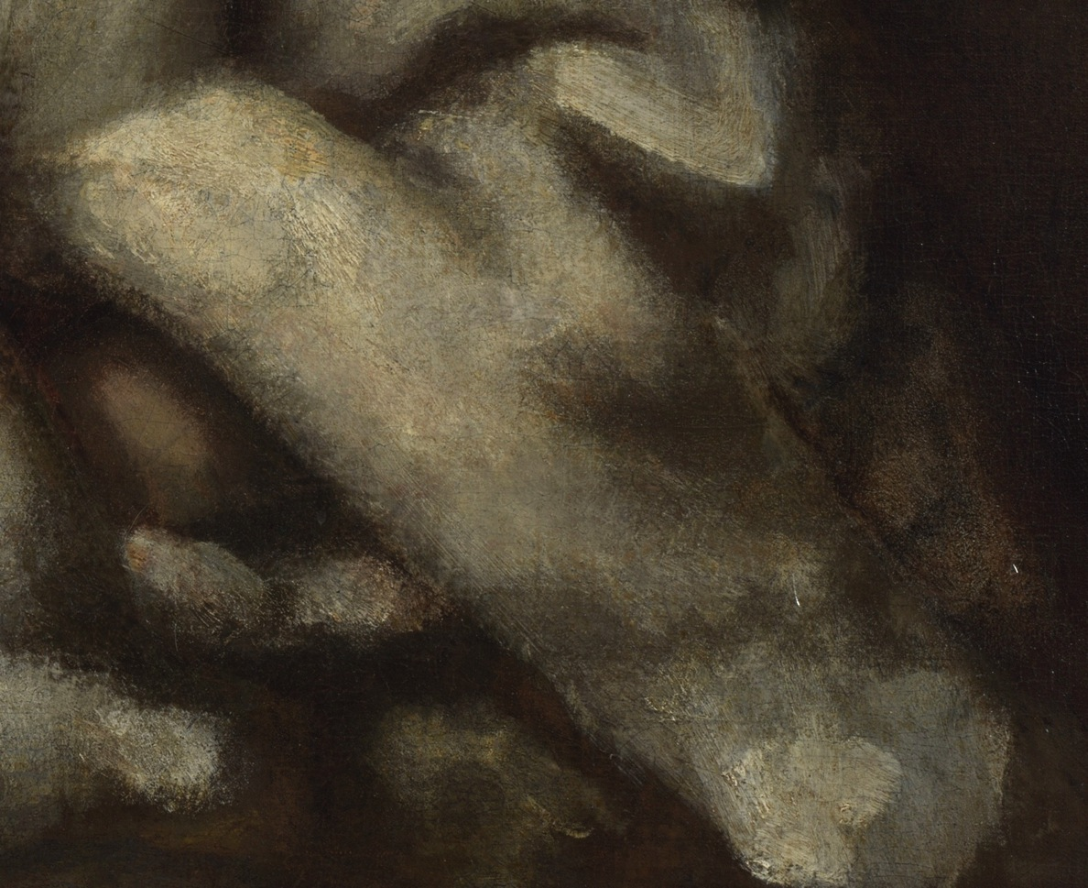
Detail of Hendrickje’s fur wrap from Rembrandt, Portrait of Hendrickje Stoffels, 1654–6
© The National Gallery, London
Notes:
Suggested activities and discussion points
Rembrandt may have applied his paint in a quick and loose manner. Why not try to set your class some drawing challenges? Draw a sitter in a pose using the following techniques:
In 30 seconds
Using your left hand
With your eyes shut
Without taking your pencil off the paper
With someone else’s hand holding the pencil
Holding the pencil in your elbow

Slide 11
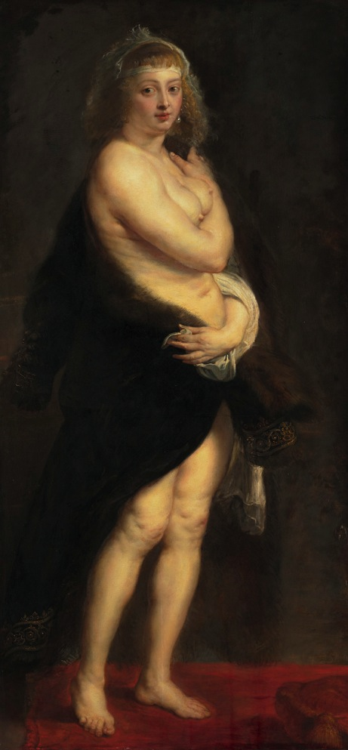
Peter Paul Rubens, Helena Fourment (“Das Pelzchen”), about 1636-38
© Kunsthistorisches Museum, Vienna
Notes:
Suggested activities and discussion points
Here we can see Rubens’s wife in a pose that shows off her nudity. Discuss the role of women in painting.
In the history of art, artists have often been male and muses female. Can you think of any contemporary artists that subvert this tradition?

Slide 12
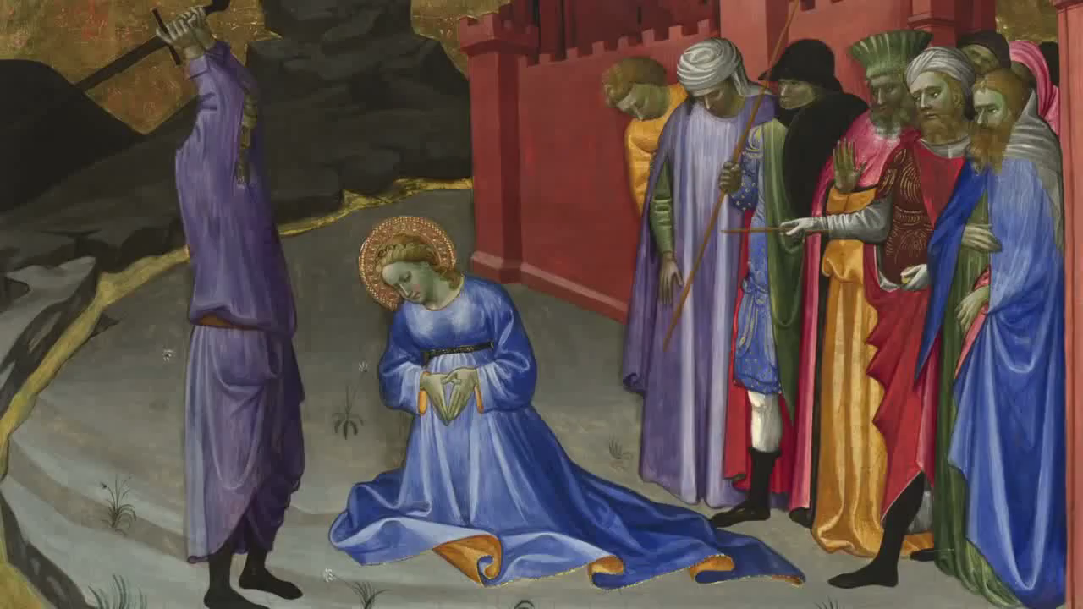
Video: Making Purple
If you have problems playing this video, please view it from the National Gallery website at www.nationalgallery.org.uk/channel/making-colour/
Notes:
Suggested activities and discussion points
Video: Making Purple
This video shows the making of paints using pigments and binders. Experiment with making your own pigments. Try the following:
Egg tempera (made with egg yolk and pigments such as Chrome Yellow)
Oil paints (made with walnut or linseed oil and pigments such as Ultramarine)
Can you make pigments from organic materials? E.g. dying materials
For more information on the difference between egg tempera and oil painting see the National Gallery’s video Making Green at http://www.nationalgallery.org.uk/channel/making-colour/

Slide 13
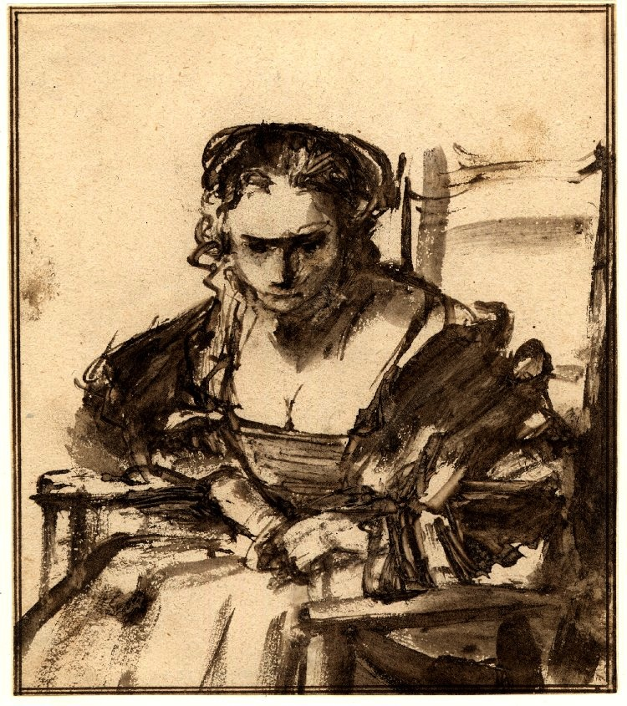
Rembrandt, A Seated Woman (believed to be Hendrickje Stoffels)
British Museum, London © The Trustees of the British Museum
Notes:
Suggested activities and discussion points
Compare this drawing to Rembrandt’s Portrait of Hendrickje Stoffels, 1654-6. How are they different or similar?
There is some debate about whether this drawing was used as part of the planning for the National Gallery’ painting. What do you think?
Rembrandt didn’t just paint, he also created many drawings and prints. Research more into these different media. Why might an artist want to work in these different ways?

Slide 14
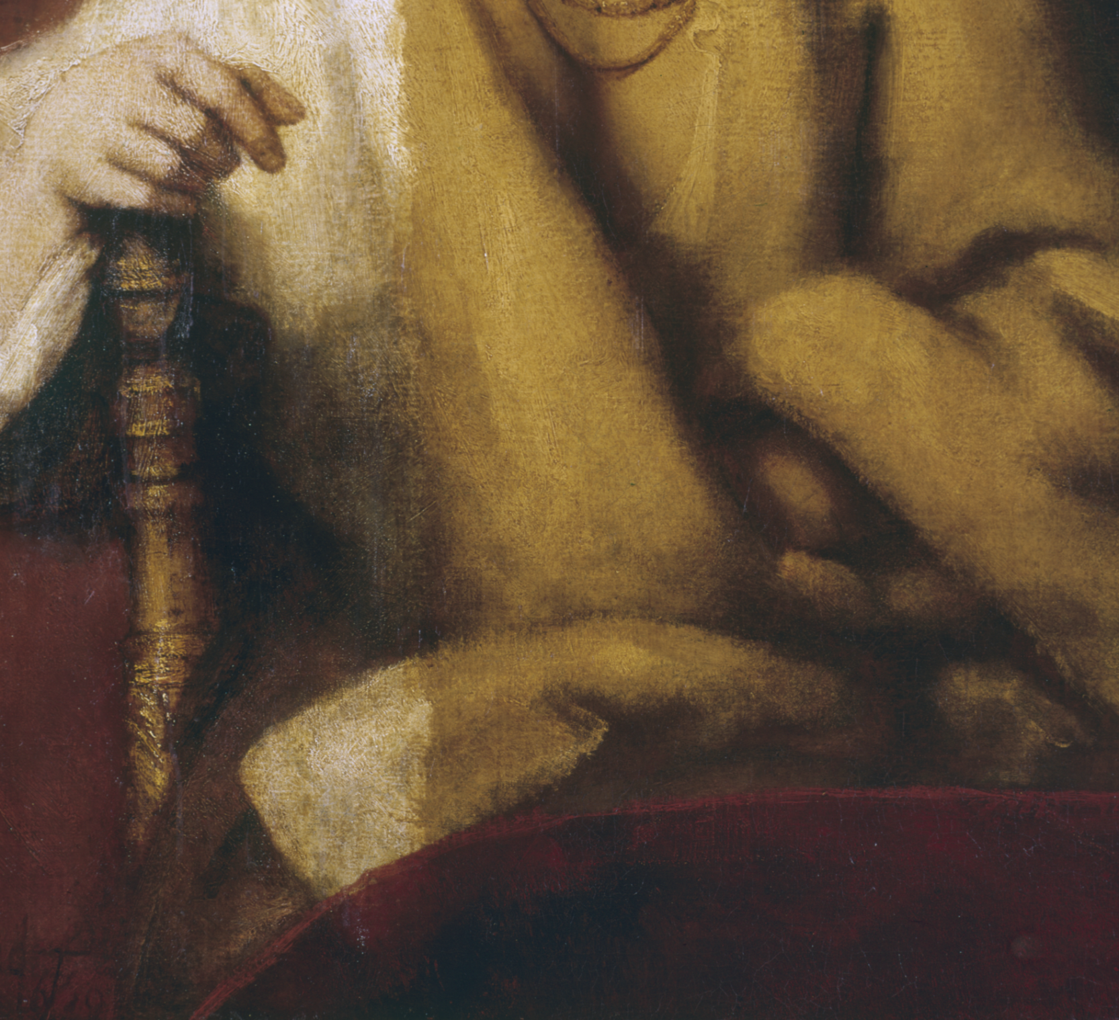
Detail during cleaning from Rembrandt, Portrait of Hendrickje Stoffels, 1654–6, Photo © The National Gallery, London
Notes:
Suggested activities and discussion points
The effect that the thick yellow varnish has on the painting is most easily observed in the shawl, the white colour of which is revealed as the discoloured varnish is removed (left hand side). The Conservation Department at the National Gallery ensures that cleaning, restoration and research takes place as necessary for every painting in the collection.
Do you think Rembrandt’s ‘Portrait of Hendrickje Stoffels’ , 1654-6 would survive for another 400 years without conservation? If it does survive, where might you expect to see it?
Cleaning objects (not just paintings) can reveal brighter colours or a hidden attraction. Collect some decaying objects. Can you conserve or restore them? Can you use your creativity to make them into art?

Slide 15
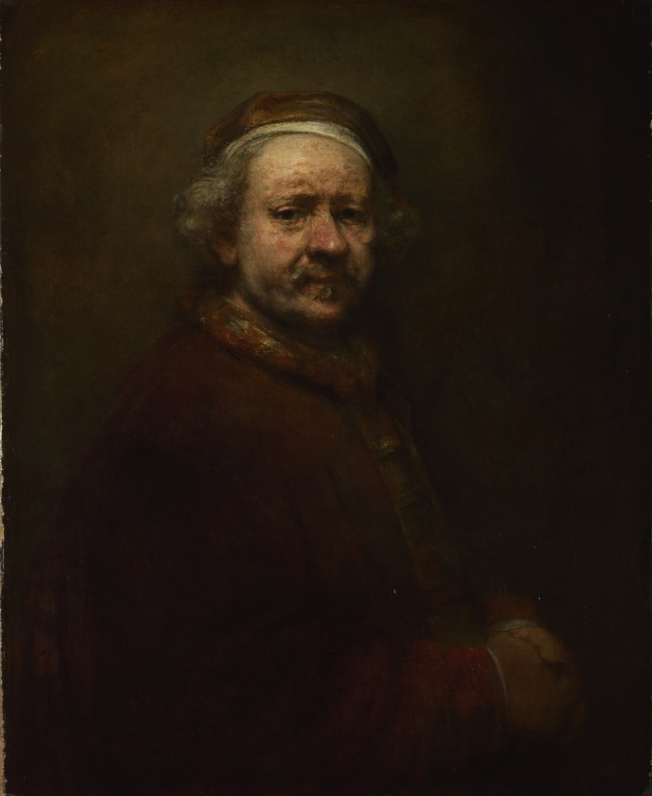
Rembrandt, Self-Portrait at the Age of 63, 1669
© The National Gallery, London
Notes:
Suggested activities and discussion points
List the types of self-portraits you might expect to see today. You could include anything from a traditional painting to an Instagram ‘selfie’.
How would you describe each type of self-portrait? How do they create different moods and atmospheres?

Slide 16
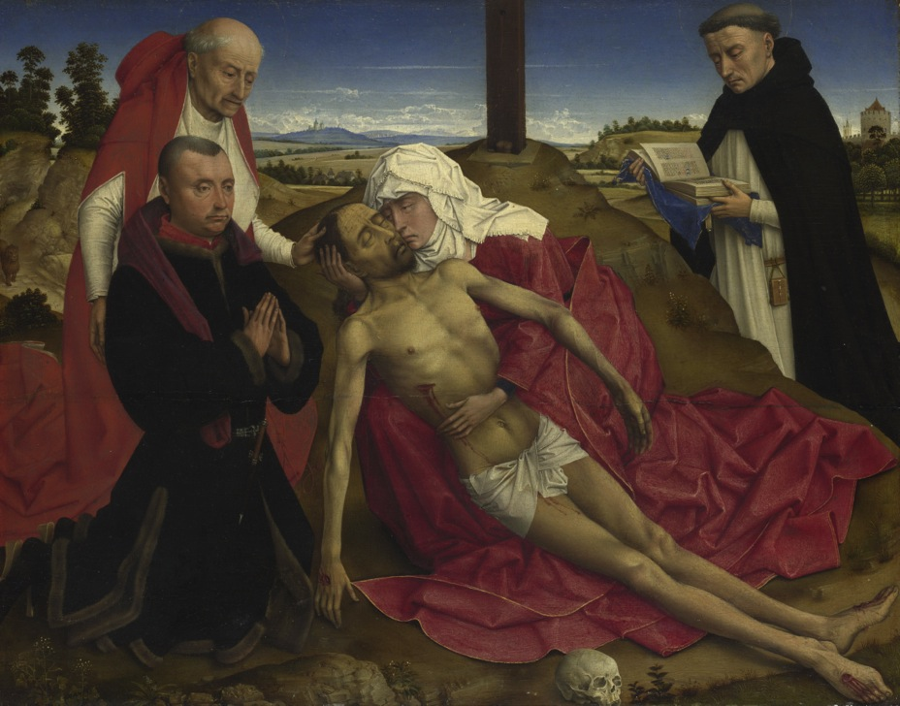
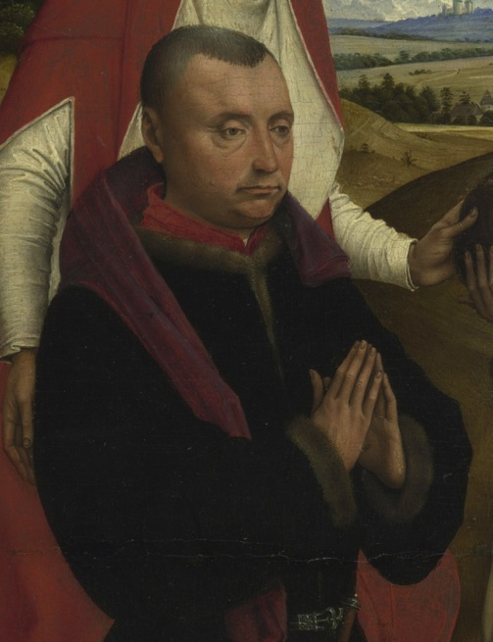
Probably by the workshop of Rogier van der Weyden, Pieta, probably about 1465 © The National Gallery, London
Detail of doublet worn by praying donor from probably by the workshop of Rogier van der Weyden, Pieta, probably about 1465
Notes:
Suggested activities and discussion points
Costume is very important in artworks because it tells us about a person’s characteristics.
Rogier van der Weyden worked 200 years before Rembrandt. Here we can see that Rembrandt chose to use similar costume in some of his self-portraits. What item of clothing from the past would you choose to dress up in for a self-portrait?
Gather a dressing up box. You’ve got 3 minutes to make a costume for a self-portrait. If successful, make another.

Slide 17
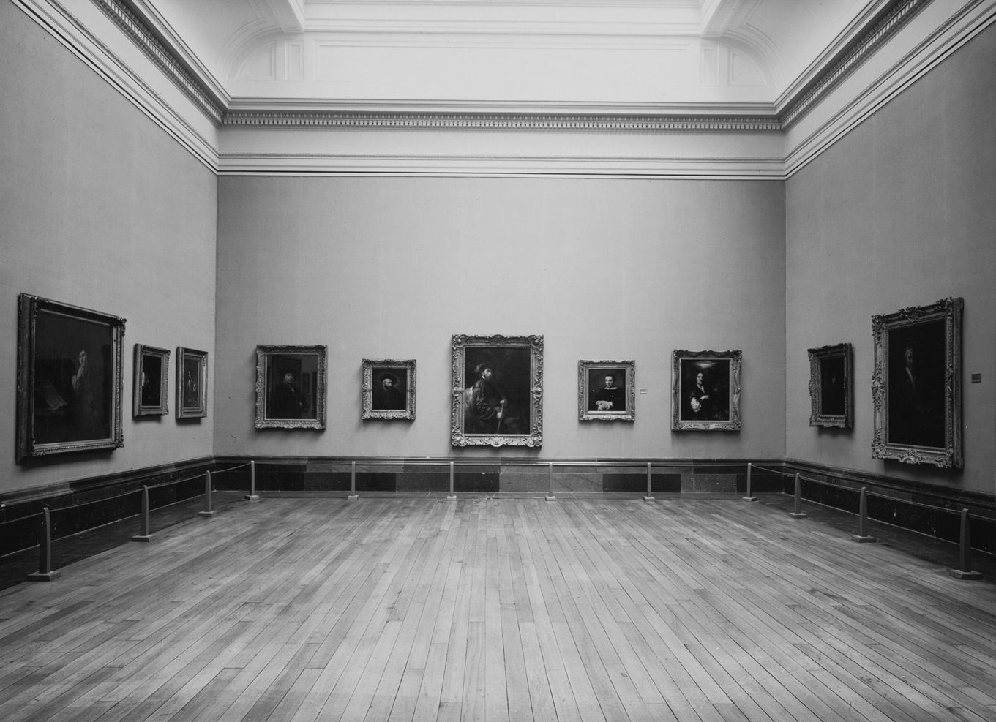
Photograph of Mond Room, 30 August 1950, National Gallery Archives. Photo © The National Gallery, London
Notes:
Suggested activities and discussion points
This photograph taken in 1950 shows the Mond Room at the National Gallery. Here you can see Rembrandt’s ‘Self-Portrait at the Age of 63’ hung in a room with other famous artists from the canon of art history. Consider the following:
What links can you see between the portraits in this room?
What do you think the curators wanted to tell us by hanging these portraits together?
What types of artists and sitters do you think are missing from this display?
Curate an alternative display for Rembrandt’s self-portrait. You can include any artwork you can think of from historical to contemporary.

Slide 18
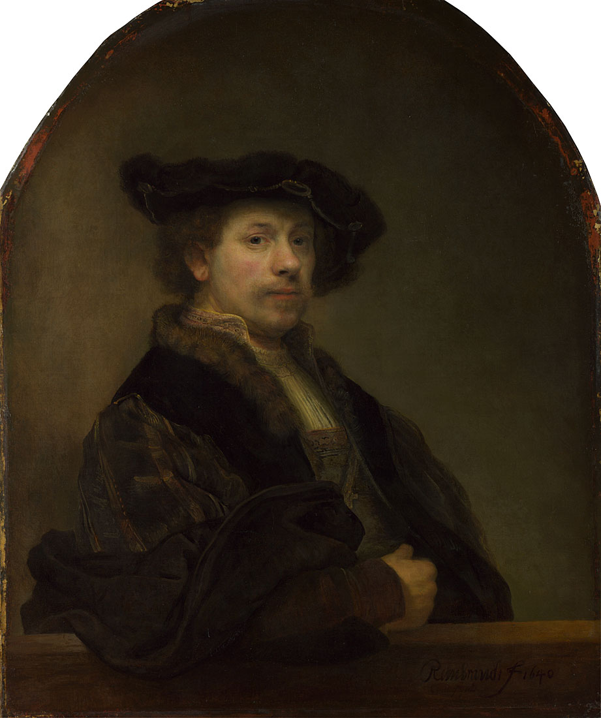
Rembrandt, Self Portrait at the Age of 63, 1669
© The National Gallery, London
Rembrandt, Self Portrait at the Age of 34, 1640
© The National Gallery, London
Notes:
Suggested activities and discussion points
Compare Rembrandt’s Self Portrait at the Age of 34 and Self Portrait at the Age of 63:
How are they similar and different?
What do you think Rembrandt wants to say about himself in each of these self-portraits?
Which do you prefer? Why?

