Slide 1

Sponsored by
Resource for Science Teachers

Slide 2
Rules and Regulations
The source is provided for non-commercial educational purposes only.
Any reuse of National Gallery or non-National Gallery images is not permitted unless requested in writing.
For further information on the National Gallery’s terms and conditions of image use, please see http://www.nationalgalleryimages.co.uk/upload/terms_and_conditions.pdf

Slide 3
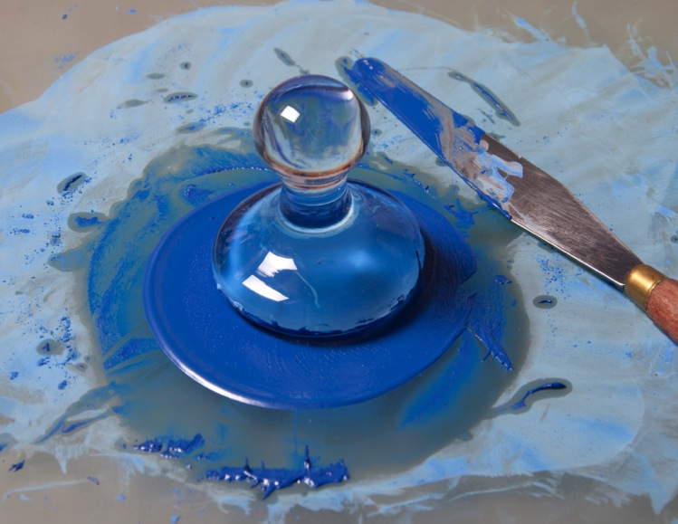
Blue pigment being ground with oil to make a paint.
Photo © The National Gallery, London

Slide 4
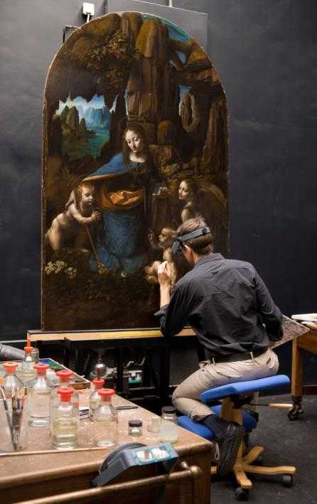
Leonardo Da Vinci’s Virgin of the Rocks in the conservation studio at the National Gallery, London.
Photo © The National Gallery, London

Slide 5
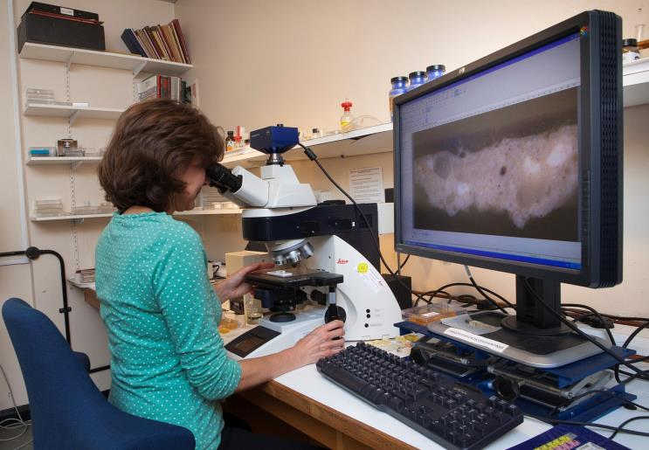
A paint cross-section being examined under a microscope in the Scientific Department at the National Gallery, London.
Photo © The National Gallery, London

Slide 6
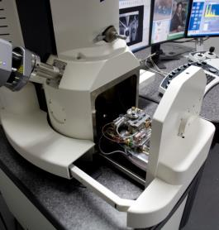
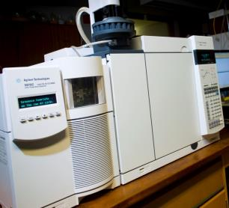
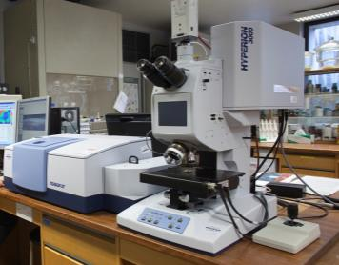
Analytical equipment used by scientists working at the National Gallery, London: (from left to right) scanning electron microscope with energy dispersive X-ray analysis, gas chromatography – mass spectrometry and infrared spectroscopy.
Photo © The National Gallery, London

Slide 7
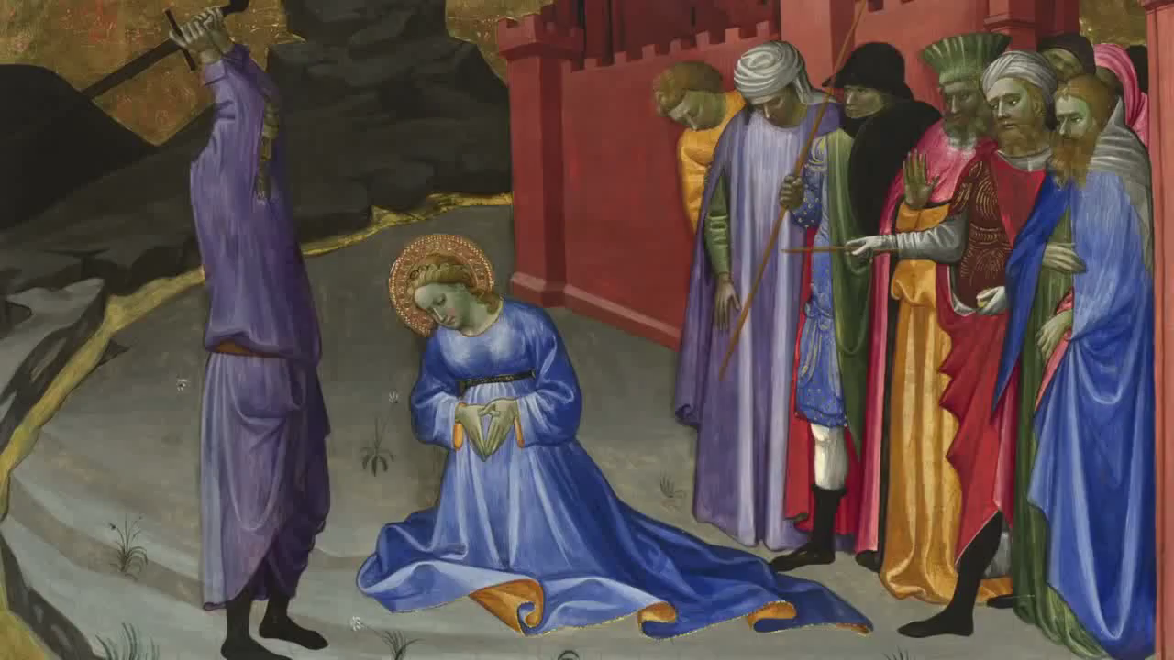
Video: Making Purple – a short introduction to the work of the scientific department
If you have problems playing this video, please view it on the National Gallery website at www.nationalgallery.org.uk/channel/making-colour/

Slide 8
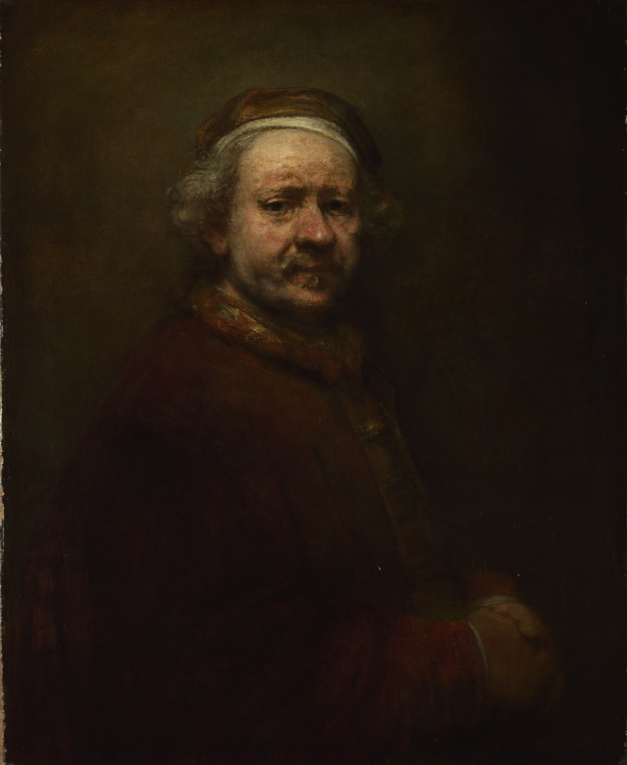
Rembrandt, Self-Portrait at the Age of 63, 1669
© The National Gallery, London

Slide 9
A triglyceride molecule. The double bonds of the triglycerides take part in a series of reactions involving oxygen from the air. The outcome of these reactions is that triglyceride molecules link together, forming a three-dimensional network polymer.

Slide 10
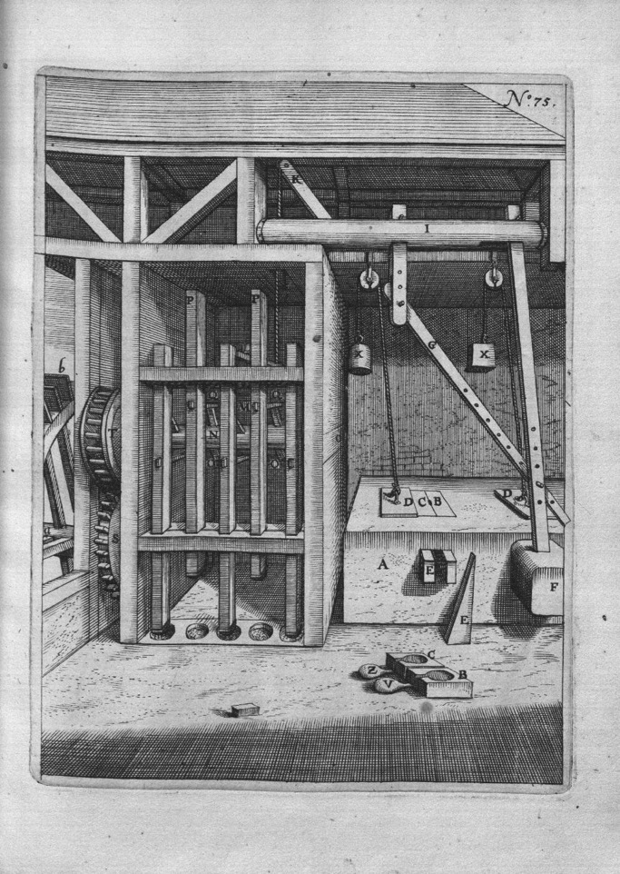
An oil press, from Georg Andreas Boecler’s Theatrum machinarum novum, Cologne, 1662
© Cornell University Library
The flax seeds or walnuts are crushed by five iron-tipped pestles (P) on the left, then wrapped and placed in containers (B, C) in an oak chest (A). The wedges (E) on either side of the containers are forced together by the pressure of the wedge (F) driven against them by the action of a falling hammer. This provides sufficient pressure to obtain the oil.

Slide 11
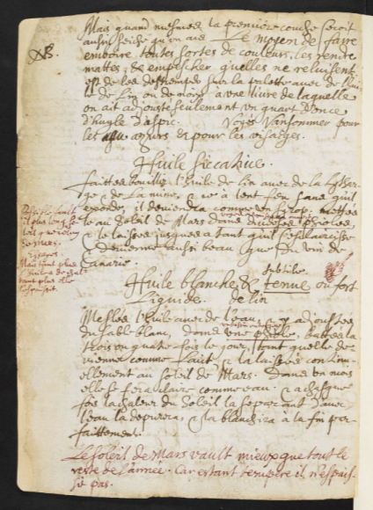
This recipe for the preparation of a drying oil (Huile siccative) is from Sir Theodore de Mayerne’s Pictoria, sculptoria et quae subalternarum artium (known as the 'Mayerne manuscript’). © British Library, London
The recipe is written in French and an approximate translation reads, ‘Boil the linseed oil with litharge and some red lead on a slow fire without it bubbling over. It will become like a syrup. Put it in the March [Spring] sun in different vials (open vessels) and leave until it clarifies and becomes as beautiful as Canary wine.’ Written in the margin, in red ink, he suggests that, ‘It is possible that you could leave it longer in the sun than that of March. Try this. But the more you expose the oil to heat, the more it will thicken’. The manuscript was compiled between 1620 and 1646 by Sir Théodore de Mayerne, a physician at the English court, and contains among other information, recipes for the preparation of artists’ materials. He obtained these by talking to artists at the English court and this recipe may have come from the painter Daniel Mytens.

Slide 12
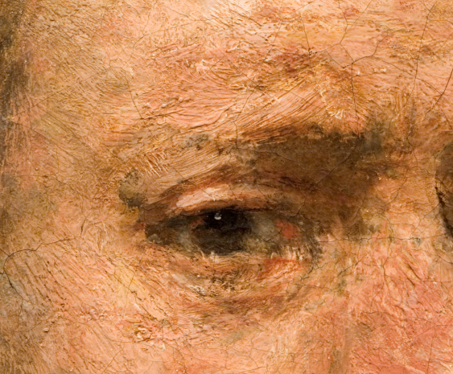
A detail showing the paint texture from Rembrandt, Self-Portrait at the age of 63, 1669
© The National Gallery, London

Slide 13
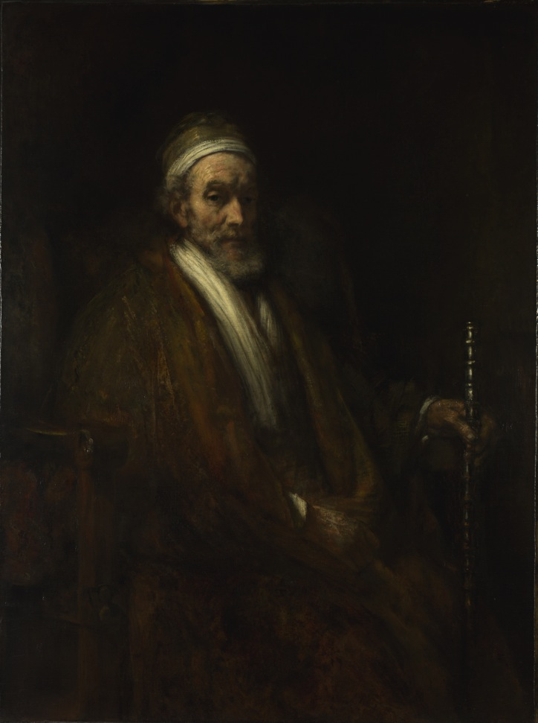
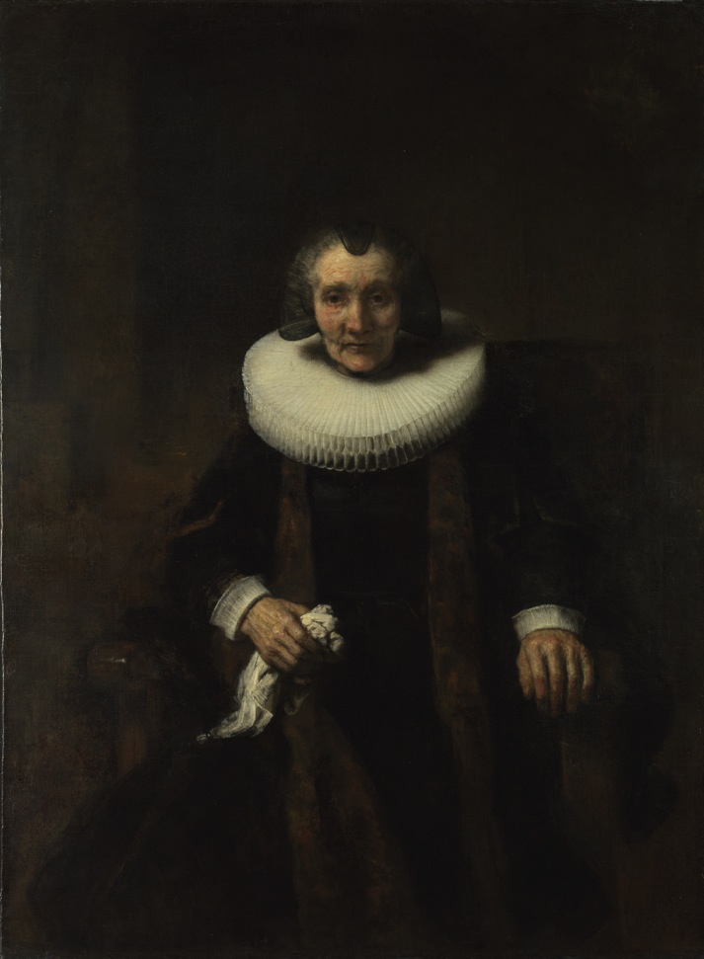
Rembrandt, Portraits of Jacob Trip and his Wife Margaretha de Geer, about 1661 © The National Gallery, London

Slide 14
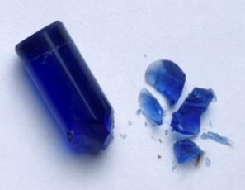
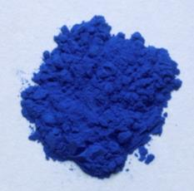
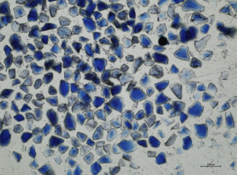
Smalt is a blue pigment made from glass; (from left to right) smalt before grinding; prepared as a pigment; and particles viewed under a microscope. Photo © The National Gallery, London

Slide 15
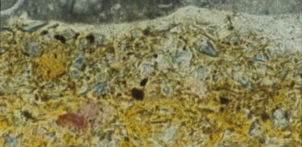
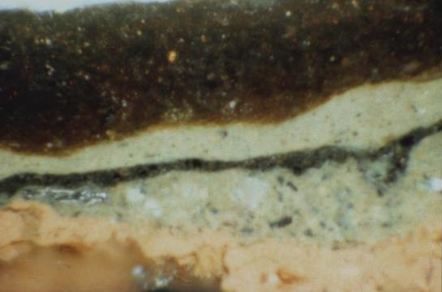
The cross-section (right), was taken from the bottom edge of the painting. It shows the paint used for the fur trim of the robe
(the thick, upper layer) which is now dark brown in appearance. A thin section was prepared to allow the pigments in this layer
to be observed and it clearly contains smalt particles within a yellow medium (left). Photo © The National Gallery, London

Slide 16
M = metal, L = ligand. The Co²⁺ ions present within the glass have a tetrahedral geometry and in this arrangement are responsible for the blue colour. As potassium ions are leached from the smalt, the ligands surrounding the cobalt ions re-arrange, shifting towards an octahedral geometry. This leads to the loss of the blue colour.

Slide 17
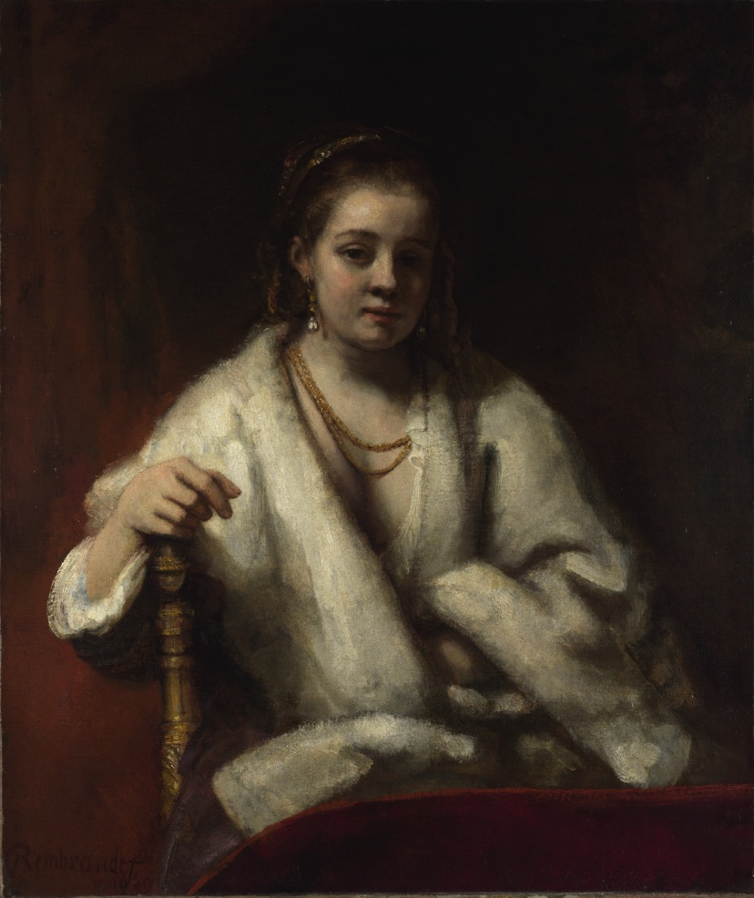
Rembrandt, Portrait of Hendrickje Stoffels, 1654–6
© The National Gallery, London

Slide 18
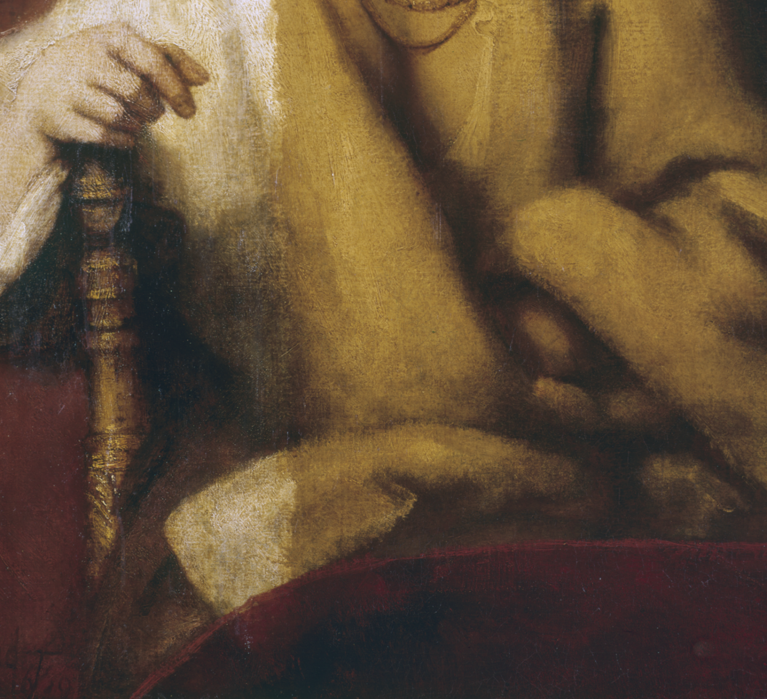
Detail during cleaning from Rembrandt, Portrait of Hendrickje Stoffels, 1654–6. The effect that the thick yellow varnish has on the painting is most easily observed in the shawl, the white colour of which is revealed as the discoloured varnish is removed (left hand side). Photo © The National Gallery, London

Slide 19
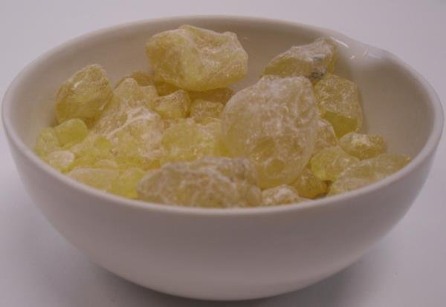
Dammar resin, obtained from the Dipterocarpaceae family of trees, is dissolved in a solvent such as white spirit to make a varnish. Photo © The National Gallery, London

Slide 20
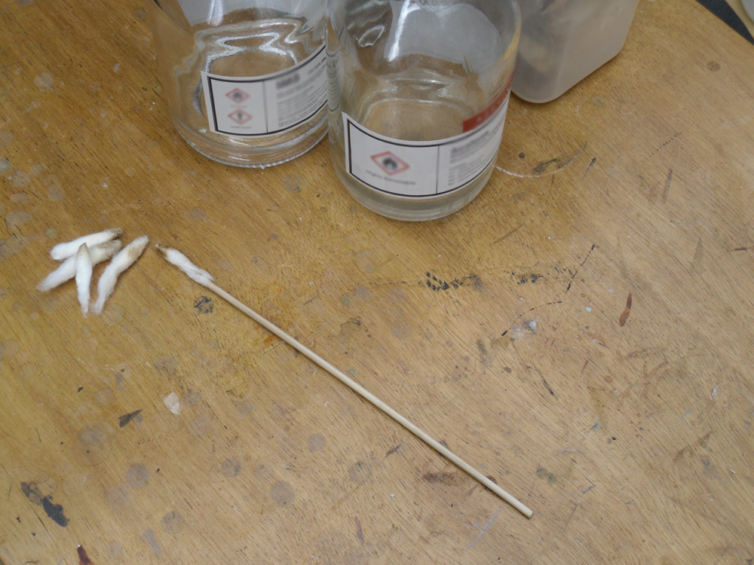
A carefully chosen solvent mixture, applied to the surface using cotton wool swabs, is used by the conservator to remove the discoloured varnish. Photo © The National Gallery, London

Slide 21
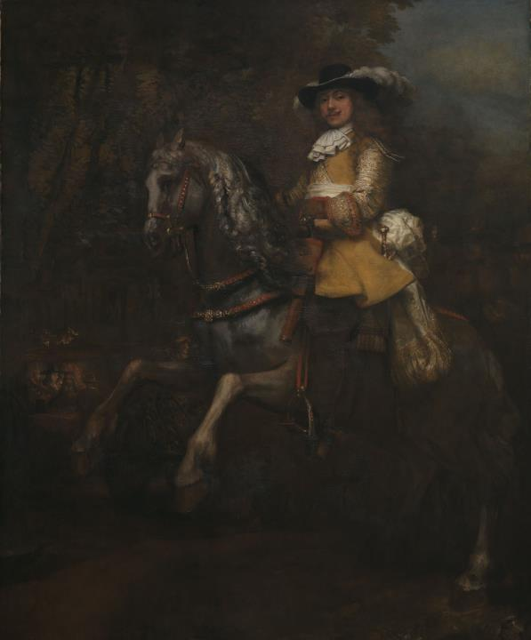
Rembrandt, Portrait of Frederick Rihel on Horseback, probably 1663
© The National Gallery, London

Slide 22
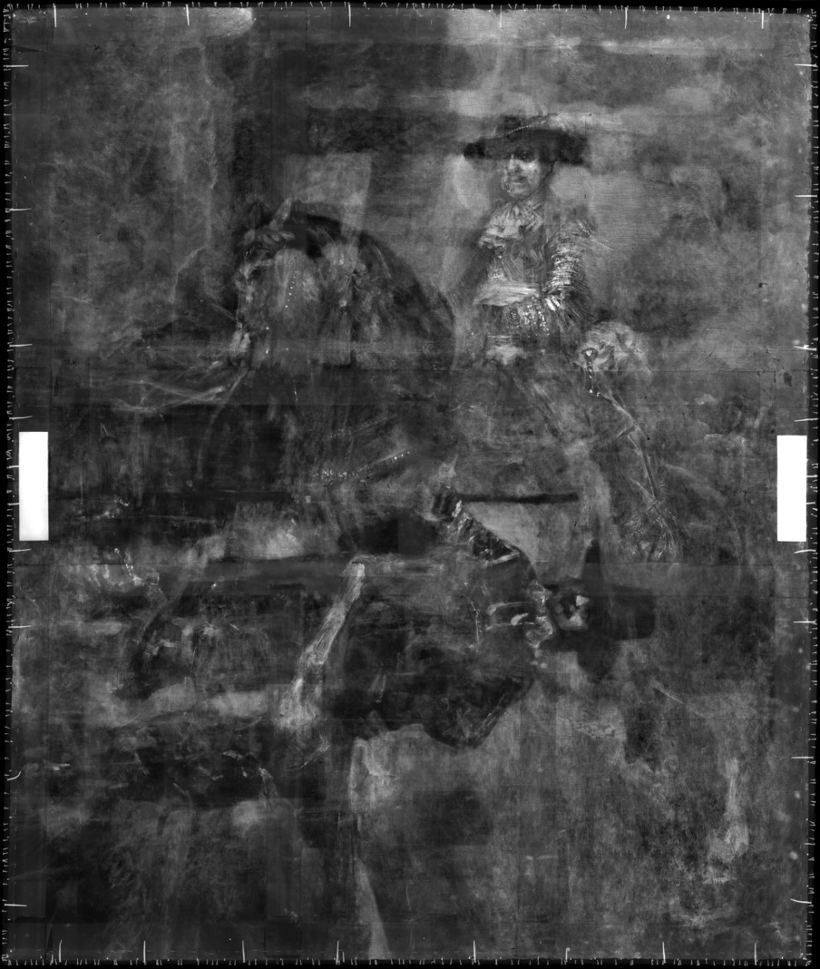
An X-ray image of Rembrandt, Portrait of Frederick Rihel on Horseback, probably 1663. Photo © The National Gallery, London

Slide 23

An X-ray image of Rembrandt, Portrait of Frederick Rihel on Horseback, probably 1663. A standing figure, not visible when viewed under normal light, can be observed when the X-radiograph is rotated anti-clockwise by 90°. Photo © The National Gallery, London

Slide 24
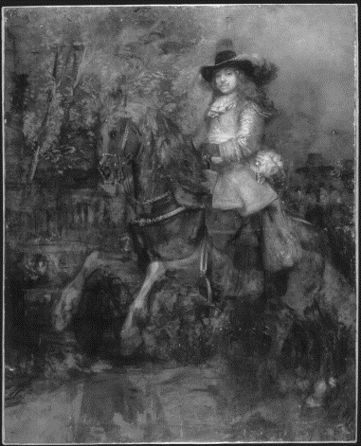
An infrared image of Rembrandt, Portrait of Frederick Rihel on Horseback, probably 1663 Photo © The National Gallery, London

Slide 25

An infrared image rotated anti-clockwise by 90°of Rembrandt, Portrait of Frederick Rihel on Horseback, probably 1663. Photo © The National Gallery, London

